Slide 1
CONTENT MANAGEMENT SYSTEM
Presented by:
Mukesh A. Pund
Sr. Principal Scientist
CSIR-NISCAIR, New Delhi

Slide 2
JOOMLA
TEMPLATE CREATION & LOGO CUSTOMIZATION

Slide 3
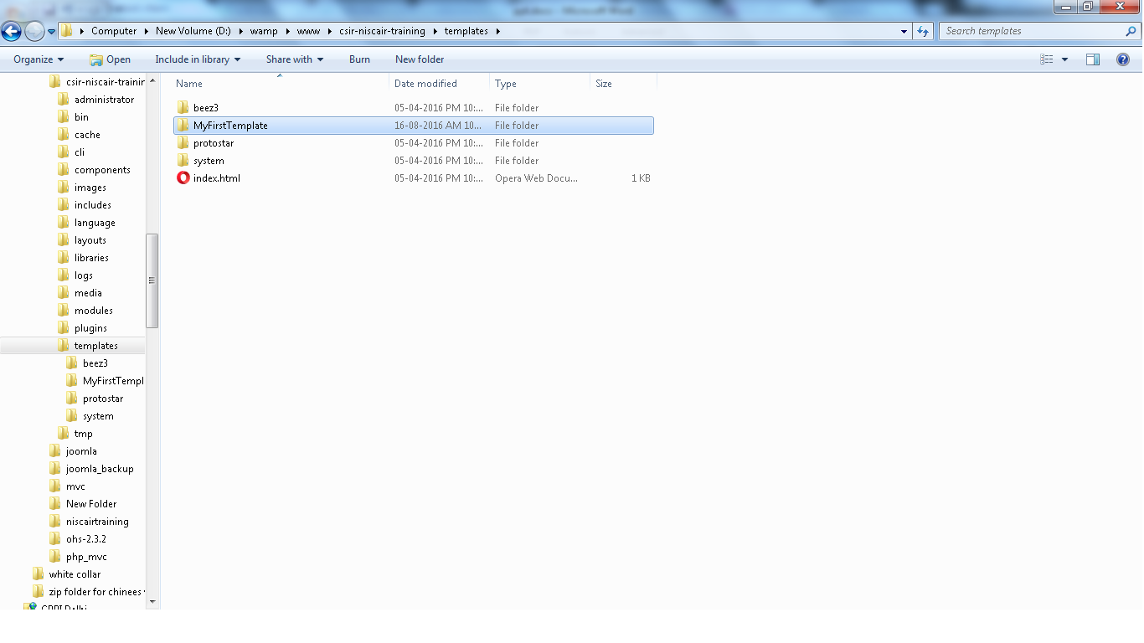
CREATING TEMPLATE
Step (1): Create a folder called MyFirstTemplate inside your Joomla --> Templates folder. Inside MyFirstTemplate folder, create 2 more folders named as images and CSS to save all the images and CSS files.

Slide 4
Template directories
A typical template for Joomla! will include the following directories:
css - contains all the .css files
html - contains template override files for core output and module chrome
images - contains all images used by the template
language - contains additional language files used by the template
Depending on the complexity and design of the template is may also contain:
javascript - contains supporting JavaScript used by the template for added functionality

Slide 5
Example structure with files
Typical path of a template is <root>/public_html/domain-name/template/<name of your template> which will contain the following directories and files based on your
/css
/html
/images
/javascript
/language
component.php
error.php
favicon.ico
index.php
templateDetails.xml
template_preview.png
template_thumbnail.png

Slide 6
Template files
index.php :Provides the logic for the display and positioning of modules and components.
component.php : Provides the logic for the display of the printer friendly page, "E-mail this link to a friend." etc.
error.php : Provides a method to handle errors such as 404, page not found error.
favicon.ico : favicon icon file
template.css : Handles the presentational aspects of the template including specifications for margins, fonts, headings, image borders, list formatting, etc. The .css files may also be located in the /css directory.
templateDetails.xml : Holds meta-information related to the template and is used by the Installer and the Template Manager.

Slide 7
template_preview.ext : replace .ext with the extension format of the image (.jpg, .png, .gif)Generally a 600x400 pixel image that is shown when the cursor is clicked on the thumbnail image in Template Manager:Templates, not Template Manager:Styles. This gives the Administrator a pop up modal window of the template before applying it to the Site.
template_thumbnail.ext : replace .ext with the extension format of the image (.jpg, .png, .gif)Generally a 200x150 pixel thumbnail image that is shown when viewing the Template list in Template Manager:Templates, not Template Manager:Styles . This gives the Administrator a thumbnail view of the template before applying it to the Site.

Slide 8
Step (2): Inside MyFirstTemplate folder, create a file called as templateDetails.xml, without this file the template will not get displayed in Joomla.
templateDetails.xml
Details of the code
<files>: It contains the available files and folders in MyFirstTemplate folder.
<folder>: It takes the entire available folders in MyFirstTemplate folder.
<?xml version="1.0" encoding="utf-8"?> <extension version="3.0" type="template">
<name>MyFirstTemplate</name> <creationDate>2015-06-13</creationDate> <author>NISCAIR</author> <authorEmail>admin@niscair.res.in</authorEmail> <authorUrl>http://www.example.com </authorUrl> <copyright>Jack 2015</copyright> <license>GNU/GPL</license> <version>1.0.2</version>
<description>MyFirstTemplate</description> <files>
<filename>index.php</filename>
<filename>templateDetails.xml</filename>
<folder>images</folder>
<folder>css</folder>
</files>
<positions>
<position>breadcrumb</position>
<position>left</position>
<position>right</position>
<position>top</position>
<position>user1</position>
<position>user2</position>
<position>user3</position>
<position>user4</position>
<position>footer</position>
</positions>
</extension>

Slide 9
Step (3): Create a file called as index.php. This helps in executing all the Joomla pages.
Index.php
<?php defined( '_JEXEC' ) or die( 'Restricted access' );?>
<!DOCTYPE html>
<html xmlns="http://www.w3.org/1999/xhtml" xml:lang="<?php echo $this->language; ?>" lang="<?php echo $this->language; ?>" >
<head> //head section
<jdoc:include type="head" />
<link rel="stylesheet" href="<?php echo $this->baseurl ?>/templates/system/css/system.css" type="text/css" />
<link rel="stylesheet" href="<?php echo $this->baseurl ?>/templates/system/css/general.css" type="text/css" />
<link rel="stylesheet" href="<?php echo $this->baseurl ?>/templates/<?php echo $this->template; ?>/css/template.css" type="text/css" />
</head>
<body> //body section
<jdoc:include type="modules" name="top" />
<jdoc:include type="component" />
<jdoc:include type="modules" name="bottom" />
</body>
</html>
?>

Slide 10
Details of the code
This code is used to tell the browser which type of html page is being used
and begins the HTML document by describing the language used in the website.
<?php defined( '_JEXEC' ) or die( 'Restricted access' );?>
<!DOCTYPE html>
<html xmlns="http://www.w3.org/1999/xhtml" xml:lang="<?php echo $this->language; ?>" lang="<?php echo $this->language; ?>" >
<head> //head section
<jdoc:include type="head" />
<link rel="stylesheet" href="<?php echo $this->baseurl ?>/templates/system/css/system.css" type="text/css" />
<link rel="stylesheet" href="<?php echo $this->baseurl ?>/templates/system/css/general.css" type="text/css" />

Slide 11
These lines are used to link the various stylesheets for the template in Joomla.
Here in the body section, the jdoc is used to include the output in Joomla from some parts of Joomla system. The name="top" is used to set the menu at the top.
<link rel="stylesheet" href="<?php echo $this->baseurl ?>/templates/<?php echo $this->template; ?>/css/template.css" type="text/css" />
</head>
<body> //body section
<jdoc:include type="modules" name="top" />
<jdoc:include type="component" />
<jdoc:include type="modules" name="bottom" />
</body>

Slide 12
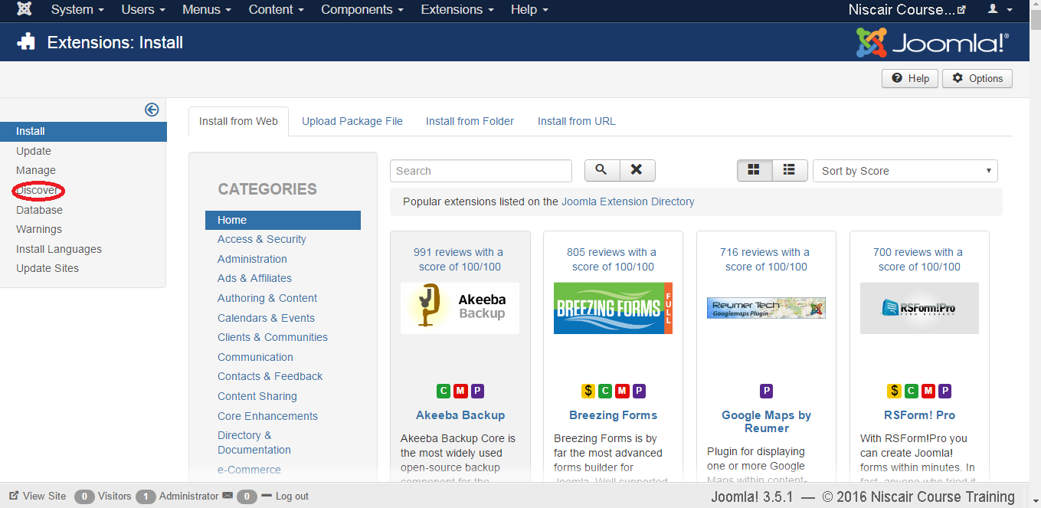
Step (4): After creating these two files, login to Joomla and click on Extension --> Extension and the following page will get displayed.

Slide 13
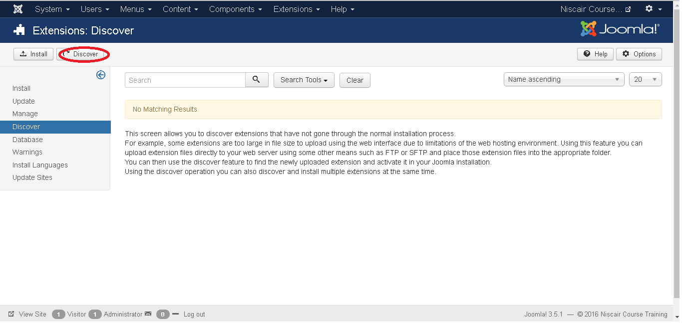
Step (5): In the above page, click on Discover link, the following page is displayed.

Slide 14
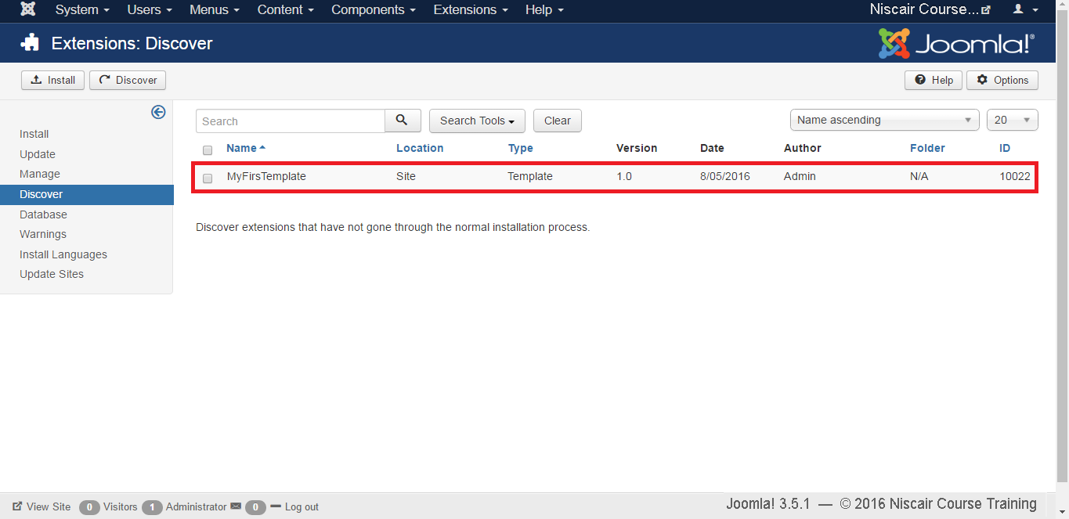
Step (6): Next, click on the Discover button to discover the new created template as shown below.

Slide 15
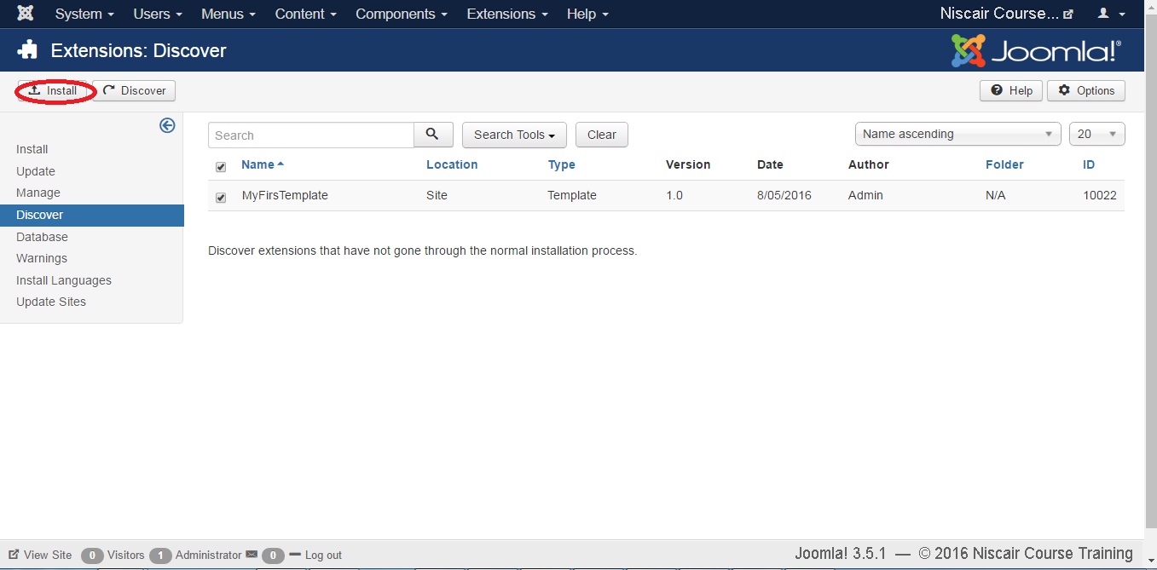
Step (7): Click on the checkbox to select the template and click on Install button to install the template in Joomla.

Slide 16
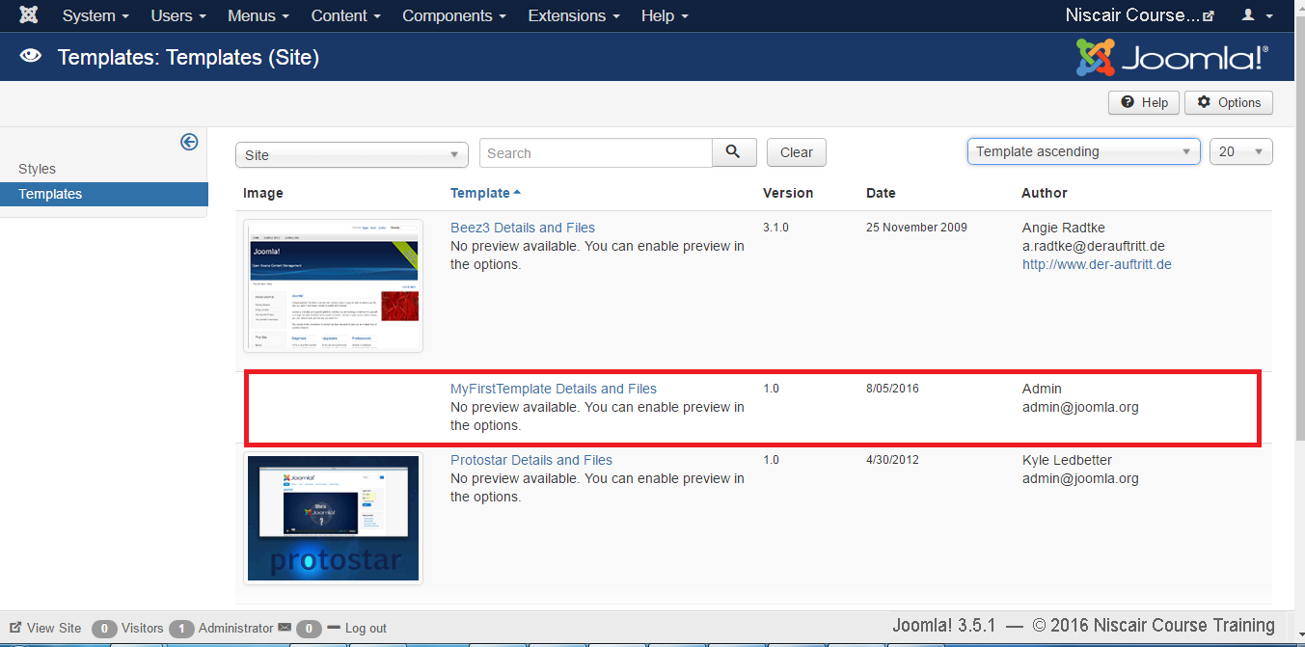
Step (8): After installing template you can view your new created template by clicking on Extension --> Template . You will see your new created template is listed as shown below.
Toolbar
Following are the toolbar options in the Template :
Default: Select the default template.
Edit: Select the template for editing.
Duplicate: Duplicate the copy of the selected template.
Delete: Delete the template for Joomla

Slide 17
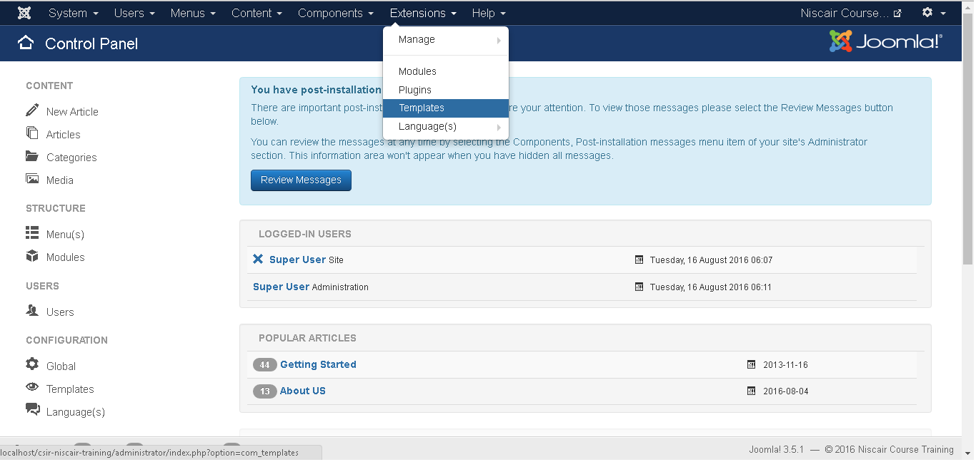
CUSTOMIZE LOGO
Step (1): Click on Extensions -> Template.

Slide 18
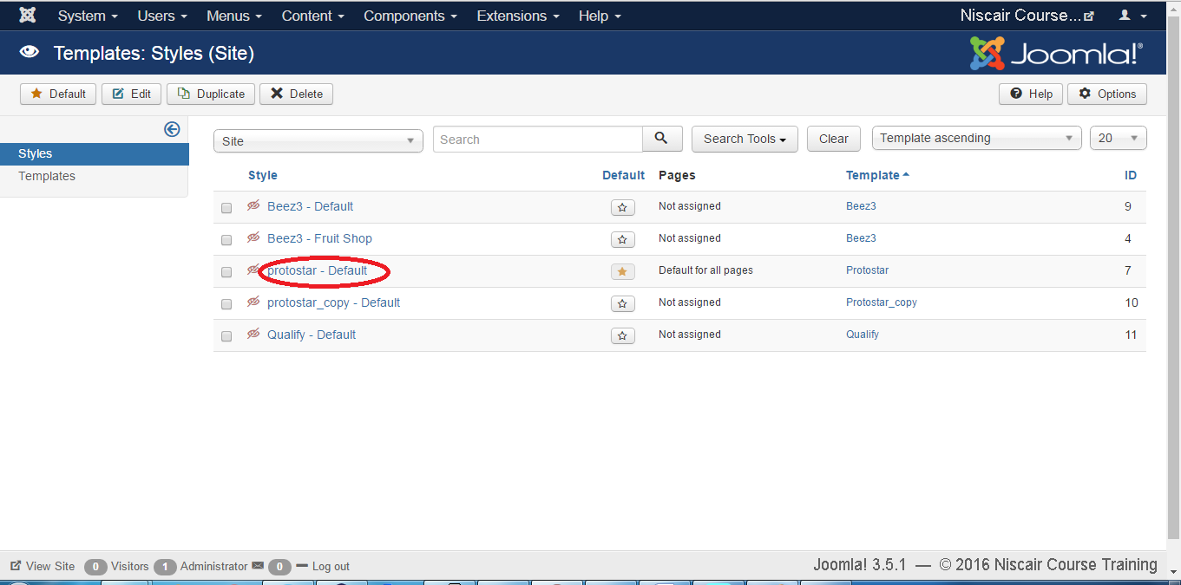
Step (2): After clicking on the Template, following screen will get displayed.

Slide 19
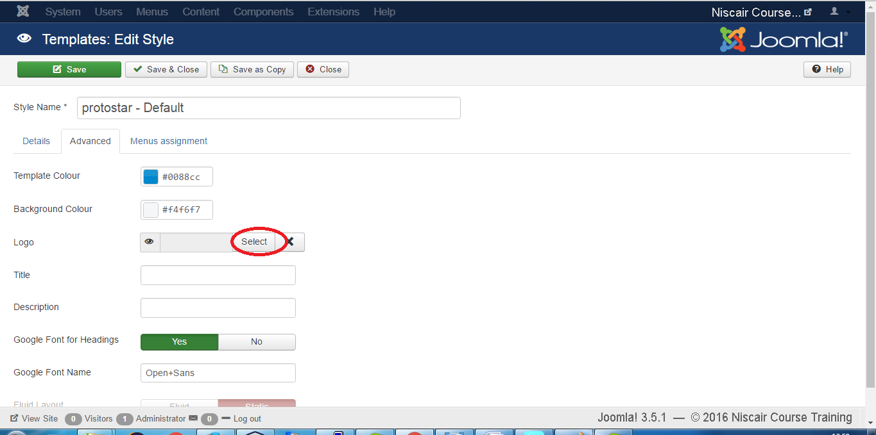
Step (3): Click on the Hathor Default option, a screen as below will be displayed. You can customize the logo for your web site here.
Following are the fields present in the Joomla Customize Logo page:
Show Site Name: Shows the name of the site in the template header.
Logo: Uploading the logo for the site. Click on the Select button to choose an image. You will get the following pop-up window when you click on the select button. Select the image from the following folder and click on Insert.

Slide 20
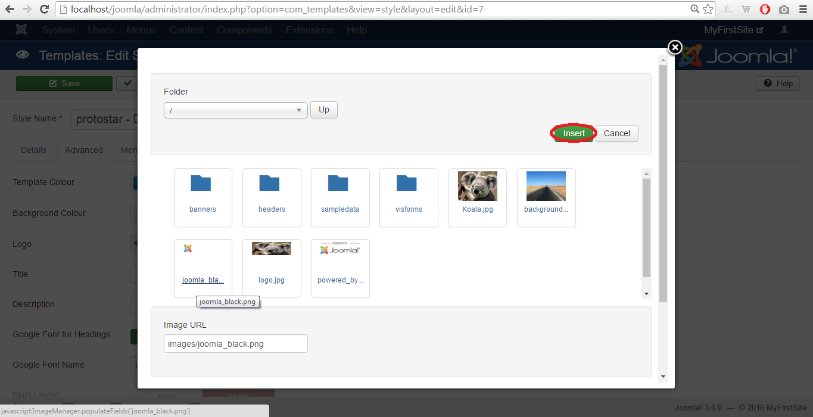
Select Color: Select color for your logo.
Bold Text: Use the bold text.
Toolbar Following are the toolbar options present:
Save: Saves your customized logo.
Save & Close: Saves the customized logo and closes the current screen.
Save & New: Saves the logo opens a new create customize logo screen.
Cancel: Cancels the customized logo in Joomla.

Slide 21
Thank You

