Slide 1
CONTENT MANAGEMENT SYSTEM
Presented by:
Mukesh A. Pund
Principal Scientist
CSIR-NISCAIR, New Delhi

Slide 2
JOOMLA MODULES

Slide 3
MODULES
Modules are lightweight and flexible extensions used for page rendering. These modules are often “boxes” arranged around a component on a typical page. A well-known example is the login module. Modules are assigned per menu item, so you can decide to show or hide (for example) the login module depending on which page (menu item) the user is currently on. Some modules are linked to components: the “latest news” module, for example, links to the content component (com_content) and displays links to the newest content items. However, modules do not need to be linked to components; they don't even need to be linked to anything and can be just static HTML or text.
Modules are managed in the Joomla! Administrator view by the Module Manager

Slide 4
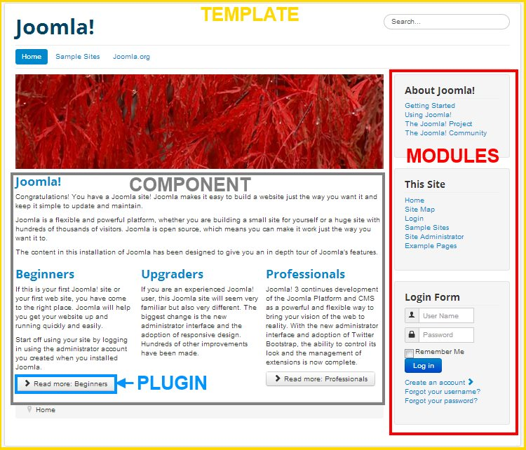
MODULES

Slide 5
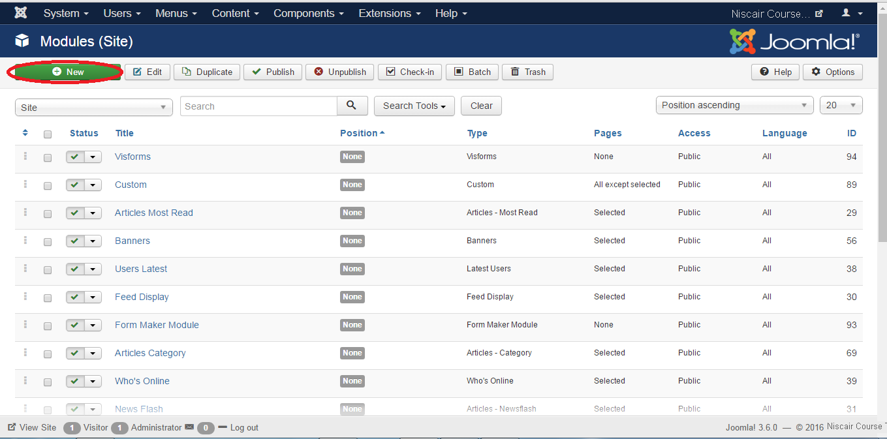
BREADCRUMB MODULE
Step (1): Click Extension --> Module in Joomla administrator. After you click on Module you get the following screen.

Slide 6
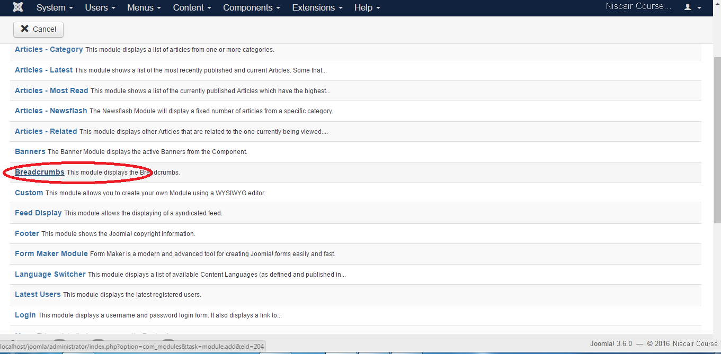
Step (2): As shown in the above screen, click on New button and the following screen displays. On this page, click on the Breadcrumbs.

Slide 7
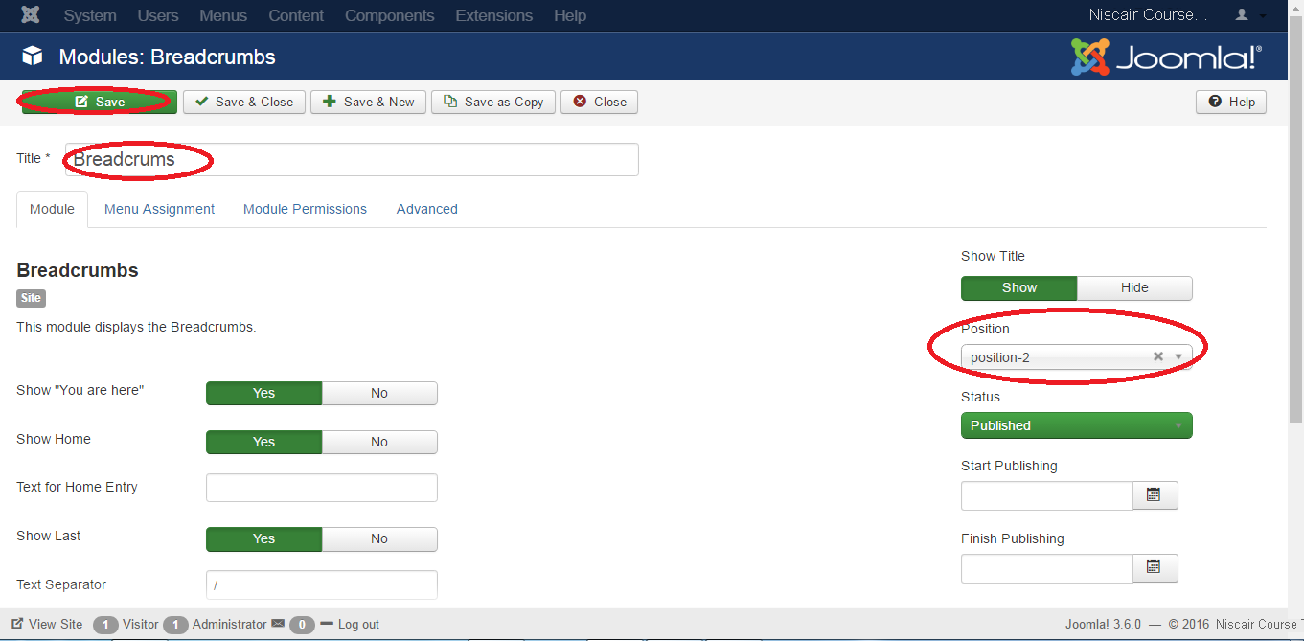
Step (3): Next, you see the existing breadcrumbs module as shown below.

Slide 8
By default, the Module tab is displayed. The Module displays the breadcrumbs.
Details of the fields present in the Module Breadcrumbs page are as follows:
Title: Displays the title of Module
Show "You are here": It will show or hide the text "You are here" in the pathway.
Show Home: Home element will be shown or hidden in the pathway.
Text for Home Entry: Text will be displayed as home entry. The default value is taken from mod_breadcrumbs.ini language file, when the text field is empty.
Show Last: Last element will be shown or hidden in the pathway.
Text Separator: It separates the text.
Show Title: Displays the title of the module in the front end.
Position: It selects the position of the module to be displayed.
Status: It displays the status of the article such as Published, Unpublished and
Trashed.
Start Publishing: It starts publishing on the assigned date and time.
Finish Publishing: It finishes publishing on the assigned date and time.
Access: Only selected users from the dropdown list such as Guest, Public, Super Users, Registered and Special options are allowed to view the item.
Ordering: Displays the dropdown of all module present in the position.
Language: It specifies the language of the site. It provides either ALL or English (UK) options.
Note: It is used to enter the text information.

Slide 9
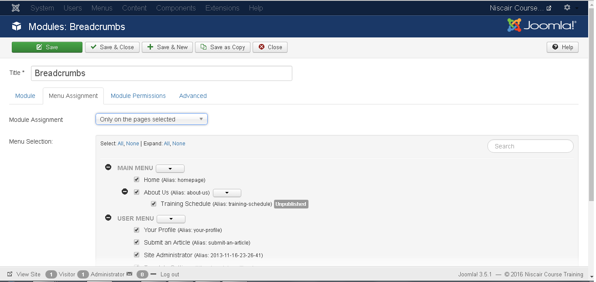
Step (4): Click on Menu Assignment tab, you will get the screen as shown below.
Module Assignment: Select the option to view the item from the dropdown list such as On All Pages, No Pages, Only on the pages selected or On all pages except those selected.
Menu Selection: After you select the option only on the pages selected or on all pages except those selected, it then displays all the menu items present in Joomla. It allows you to assign modules to some and not all pages.

Slide 10
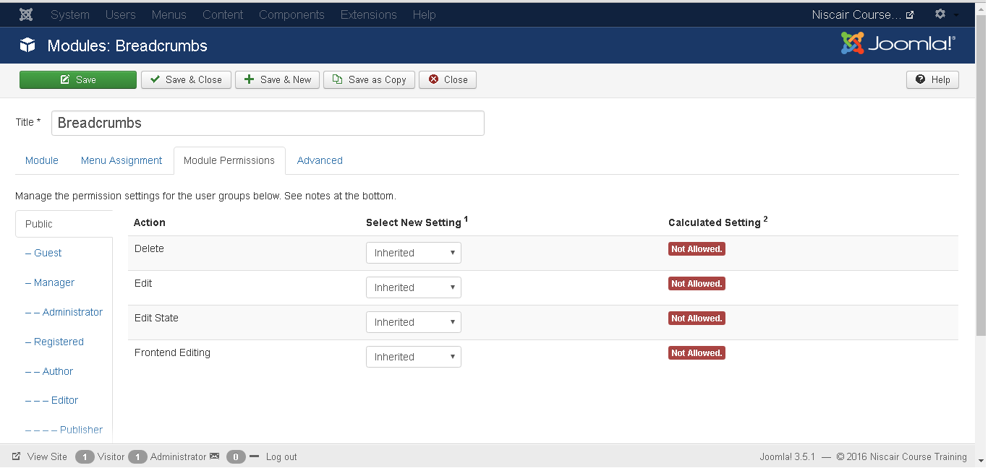
Step (5): In Module Permissions tab, we can view the three actions. It manages the setting of module permission for the user groups as shown below
Delete: It allows users in group to delete the content present in the breadcrumb.
Edit: It allows users in group to edit the content present in the breadcrumb.
Edit State: It allows users in group to change the state of content present in the breadcrumb.

Slide 11
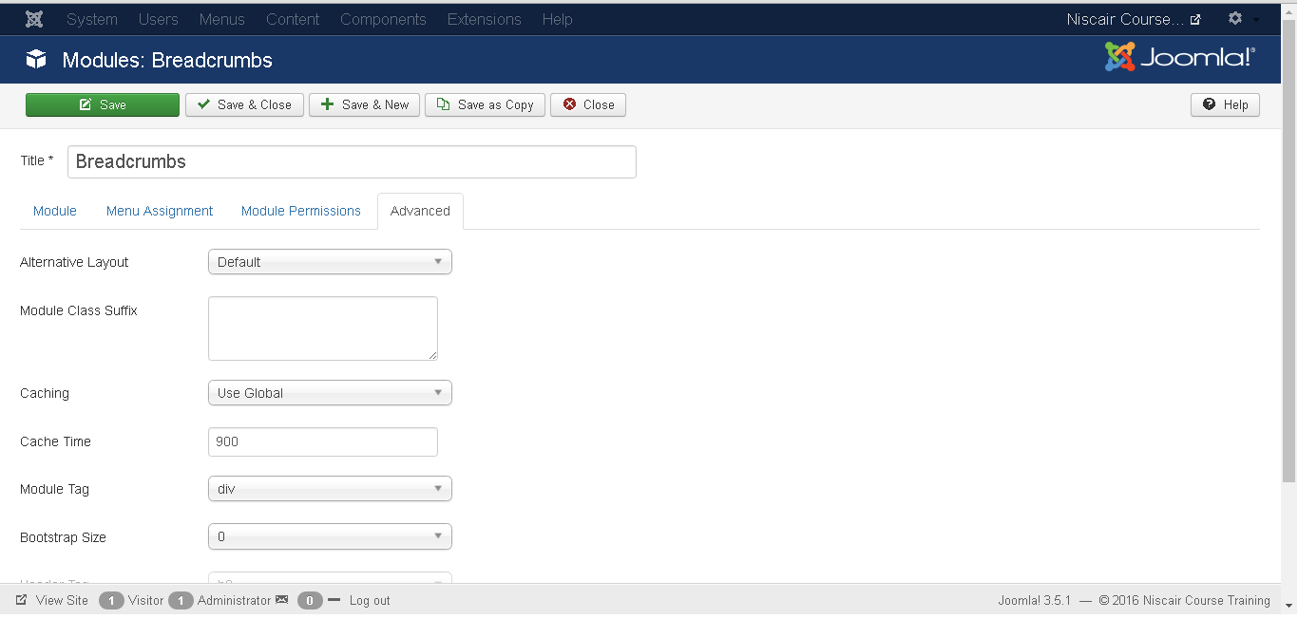
Step (6): The Advanced tab is used to do the advanced settings of the breadcrumbs. The advanced tab screen is shown below.
Alternative Layout: Select the layout to be used for this module.
Module Class Suffix: Setting this parameter causes Joomla to either add a new CSS class or modify the existing CSS class for the div element for this specific module.

Slide 12
Caching: Cache the content of the module. Use Global is used to cache settings from global configuration. No Caching does not cache the module content.
Cache Time: Specifies the time in minutes before the module is re-cached.
Module Tag: Specifies the HTML tag for the modules.
Bootstrap Size: Select width of the module built into bootstrap.
Header Tag: Modules use the HTML header tags.
Header Class: Optional CSS classes are added in the modules header.
Module Style: Overrides the template style for its position.
Toolbar
Save: Saves your modules.
Save & Close: Saves the modules and will close the current screen.
Save & New: Saves modules and opens a new creating module screen.
Cancel : Cancels the created modules in Joomla.

Slide 13
SEARCH MODULE
Joomla is a powerful content management system which is capable of supporting websites with hundreds and even thousands of pages. When websites become this large, it's often important to provide your website's visitors with a search feature as a means of locating the information on your website that they are looking for. One option that Joomla provides for your visitors to search your website is the search module, which is a block displayed within your template.

Slide 14
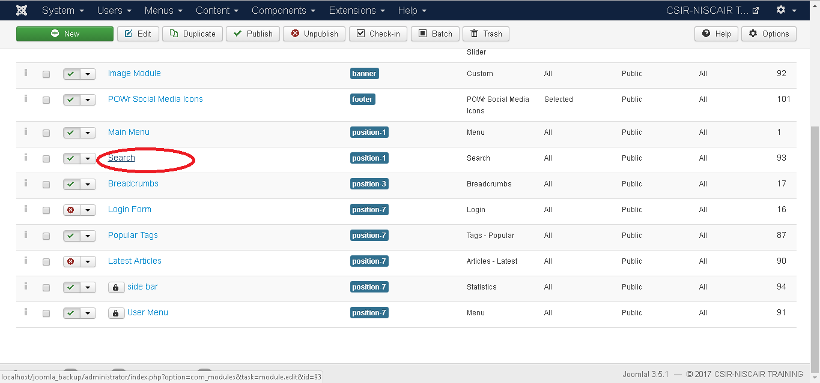
Step (1): Click Extension --> Module in Joomla administrator control panel, you get the following screen:

Slide 15
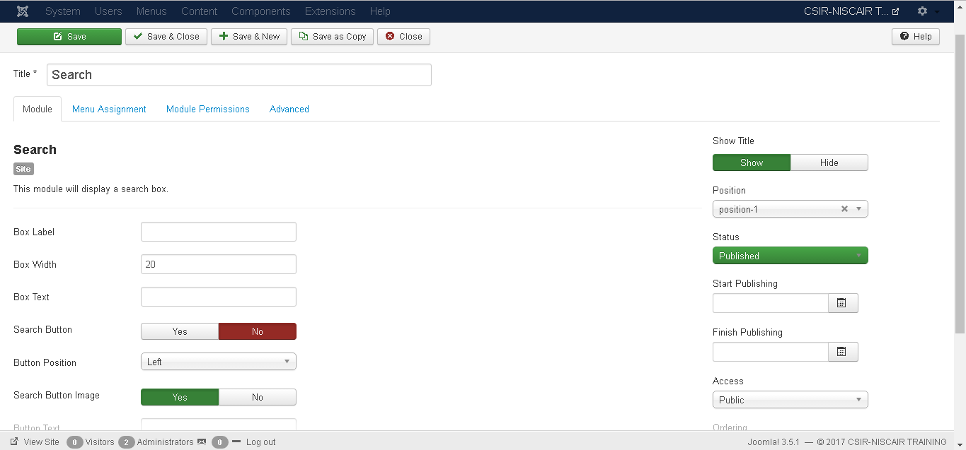
Step (2): After clicking on Search, the existing Search module displays as shown below.
By default, the Module tab is displayed. The module displays a search box. Below, we have mentioned the details of the fields present in the Module tab.
Title: Displays the title of Module
Box Label: In search box label the text will appear.
Box Width: Sets the width of the search box. By default it is set to20.
Box Text: Text to view on the search box.

Slide 16
Search Button: Search button is displayed. By default it is set to No.
Button Position: Sets the position of search button such as Left, Right, Bottom, Top.
Search Button Image: Insert image as button. The image must be located in the templates/templates name/images/
Button Text: Text to view on search button.
OpenSearch autodiscovery: For site search it adds browser support. By default it is set to Yes.
OpenSearch title: When a site is added as a search provider, the text gets displayed in the supported browser.
Set ItemID: To display the search result, itemID is assigned by selecting menu item.
Show Title: Displays the title of the module in the front end.
Position: It selects the position of the module to be displayed.
Status: It displays the status of the article such as Published, Unpublished and
Trashed.
Start Publishing: It starts publishing on the assigned date and time.
Finish Publishing: It finishes publishing on the assigned date and time..

Slide 17
Position: It selects the position of the module to be displayed.
Status: It displays the status of the article such as Published, Unpublished and Trashed.
Start Publishing: It starts publishing on the assigned date and time.
Finish Publishing: It finishes publishing on the assigned date and time.
Access: It allows access to only selected users from the dropdown list such as Guest, Public, Super Users, Registered and Special options to view the items.
Ordering: Displays the dropdown of all modules present in the position.
Language: It specifies the language of the site. It provides either ALL or English (UK) options.
Note: It is used to enter the text information.

Slide 18
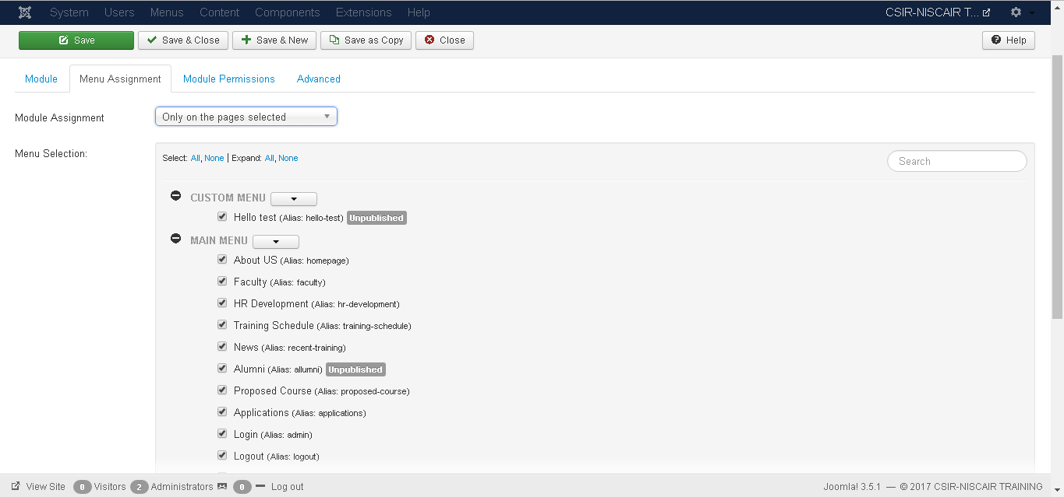
Step (3): Click on Menu Assignment tab, you will get the screen as shown below.

Slide 19
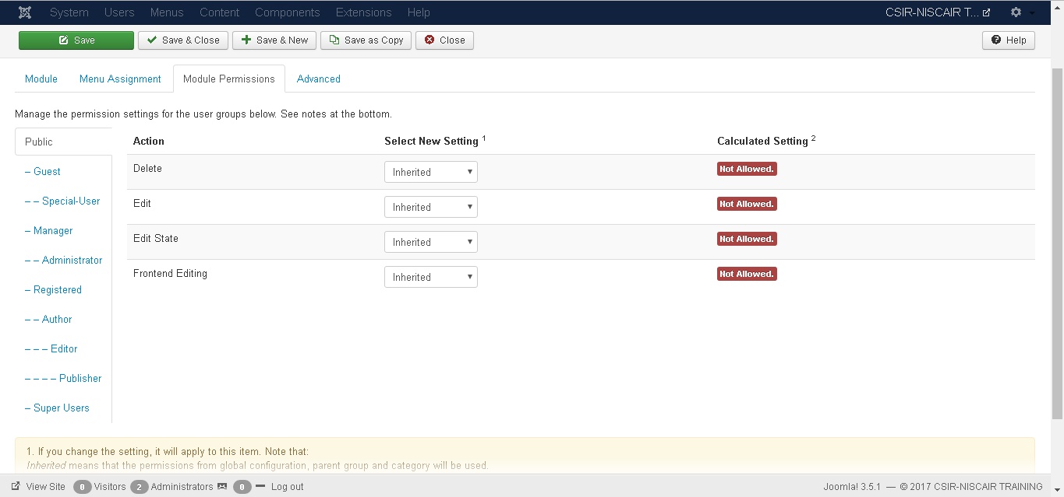
Step (4): Module Permissions tab has three actions to choose from. It manages the setting of module permission for the user groups as shown in the following screen.

Slide 20
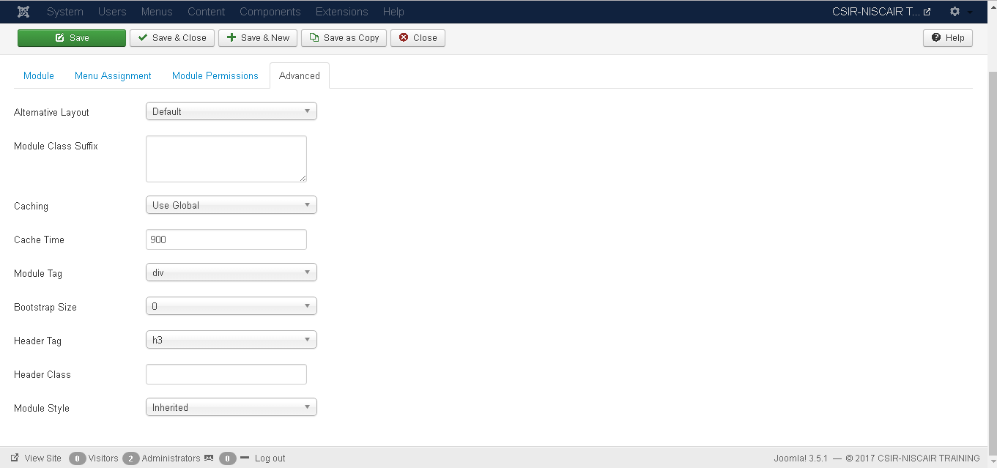
Step (5): The Advanced tab is used to do the advanced settings of the Search. The advanced tab screen is shown below.

Slide 21
FOOTER MODULE
We have often seen websites with things like “Powered by WordPress” or “Copyright (C) 2016” or “Mobile Friendly Website” or “Mobile Responsive” mentioned at the bottom of the page. Footer displays the information of license and the copyright of the website.Below are the things that you should include in footer.
Contact Details
Social Media
Website Search
Legal Stuff
Disclaimer or Warning
Copyright Information

Slide 22
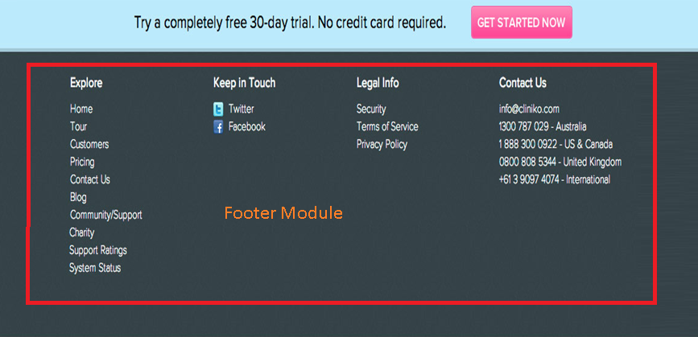

Slide 23
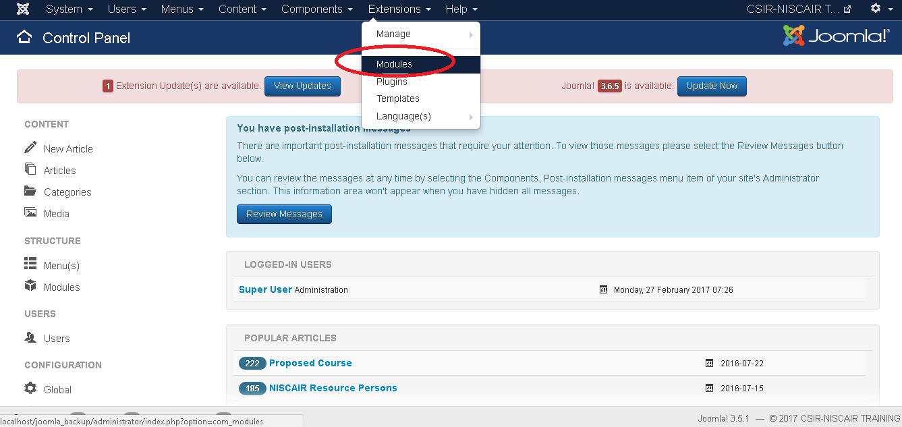
Step(1): Click on Extensions → Modules

Slide 24
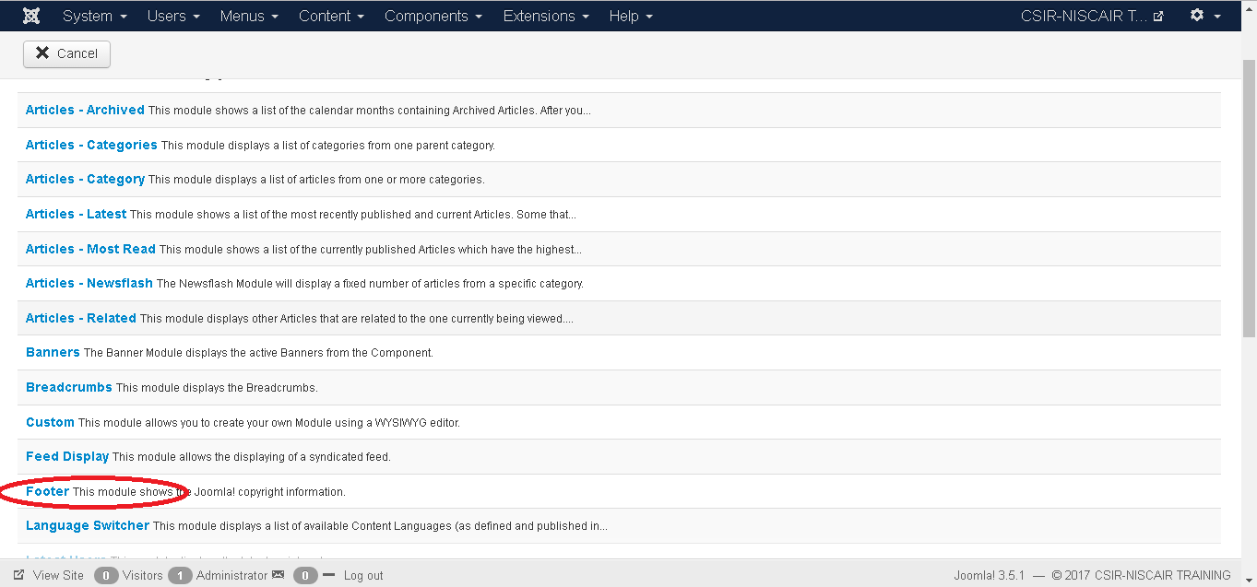
Step(2): Click on New Button
Step(3): Click on New Button

Slide 25
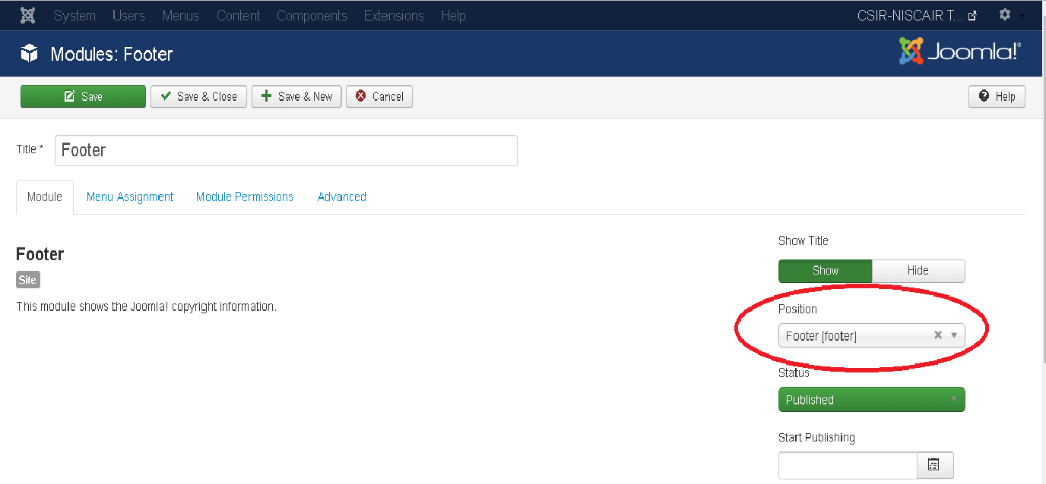
Step(4): After clicking on footer you will get the following screen
By default, the Module tab is displayed. The ab displays the copyright information of Joomla.

Slide 26
Given below is the information about the function tabs displayed on the page.
Title: Displays the title of Module.
Following content is present on the right side of the module tab.
Show Title: Displays the title of the module in the front end.
Position: It selects the position of the module to be displayed.
Status: It displays the status of the article such as Published, Unpublished and Trashed.
Start Publishing: It starts publishing on the assigned date and time.
Finish Publishing: It finishes publishing on the assigned date and time.

Slide 27
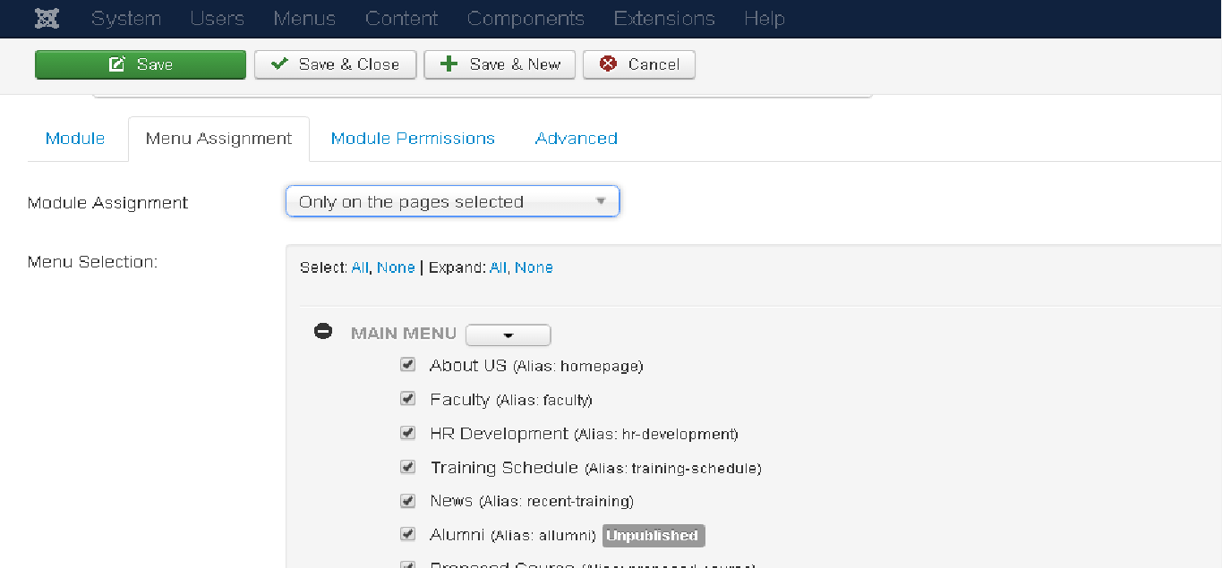
Module Assignment: Select the option to view the item from the dropdown list such as on all pages, no pages, only on the pages selected or on all pages except those selected.
Menu Selection: After selecting the option only on the pages selected or on all pages except those selected, it displays all the menu items present in Joomla. It allows you to assign module to some and not all pages.

Slide 28
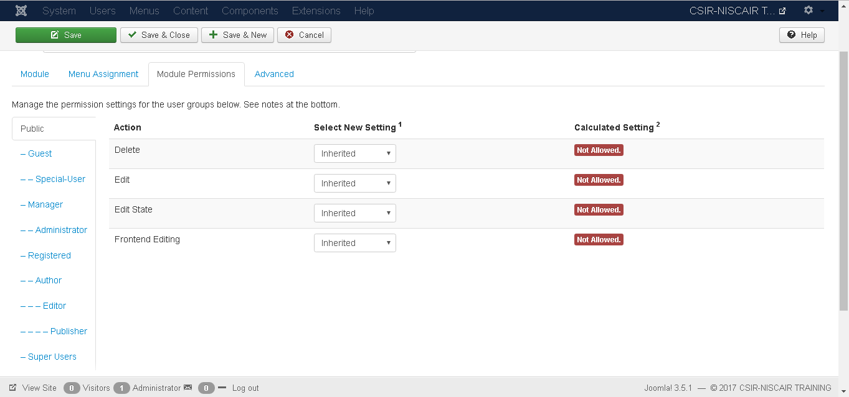
Details of the function tabs on the page is given below.
Delete: It allows users in group to delete the content present in the Footer.
Edit: It allows users in group to edit the content present in the Footer
Edit State: It allows users in group to change the state of content present in the Footer.

Slide 29
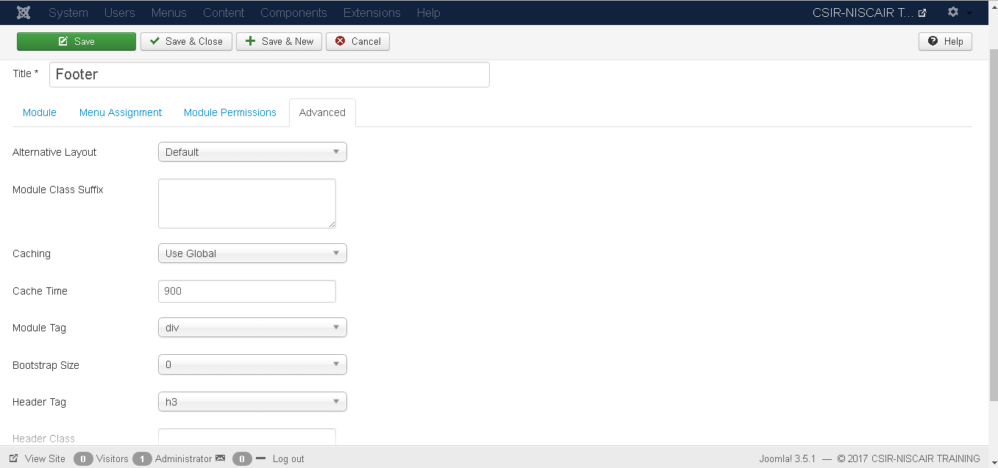
Step (5): The Advanced tab is used to do the advanced settings of the footer. Following screenshot represents the advanced tab.

Slide 30
Alternative Layout: Selects the layout to be used for this module, which you have already defined as one or more layouts for a module in Joomla or template.
Module Class Suffix: Setting this parameter causes Joomla to either add a new CSS class or modify the existing CSS class for the div element for this specific module.
Caching: Cache the content of the module. Use Global is used to cache settings from global configuration. No Caching is used whether to cache the content of the module or not.
Cache Time: Specify the time in minutes before the module is re-cached.
Module Tag: Specify the HTML tag for the modules.
Bootstrap Size: Select width of the module built into bootstrap.
Header Tag: Modules uses the HTML header tags.

Slide 31
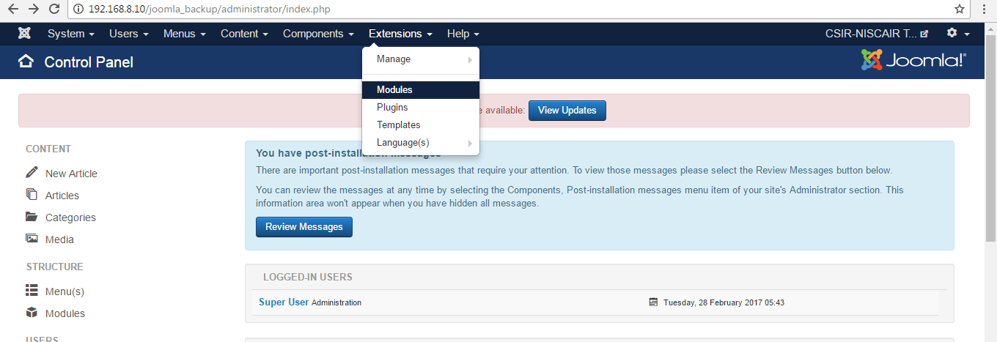
Random Image Module
Step (1): Click Extension --> Module Manager in Joomla administrator, the following screen will be displayed:

Slide 32
Step (2): Next, click on New button and the following screen gets displayed.

Slide 33
Step (3): Next, click on the Random Image.

Slide 34
Step (4): After clicking on Random Image, the existing Random Image module displays as shown below.
By default, the Module tab is displayed. Below, we have mentioned the details of the fields present in the Module tab.
Title: Displays the title of Module
Image Type: Displays the image type i.e. png, jpg, .gif etc. By default it is set to jpg.
Image Folder: Defines the path of the image folder which is stored on the server.
Link: When images are clicked, the URL is redirected.

Slide 35
Width (px): Specifies the width of the image in pixels.
Height (px): Specifies the height of the image in pixels.
Show Title: Displays the title of the module in the front end.
Position: It selects the position of the module to be displayed.
Status: It displays the status of the article such as Published, Unpublished and Trashed.
Start Publishing: It starts publishing on the assigned date and time.
Finish Publishing: It finishes publishing on the assigned date and time.
Access: It allows access to only selected users from the dropdown list such as Guest, Public, Super Users, Registered and Special options to view the items.
Ordering: Displays the dropdown of all modules present in the position.
Language: It specifies the language of the site. It provides either ALL or English (UK) options.
Note: It is used to enter the text information.

Slide 36
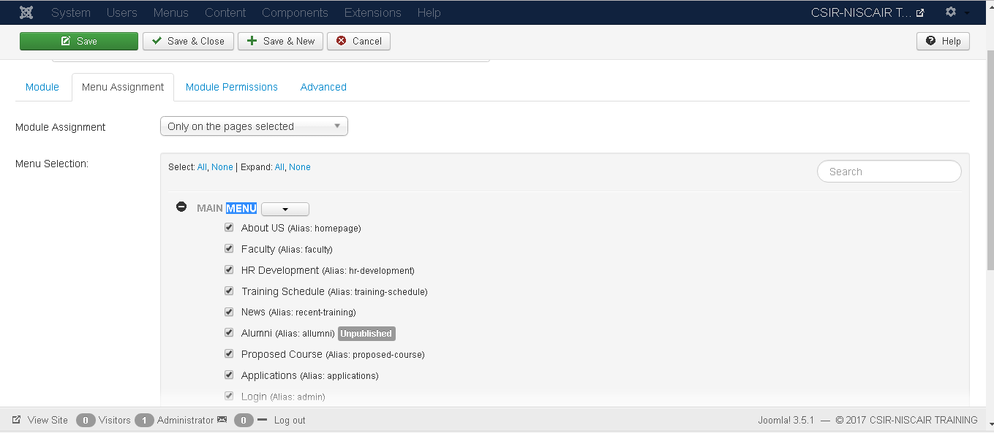
Step (5): When we click on Menu Assignment tab, you will get the screen as shown below.
Module Assignment: Select the option to view the item from the dropdown list such as on all pages, no pages, only on the pages selected or on all pages except those selected.
Menu Selection: After selecting the option only on the pages selected or on all pages except those selected, it displays all the menu items present in Joomla. It allows you to assign module to some and not all pages.

Slide 37
Step (6): Module Permissions tab provides three actions to choose from. It manages the setting of module permission for the user groups as shown in the following screen.
Delete: It allows users in group to delete the content present in the module.
Edit: It allows users in group to edit the content present in the module.
Edit State: It allows users in group to change the state of content present in the module.

Slide 38
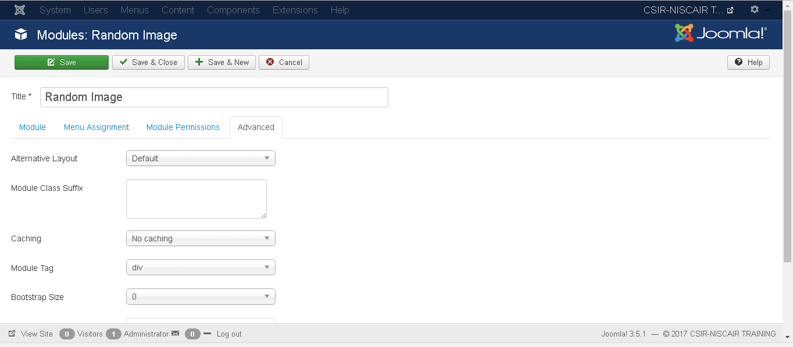
Step (7): The Advanced tab is used to do the advanced settings of the Random Image. The advanced tab screen is shown below.

Slide 39
Alternative Layout: Selects the layout to be used for this module, which you have already defined as one or more layouts for a module in Joomla or template.
Module Class Suffix: Setting this parameter causes Joomla to either add a new CSS class or modify the existing CSS class for the div element for this specific module.
Caching: Caches the content of the module. Use Global is used to cache settings from global configuration. No Caching is used whether to cache the content of the module or not.
Cache Time: Specifies the time in minutes before the module is re-cached.
Module Tag: Specifies the HTML tag for the modules.
Bootstrap Size: Selects width of the module built into bootstrap.
Header Tag: Modules uses the HTML header tags.
Header Class: Optional CSS classes are added in the modules header.

Slide 40
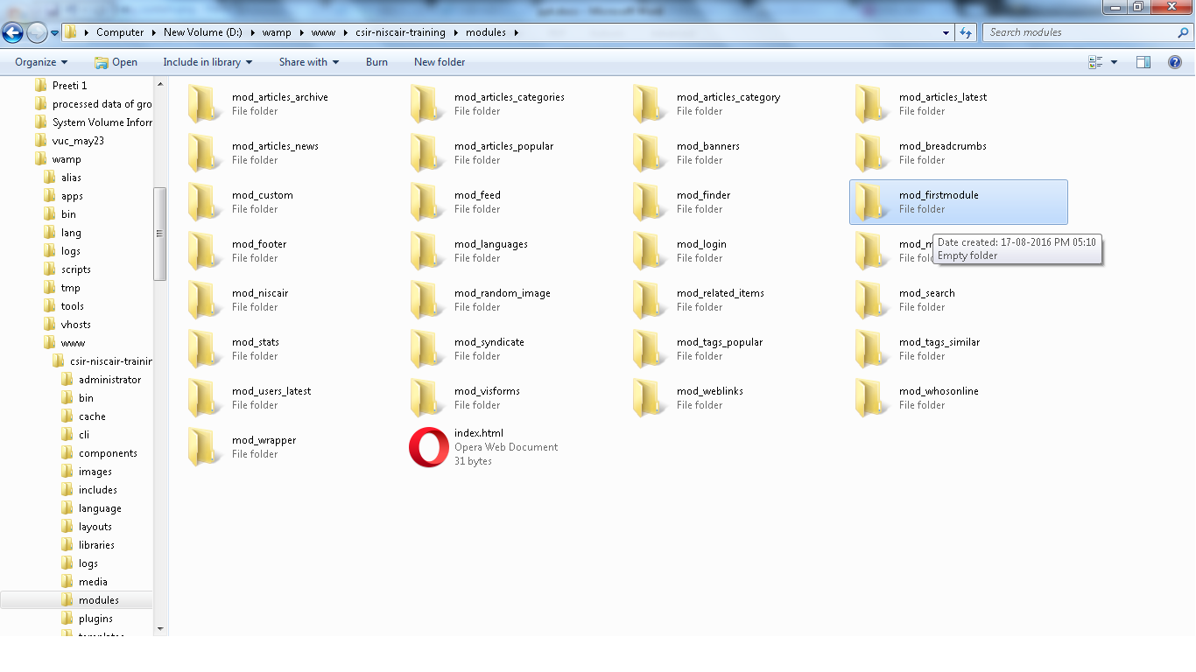
CREATE CUSTOM MODULES
Step (1): Create a folder starting with prefix mod_ and followed by module name .For e.g. mod_firstmodule in your Joomla --> modules folder as shown bellow.

Slide 41
Step (2): In the mod_firstmodule folder create a file called as “modannouncementshelper.php". This file contains class name as ModAnnouncementsHelper, it helps to display the retrieved data in the module output.
modannouncementshelper.php
<?php
/**
* Helper class for Hello World! module
* @package Joomla
* @subpackage Modules
* @link http://docs.joomla.org/J3.x:Creating_a_simple_module/Developing_a_Basic_Module
* @license GNU/GPL, see LICENSE.php
mod_helloworld is free software. This version may have been modified pursuant
to the GNU General Public License, and as distributed it includes or
is derivative of works licensed under the GNU General Public License or
other free or open source software licenses.
*/
class modAnnouncementsHelper{
/**
* Retrieves the hello message
* @param array $params An object containing the module parameters
* @access public */
public static function getAnnouncements($params){

Slide 42
$announcements='<marquee direction="up“ onmouseover=“this.stop();” onmouseout=“this.start();”>'.
'<h4><a href="http://www.niscair.res.in/movingmenu/move.asp?a=topframe.htm&b=content.asp&c=Tender-DisplayScreen-22Feb17.pdf">Tender- Replacement of LT Panel & SITC of new LT Panel & Servo-controlled voltage stabilizer at Pusa (Electric Work) [Last Dt. for obtaining tender: 10.3.17 17.00 Hrs, Last Dt. for submission: 14.3.17 15.00 Hrs]</a> </h4>'.
'<h4><a href="http://www.niscair.res.in/movingmenu/move.asp?a=topframe.htm&b=content.asp&c=Tender-LTPanelElectricWork-1Mar17.pdf">Tender- Replacement of LT Panel & SITC of new LT Panel & Servo-controlled voltage stabilizer at Pusa (Civil Works) [Last Dt. for obtaining tender: 10.3.17 17.00 Hrs, Last Dt. for submission: 14.3.17 15.00 Hrs]</a> </h4>'.
'<h4><a href="http://www.niscair.res.in/movingmenu/move.asp?a=topframe.htm&b=content.asp&c=Tender-LTPanelCivilWork-1Mar17.pdf">Tender- Procurement of Outdoor Display Screen [Last Dt. for submission: 7.3.17 14.30 Hrs] </a> </h4>'.
'<h4><a href="http://www.niscair.res.in/movingmenu/move.asp?a=topframe.htm&b=content.asp&c=Tender-RO-SITC-21Feb17.pdf">Tender- SITC of RO system at NISCAIR Pusa Campus, SVM Campus and MBGH, New Delhi [Last Dt. for obtaining tender: 3.3.17 17.00 Hrs, Last Dt. for submission: 6.3.17 15.00 Hrs] </a> </h4>'.
'<h4><a href="http://www.niscair.res.in/Downloadables/OM-NISCAIRBankDetails-12Sep16_29Dec16.pdf">Bank details for acceptance of receipts through NEFT/RTGS </a> </h4>'.
'<h4><a href="#">Short term training programme on Recent Trends in Libraries is rescheduled to be held during March 06 - 10, 2017</a> </h4>'.
'<h4><a href="#">Service of authentication of botanical specimens/crude drugs has been resumed </a> </h4>'.
'<h4><a href="http://www.niscair.res.in/ActivitiesandServices/Services/LibModernizationServices-20May16.pdf">New service from NISCAIR- Library modernization facility</a></h4>'.
'<h4><a href="http://www.niscair.res.in/aboutus/about.asp?a=topframe.htm&b=leftcon.asp&c=Annual-Report-13-14/AnnualReport13-14.asp&d=test5">CSIR-NISCAIR Annual Report 2013-2014</a> </h4>'.
'<h4><a href="http://www.niscair.res.in/aboutus/TelephoneDirectory.pdf">NISCAIR Directory </a></h4>'.
'</marquee>';
return $announcements;
} } ?>

Slide 43
Step (3): Create a file called as mod_announcements.php. It is an entry point for the module which performs initialization routines, collects necessary data and displays the module output using template.
mod_announcements.php
<?php
/** Hello World! Module Entry Point
* @package Joomla @subpackage Modules @license GNU/GPL, see LICENSE.php
* @link http://docs.joomla.org/J3.x:Creating_a_simple_module/Developing_a_Basic_Module
mod_helloworld is free software. This version may have been modified pursuant to the GNU General Public License, and as distributed it includes or is derivative of works licensed under the GNU General Public License or other free or open source software licenses.
No direct access
*/
defined('_JEXEC') or die;
//Include the syndicate functions only once
require_once dirname(__FILE__) . '/modannouncementshelper.php';
$announcements = modAnnouncementsHelper::getAnnouncements($params);
echo $announcements;
require JModuleHelper::getLayoutPath('mod_announcements');
?>

Slide 44
Step (4): Create a mod_announcements.xml file. This file contains the information about module. This xml file contains information of files that are to be installed in Joomla for the module.
mod_announcements.xml
<?xml version="1.0" encoding="utf-8"?>
<extension type="module" version="3.1.0" client="site" method="upgrade"> <name>Announcements</name>
<author>CSIR-NISCAIR</author> <version>1.0.0</version>
<description>Displays current announcements by CSIR-NISCAIR in vertical scrolling from down to up.</description> <files>
<filename>mod_announcements.xml</filename>
<filename module="mod_announcements">mod_announcements.php</filename> <filename>index.html</filename>
<filename>modannouncementshelper.php</filename>
<filename>tmpl/default.php</filename>
<filename>tmpl/index.html</filename> </files> <config>
</config>
</extension>

Slide 45
Step (5): Create a simple html file called index.html. The purpose of writing this file is that, the created directories should not be browsed. When a user browses into these directories, the index.html file gets displayed. You can even keep this file empty.
index.html
Step (6): Create a folder called as tmpl. Place default.php file as shown below and index.html (created in step (5)) under tmpl folder. The default.php file is a template that displays the module output.
default.php
<html>
<body> Welcome to CSIR-NISCAIR!!!!! </body>
</html>
<?php
defined('_JEXEC') or die;
?>
<!—The below text will get displayed when we don’t display announcements in modannouncementshelper.php file -->
<marquee direction="left"><h1 color="red">Hello,Friends how is your joomla training going on?</h1></marquee>

Slide 46
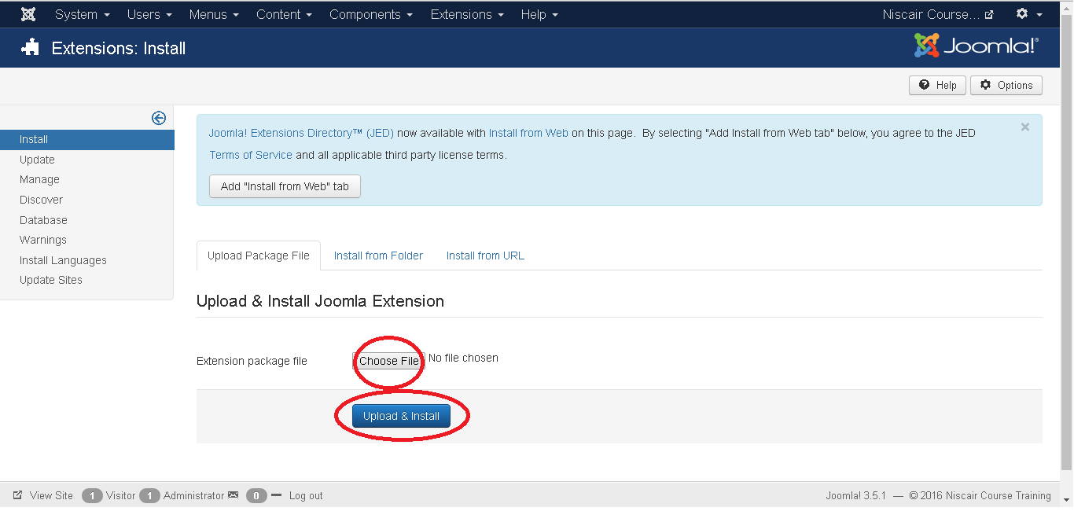
After you have finished creating all these files, compress the complete folder mod_firstmodule.
Step (7): Go to Extension --> Extension in Joomla administrator and you will get the following screen. Here you can upload and install your created module files i.e. mod_firstmodule folder. Click on Choose File and select the created module file (compressed one). Click on Upload & Install button to upload the module file.

Slide 47
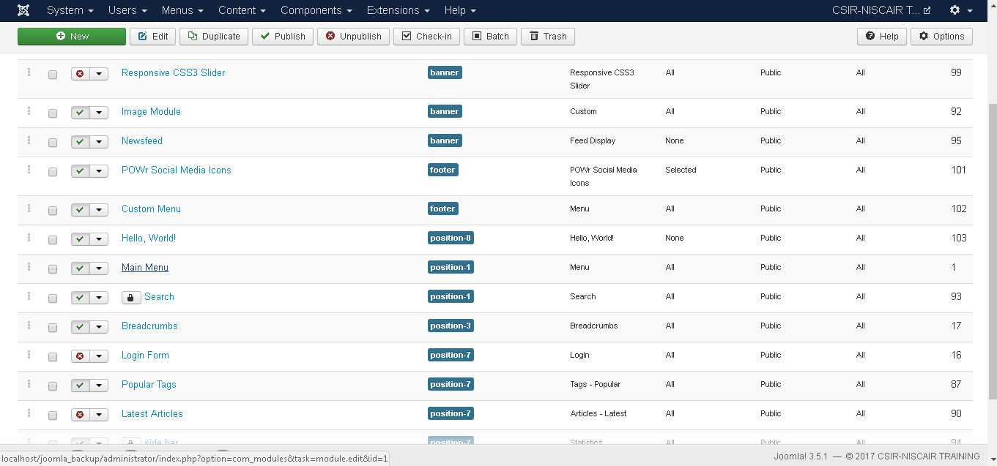
Step (8): After upload and installation, go to Module and click on New. There you can view your created module file as shown below.
Step (9): You can assign this module similar to the other modules and then publish it.

Slide 48
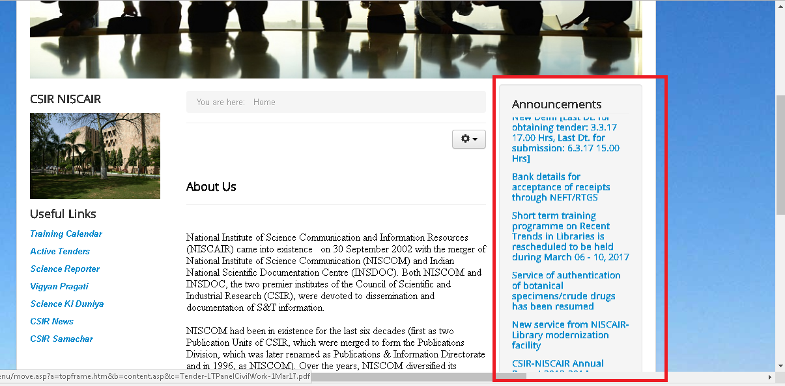
Custom Module Output
Here you can see the marquee rendering of the text .

Slide 49
Thank You

