Slide 1
CONTENT MANAGEMENT SYSTEM
Presented by:
Mukesh A. Pund
Principal Scientist
CSIR-NISCAIR, New Delhi

Slide 2
JOOMLA MENUS

Slide 3
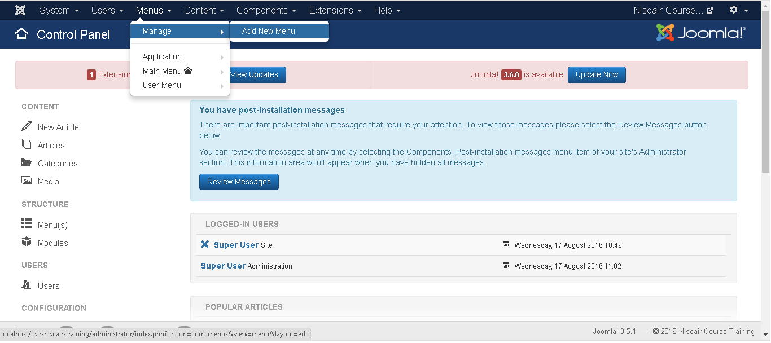
CREATE MENUS
Step (1): Click Menus --> Menu --> Add New Menu as shown below.

Slide 4
Step (2): After clicking on Add New Menu, the Menu : Add Menu page will displayed as shown below. Here, we can add Menu Title (Name), Type and Description as shown.
Menu Title (Name): It should indicate the Title (Name) of the menu.
Menu Type: The name of the menu type.
Description: Description about the menu.

Slide 5
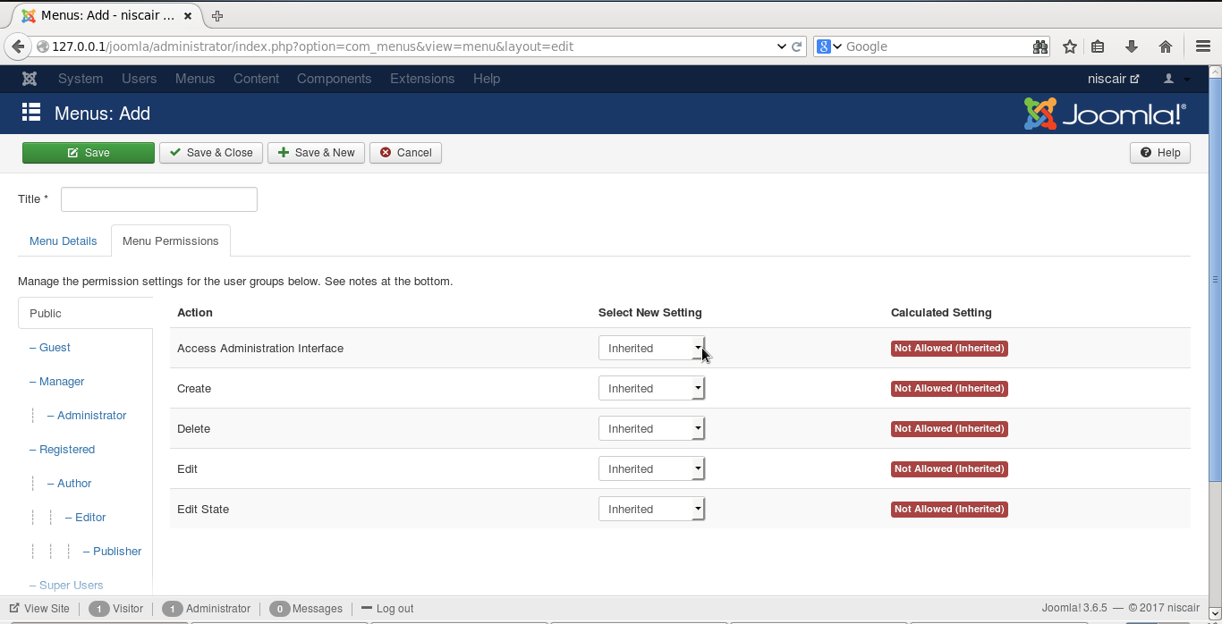
Menu Permissions: To give permissions to Users

Slide 6
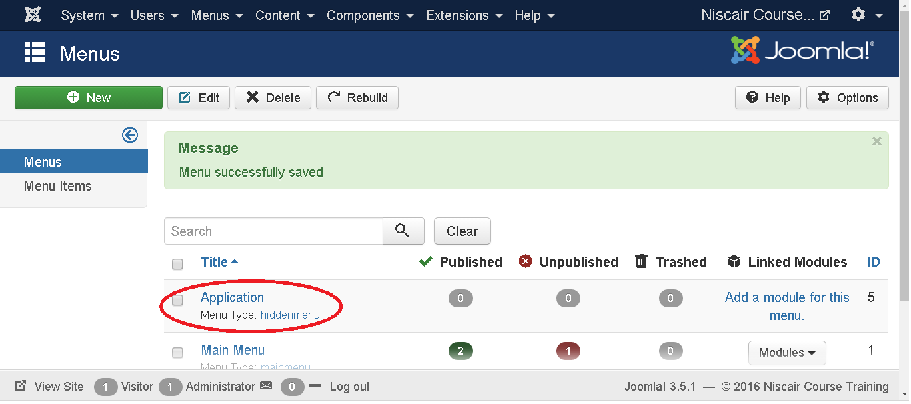
Step (3): After filling all the information about menu, click on Save button. It saves the menu bar you created.
Step (4): We can also click on Save & Close button. It saves the menu bar and then closes the present screen. Finally, you get the following screen as shown below.
In this page, you can view the name of the menu you had created in previous step.
Step (5): When we click on Save & New button, your menu is saved .

Slide 7
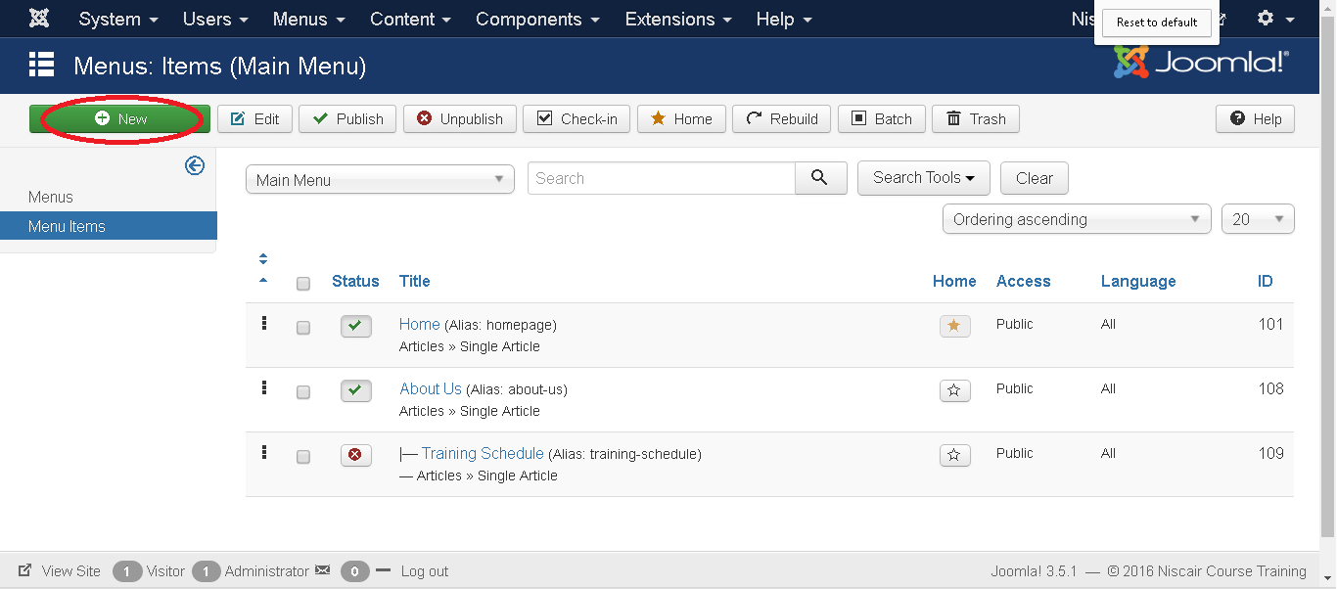
ADDING MENU ITEMS
Adding Menu Items
Following are the simple steps to add a menu item in Joomla.
Step (1): Click on Menus --> Main Menu --> Add New Menu Item as shown below.

Slide 8
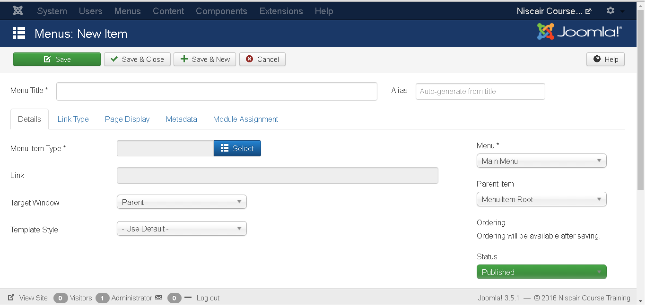
Step (2): After clicking on Add New Menu Item, the Menu : New Menu Item page is displayed as shown below.
Menu Title: It displays the title of the menu item.
Alias: It is used as SEF URL. Joomla will automatically fill the value from the title. It will produce UTF-8 aliases, however, it does not allow any spaces and underscores.
Menu Item Type: In Menu item type, it specifies the type of menu item such as articles, tags, web links, system links, contacts etc. Here you can select menu item type by clicking on the Select button. By clicking on this button, a screen appears as shown below.

Slide 11
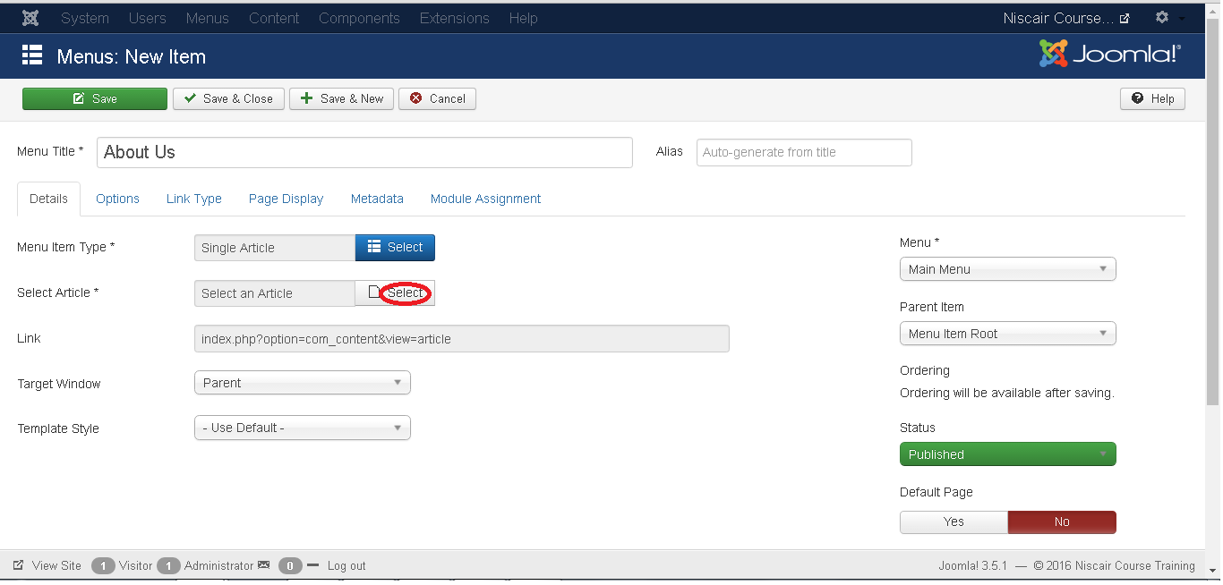
After selecting Single Article you will get the following screen.

Slide 12
Select Article: Selects the article from the list.
Link: Specifies link reference for the menu item.
Template Style: You can select a template style for your website by clicking at the dropdown menu which gives you Beez3 - Default and Protostar - Default styles or provides default template for your website.
Target Window: It targets the window for menu items such as Parent, New Window With Navigation and New Without Navigation.
Menu Location: It specifies which menu link will appear either Main Menu or User Menu.
Parent Item: It selects parent item by selecting either Menu Item Root or Home.
Status: It displays the status of the article such as Published, Unpublished and
Trashed.
Default Page: It provides Yes or No options to set the menu item as default or home page of the site.
Access: It allows access only to selected users from the dropdown list such as Guest, Public, Super Users, Registered and Special option to view the items
Language: It specifies the language of the site. It provides either ALL or English (UK) options.
Note: It is used to enter the text information.

Slide 13
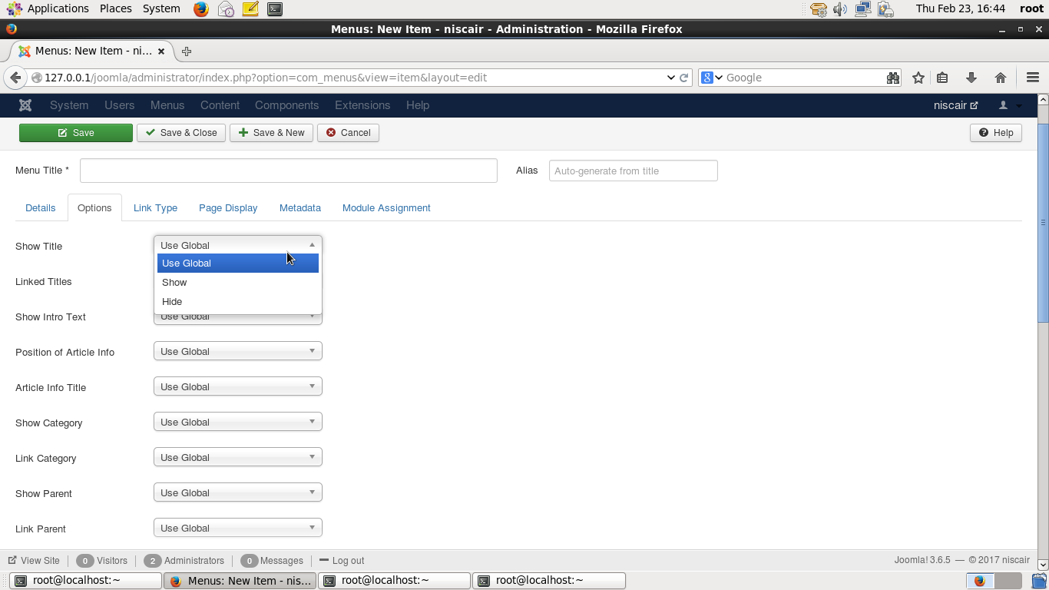
After selecting Menu Item Type it will generate an Options tab automatically.
Step (3): When we click on Options tab we will get the following screen.

Slide 14
Step (4): Click on Link Type tab we will get the following screen.
Link Title Attribute: It specifies description for the title attribute of the given hyperlink.
Link CSS Style: It applies custom CSS style to the hyperlink.
Link Image: It uses an image to be used with hyperlink.
Add Menu Title: It provides Yes or No options and adds the menu title next to the image. The default is Yes.

Slide 15
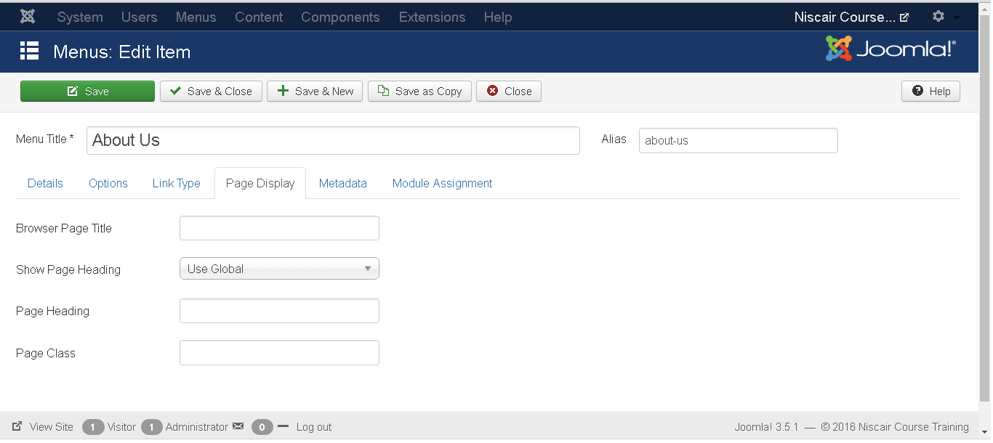
Step (5): Click on Page Display tab we will get the following screen.
Browser Page Title: It specifies the description for the browser page title.
Show Page Heading: It provides Yes or No option to show the page heading.
Page Heading: It specifies the text for the page heading.
Page Class: It defines the optional CSS class to style the elements in the page.

Slide 16
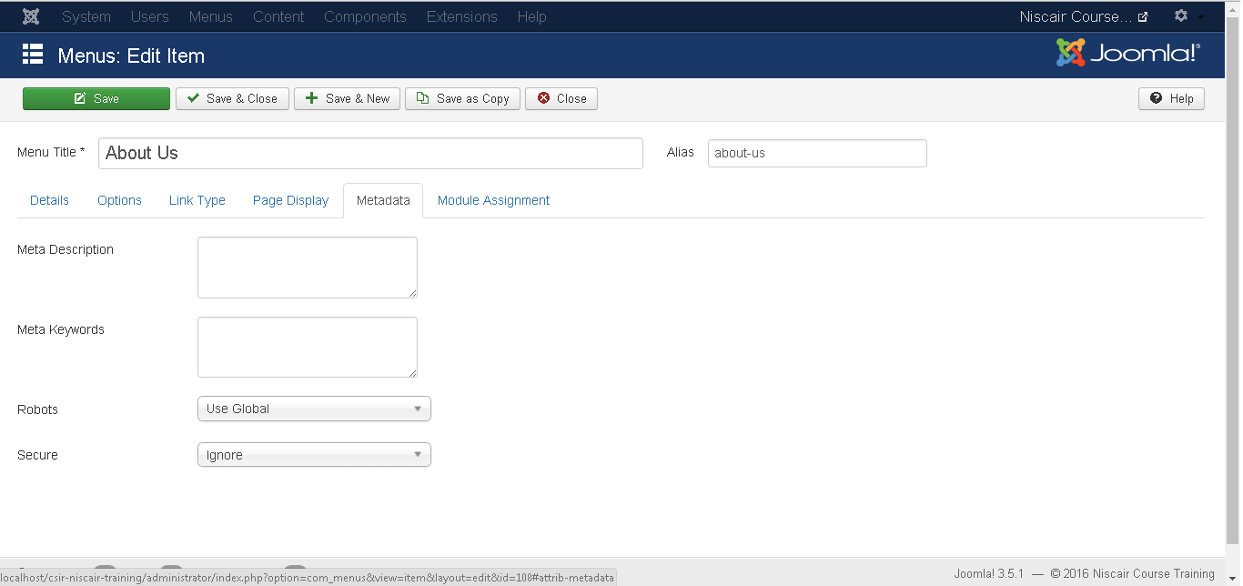
Step (6): Click on Metadata tab we get the screen given below.
Meta Description: It is used as optional paragraph which includes description of the page and displays in the results of the search engines.
Meta Keywords: These are the optional keywords to be used in the html page.
Robots: It specifies robotic instructions such as Use Global, Index, Follow, No Index, No follow.
Secure: It defines whether link must use SSL or Secure Site URL. It provides three options such as Off, On and Ignore.

Slide 17
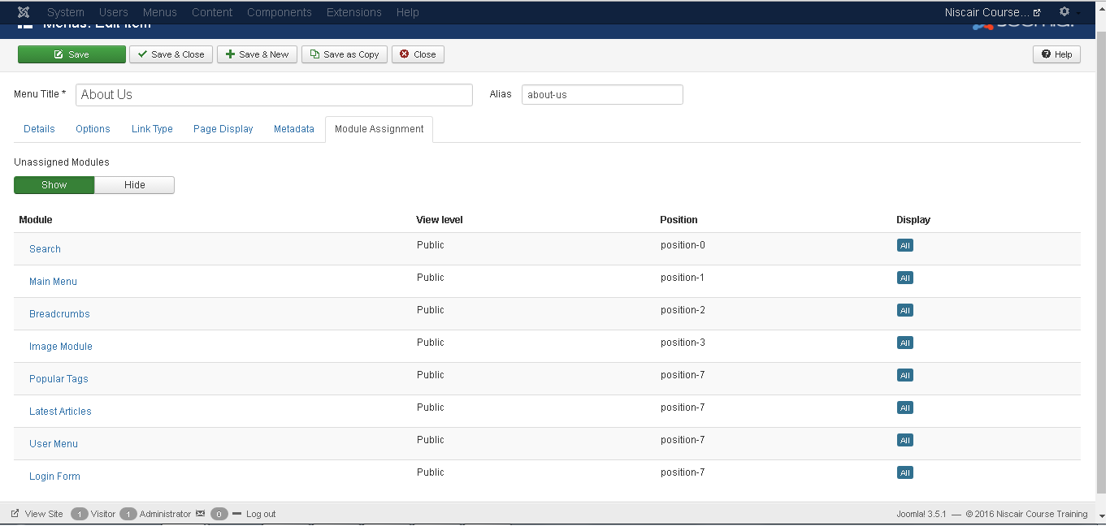
Step (7): The Module Assignment controls the module display on the page by
assigning modules in menu items.
Toolbar
Save: Saves your created menu items.
Save & Close: Saves the menu item and closes the current screen.
Save & New: Menu item will get saved and it will open a new adding menu items screen.
Cancel: Cancels the current action.

Slide 18
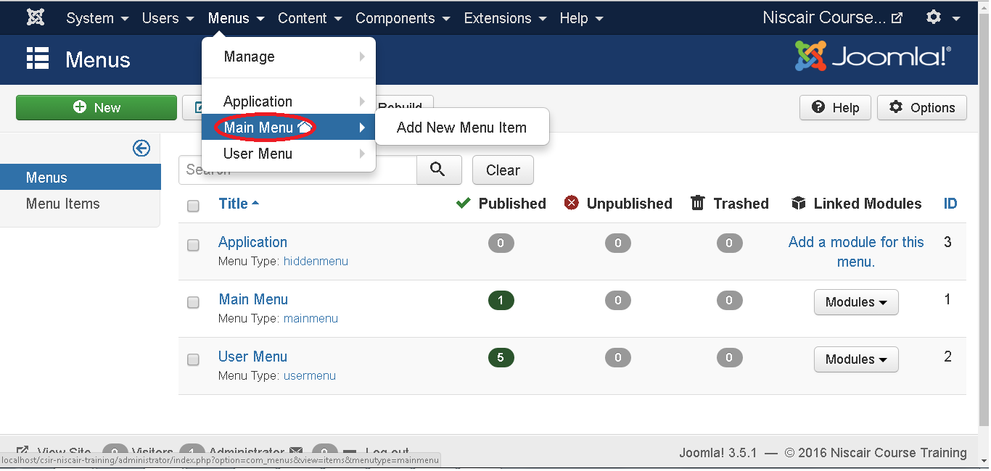
MODIFY MENU ITEMS
Step (1): Click on Menus -->Main Menu

Slide 19
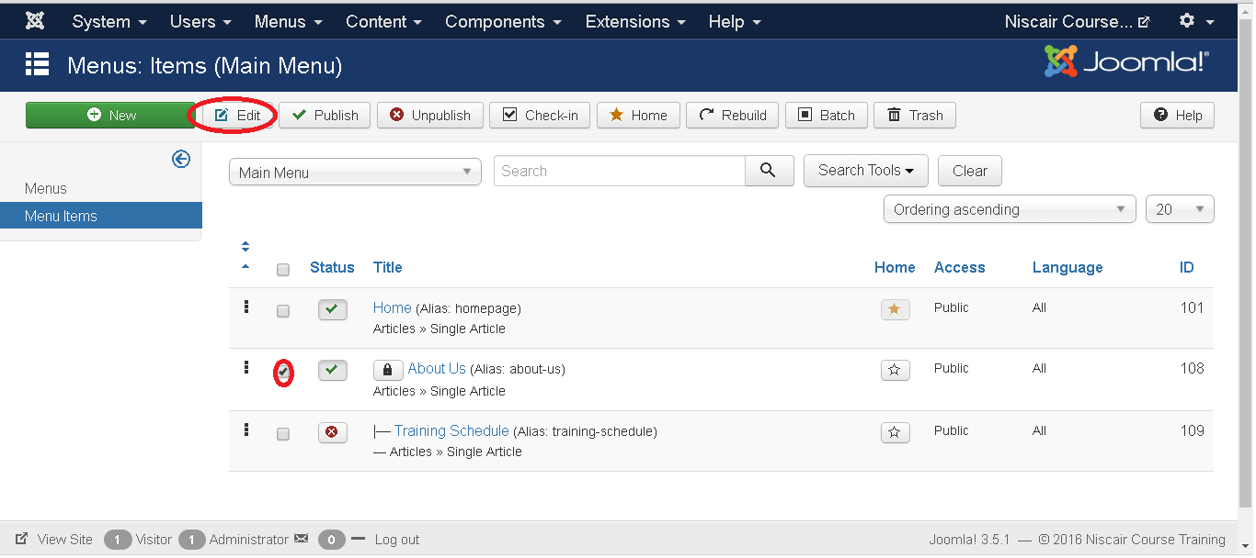
Step (2): Select a file which you would like to modify by clicking on the checkbox and then click on Edit button to open the selected page for editing as shown below.

Slide 20
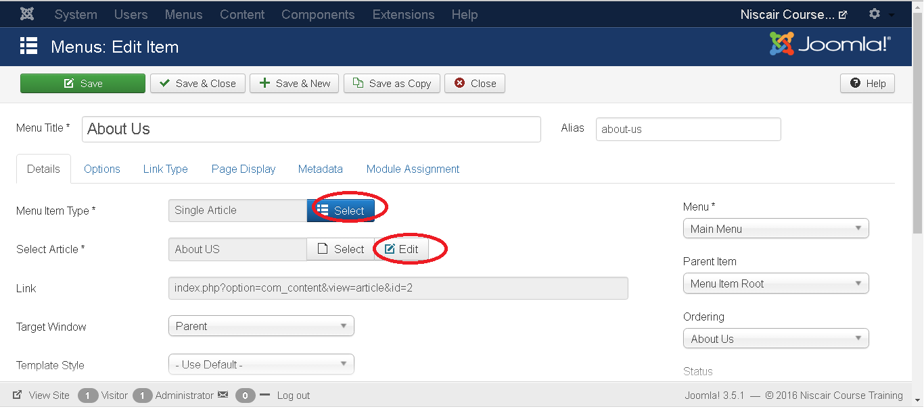
Step(3): After clicking on edit button you get the following screen. Here you can modify the file as per your choice.
Here you can change the Menu Item Type by clicking on the Select button and selecting the type of menu. And in Select Article by clicking on the Edit button you can edit any particular page or article.
Click on the save button to save the changes of the edited file.

Slide 21
CREATING SUBMENUS
Step (1): Click on Menus --> Main Menu as shown below.

Slide 22
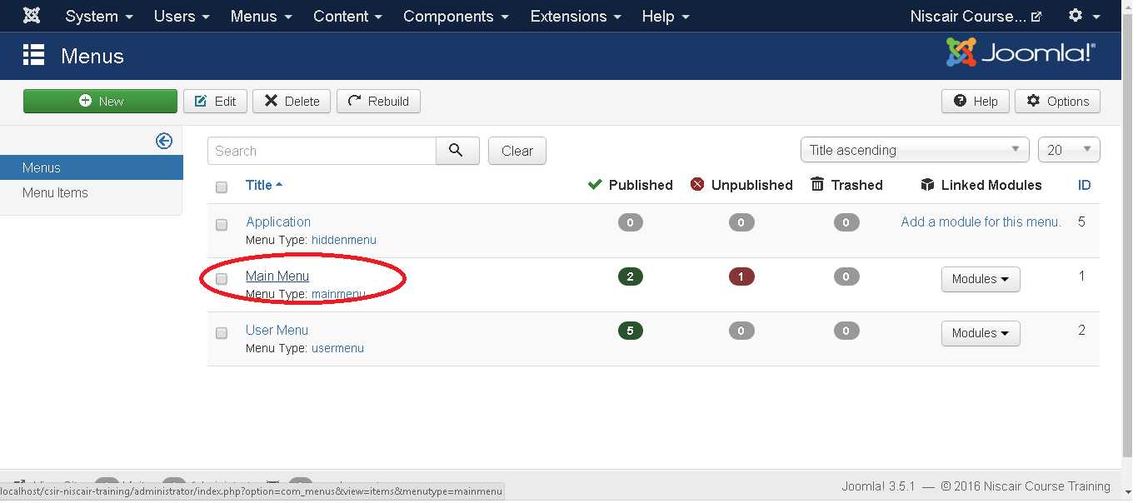
Step (2): After clicking on Menu you will get the following screen. Here we have already created a menu as Main Menu as shown below.

Slide 23
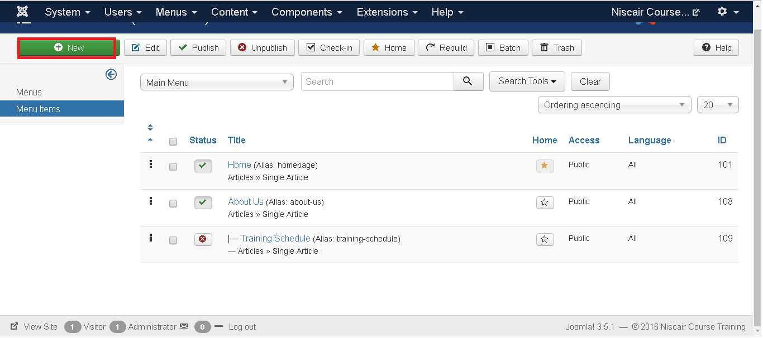
Step (3): Click directly on Main Menu link, you get the following screen.

Slide 24
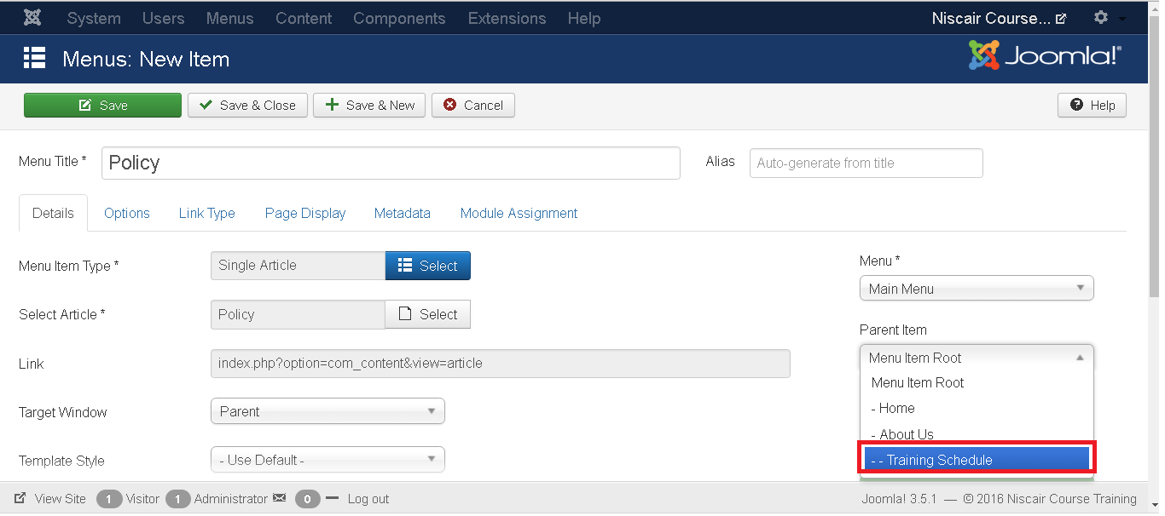
Step (4): Create a new article called as Policy and later create a menu item called Policy as shown below:
Step (5): Click on the button Save & Close.
Step (6): Repeating step (4) and step (5) we have created one more submenu called
Additional Service.

Slide 25
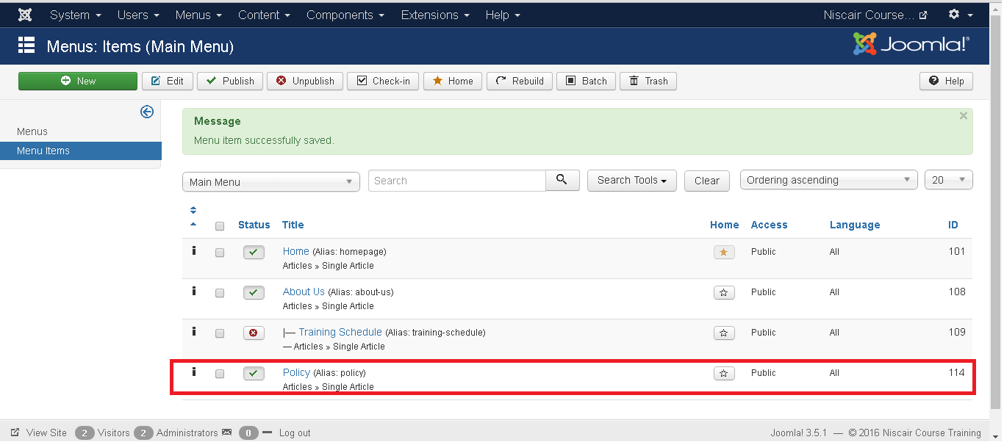
Step (7): After you have finished creating submenus in menu items, the Menu : Menu Items will look like as shown below. We can see that there are two submenus present below the Service Menu.

Slide 26
Thank You

