Slide 1
CONTENT MANAGEMENT SYSTEM
Presented by:
Mukesh A. Pund
Sr. Principal Scientist
CSIR-NISCAIR, New Delhi

Slide 2
ADMINISTRATOR WORKSPACE/JOOMLA DASHBOARD

Slide 3
CONTROL PANEL
The Control Panel provides default features and functions of Joomla to access through clickable icons, menu bar etc. When you login to the Joomla administrative panel, you will get the screen as shown below. Important icons of control panel and their functions are marked in the following screen:

Slide 4
ARTICLE CONTENT There are four icons under the CONTENT section as shown below:
Add New Article: It creates a new article page.
Article : It manages all your present articles.
Category : It creates new categories and helps in publishing/unpublishing the categories.
Media : It manages the files by uploading various new files or deleting the existing ones on your web server.
STRUCTURE FORMAT
In STRUCTURE section, there are two groups of icons:
Menu : Menu allows creating custom menus for your website and navigating through your website.
Module : It manages the modules such as location and function of modules that are installed on site.
USER INFORMATION
Under USERS section, there is one icon located:
User : It manages the user information, which allows creating or deleting the user, changing passwords, time and languages. You can also assign the user to User Groups.

Slide 5
SET THE CONFIGURATION
Three icons are located under the CONFIGURATION section as given below:
Global Configuration: This is an important part in the Joomla back-end. Any changes made in this configuration, will affect the entire website.
Template : It manages the templates used in the website.
Language : It manages installed language by setting the default language for your site.
INSTALL EXTENSION
There are many Extensions available in Joomla. You can install different types of extensions to extend the functionality of the site.
MAINTENANCE
In MAINTENANCE section, there are two icons located:
Joomla is up-to-date: It views the current update status of the Joomla installation.
All extensions are up-to-date: It views the current update status of the Joomla extension.

Slide 6
LOGGED-IN USER
It shows the administrator name who has logged in to the Joomla site.
PUBLISHED ARTICLES
It shows the published articles and also shows the present article, that you have published .
INFORMATION OF SITES
It displays the details of the site such as OS name, version of PHP and MySQL etc. and also shows the number of users that are using this site.

Slide 7
TOOLBAR
Toolbars in Joomla:
Article Toolbar
Category Toolbar
Media Toolbar
Menu Toolbar
Module Toolbar
User Toolbar
Global Configuration Toolbar
Template Toolbar

Slide 8
ARTICLE TOOLBAR
Click on Content --> Article in Joomla administrator control panel. In Article , you can create the standard pages that consist of images, text and hyperlinks. The following figure depicts the Article Toolbar.
New: Create a new article.
Edit: Edit any specific article.
Publish: Publish the article to the user on the website.
Unpublish: Unpublish the article to the user on the website.
Featured: Selected article is featured. Multiple articles can also be featured

Slide 9
Archive: It can change the status of the articles to published or unpublished by selecting archived in the select status filter.
Check In: Check-in the selected article. Multiple articles can be checked-in.
Trash: Delete the selected article permanently.
Batch: Selected articles are processed by batch.
Help: Help button is used to open the help screen.
Option: It opens the setting window where you can change the setting of the articles.

Slide 10
CATEGORY TOOLBAR
Click on Content --> Category in Joomla administrator control panel. It manages to create categorize the articles which allows to group your content better. The following figure depicts the Category Toolbar.
New: Add a new category.
Edit: Edits an existing category.
Publish: Publish the categories to the user on the website.

Slide 11
Unpublish: Unpublish the categories to the user on the website.
Archive: It can change the status of the categories to published or unpublished by selecting archived in the select status filter.
Check In: Check-in the particular selected category. Multiple categories can be checked-in.
Trash: Delete the selected category permanently.
Batch: Selected categories are processed by batch.
Rebuild: It is used to rebuild the categories tree data.
Help: Help button is used to open the help screen.
Option: It opens the setting window where you can change the setting of the articles.

Slide 12
MEDIA TOOLBAR
Click on Content --> Media in Joomla administrator control panel. It manages the files by uploading a new file or deleting the existing ones on your web server. Given below is a snapshot of the Media Toolbar.
Upload: Upload images from your system.
Create New Folder: Create a new folder on Joomla server.
Delete: Deletes the selected item/images permanently.
Help: This opens the help screen.
Option: It opens the setting window where you can change the setting of the articles.

Slide 13
MENU TOOLBAR
Click on Menus --> Menu in Joomla administrator control panel. It manages the menu items. Here new menus are created, deleted or menus are managed subsequently. Given below is a snapshot of the Menu Toolbar.
New: It creates a new menu item.
Edit: Edits the selected menu item.
Delete: Deletes the selected menu item permanently.
Rebuild: It rebuilds or refreshes the relevant menu items present.
Help: Help button is used to open the help screen.
Option: It opens the setting window where you can change the setting of the articles.

Slide 14
MODULE TOOLBAR
Click on Extension --> Module in Joomla administrator control panel. It manages the modules location and functions that are installed. The following figure depicts the Module Toolbar.
New: It creates new modules.
Edit: It edits the selected modules.
Duplicate: A copy of the selected module can be created using this button.
Publish: Publish the selected modules to the user on the website.
Unpublish: Unpublish the selected modules to the user on the website.
Check In: Check-in the particular selected modules. Multiple modules can be checked in.
Trash: Delete the selected modules permanently.
Batch: Selected modules are processed by batch.
Option: It opens the setting window where you can change the setting of the articles.

Slide 15
USER TOOLBAR
Click on Users --> User in Joomla administrator control panel. It manages all the user information such as Username, Email, Last Visit Date and Registration Date. Given below is the snapshot of the User Toolbar.
New: It creates a new user.
Edit: It edits the selected user.
Activate: It activates multiple users.
Block: It blocks the selected user.
Unblock: It unblocks the selected users.
Delete: It deletes the particular users.
Batch: Selected users are processed as a batch.
Option: It opens the setting window where you can change the setting of the articles.

Slide 16
GLOBAL CONFIGURATION TOOLBAR
Click on System --> Global Configuration in Joomla administrator control panel. It manages the global setting of the Joomla site. Given below is a snapshot of the Global Configuration Toolbar.
Save: Saves the configuration and stays on the same screen.
Save & Close: Saves the configuration and closes the screen.
Cancel: Cancels the configuration changes and returns to the previous screen without saving.
Help: Help button is used to open the help screen.

Slide 17
TEMPLATE TOOLBAR
Click on Extension --> Template in Joomla administrator control panel. It manages the templates that you use in the website. The following picture shows the Template Toolbar.
Default: Sets the particular selected style as default.
Edit: Edits the template pages.
Duplicate: Creates a duplicate template.
Delete: Deletes the template.
Help: Help button is used to open the help screen.
Option: It opens the setting window where you can change the setting of the articles.

Slide 18
LANGUAGE TOOLBAR
Click on Extension --> Language in Joomla administrator control panel. It manages the languages that you use in the website. The following picture shows the Language Toolbar.
Default: Sets the particular selected language as default.
Install Language: Install the required language.
Help: Help button is used to open the help screen.
Option: It opens the setting window where you can change the setting of the articles.

Slide 19
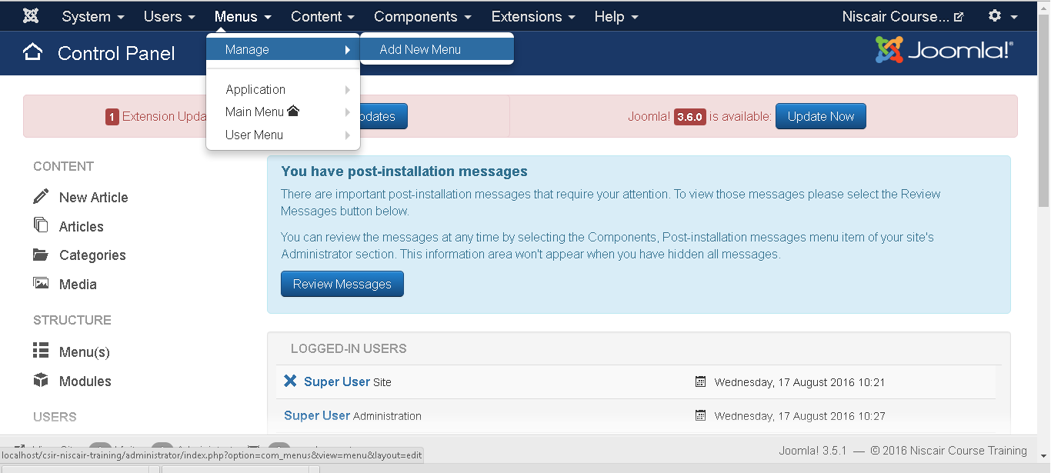
MENUS
Menu allows creating custom menus for your website and allows navigation through your website.
Step (1): Click on Menus ->Manage in Joomla administrator, you will get the following screen:

Slide 20
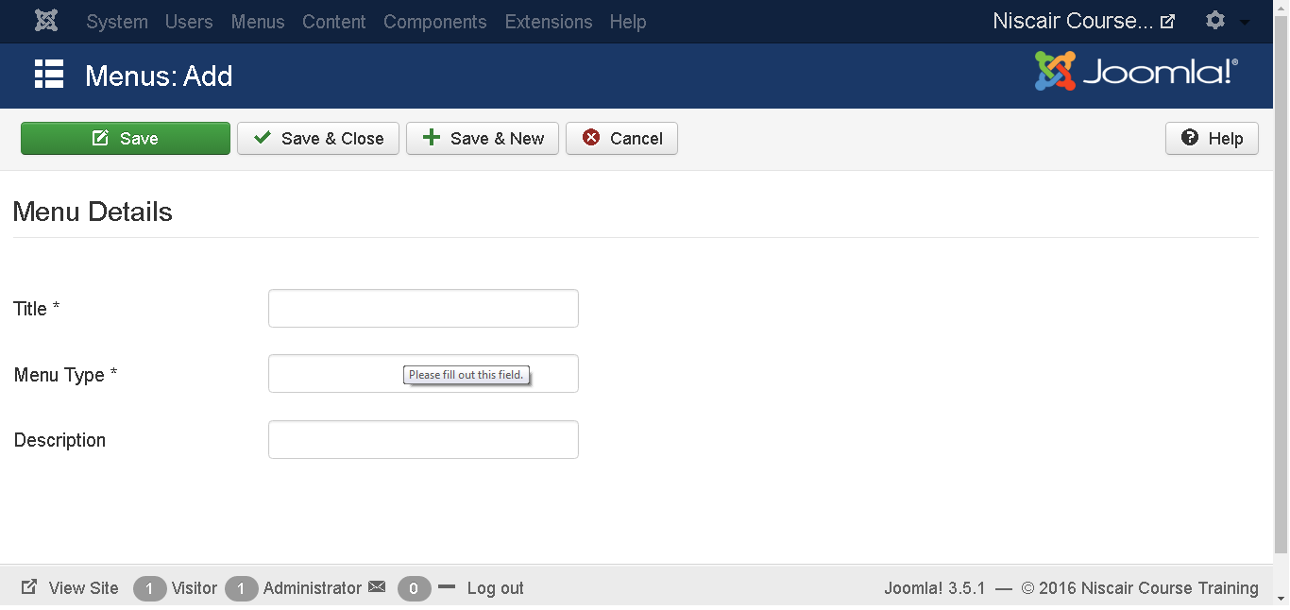
Step (2): To add a new menu to your website, go to Menus ->Manage -> New and you will get the following screen:
Title: Title of the menu.
Menu Type: Type of menu.
Description: Brief description about the menu.

Slide 21
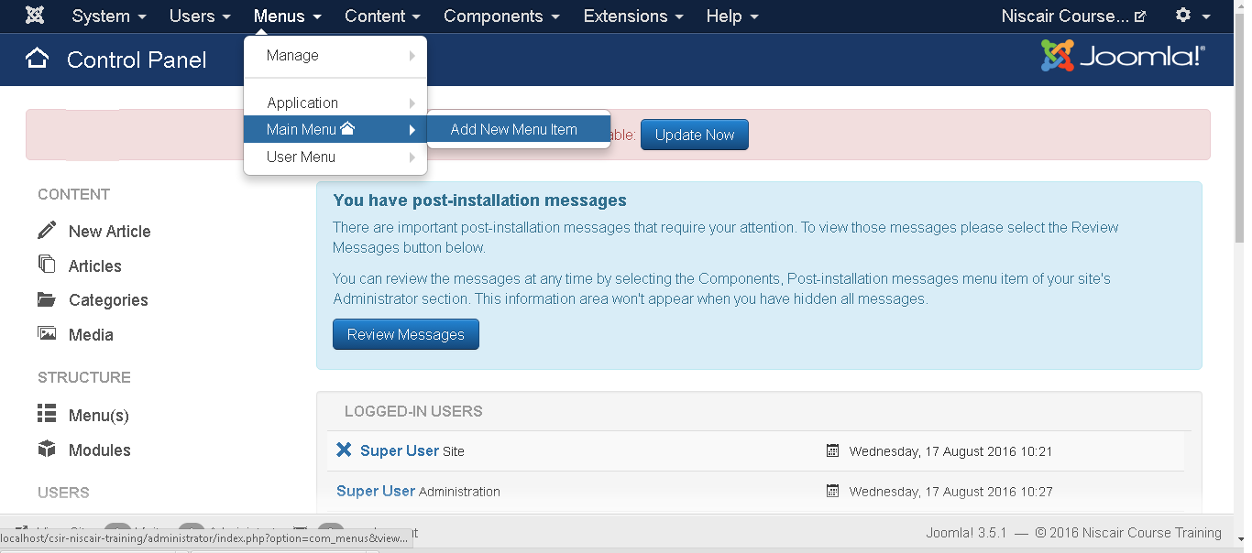
Step (3): To create a new menu item, go to Menus -> Name of the Menu -> New as shown in the following screen:
You can also add new menu item via User Menu. All the steps described below applies to menu item creation via this method.
When you open the page of a New Menu Item, you will get the following screen:

Slide 22
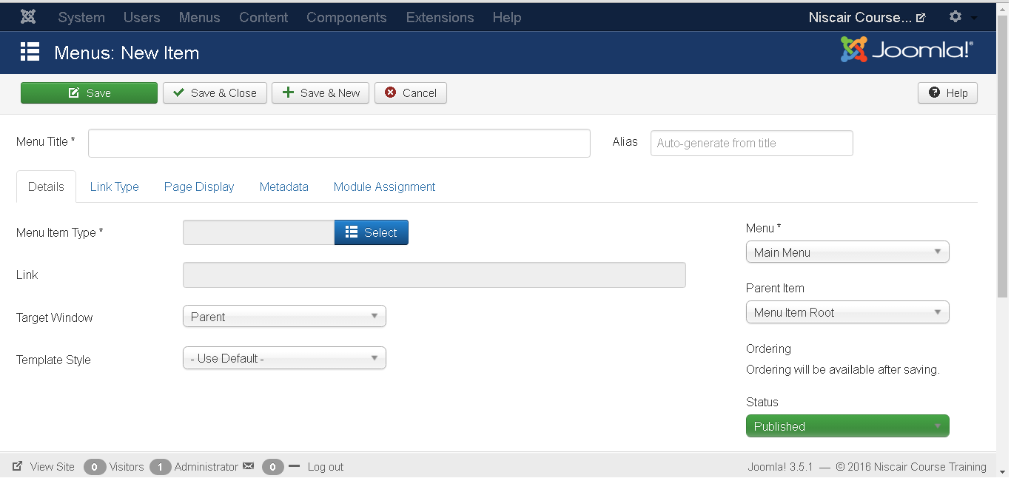
There are two main sections under New Menu Item:
Menu Title: It displays the title of the menu item in the menu.
Alias: It is used as SEF url. Joomla will automatically fill the value of the title. It will produce UTF-8 aliases; it does not allow spaces and underscores.
There are some tabs present while creating menu items as shown in the following screen:

Slide 23
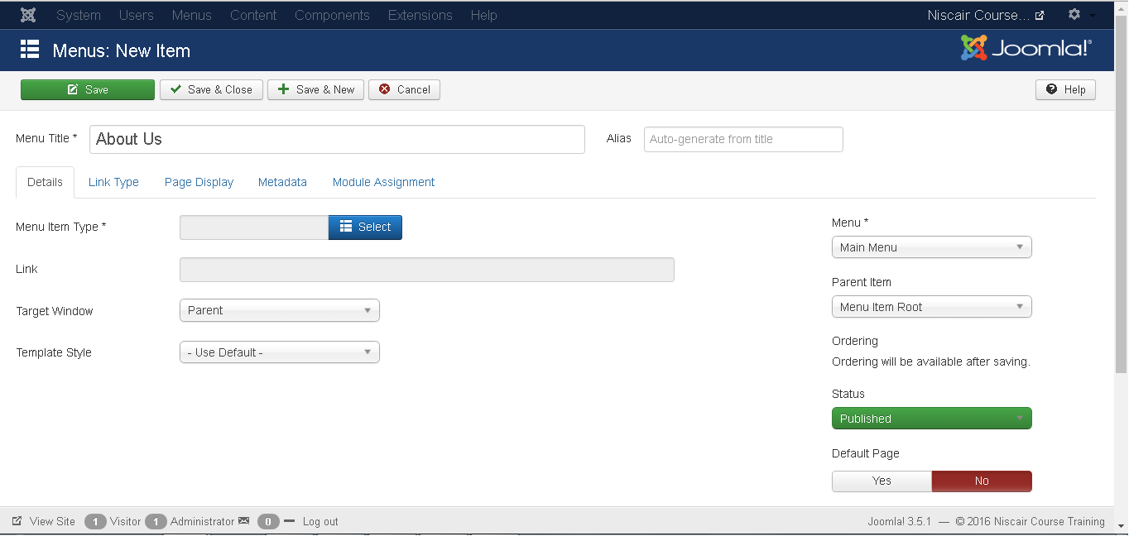
DETAILS
The Details tab in Add New Menu Item, is as shown below:
It contains the following options:
Menu Item Type: It specifies the type of menu item such as articles, tags, web links, system links, contacts etc.
Link: It determines the link in the menu.
Target Window: It provides three options: Parent, New Window with Navigation and New without Navigation which targets the browser window when a menu item is clicked.

Slide 24
Template Style: You can select a template style for your website by clicking dropdown menu which gives Beez3 - Default and protostar - Default styles or provides default templates for your website.
Menu Location: It specifies which menu link will appear; either the Main Menu or
User Menu.
Parent Item: This helps you select a parent item by selecting either Menu Item Root or Home.
Status: It displays the status of the article. Status such as Published, Unpublished and Trashed.
Default Page: It provides Yes or No options to set the menu item as default or home page of the site.
Access: Only the selected option from this dropdown list such as Guest, Public, Super Users, Registered and Special can view the site.
Language: It specifies the language of the site. It provides either ALL or English (UK) options.
Note: It is used to enter the text information.

Slide 25
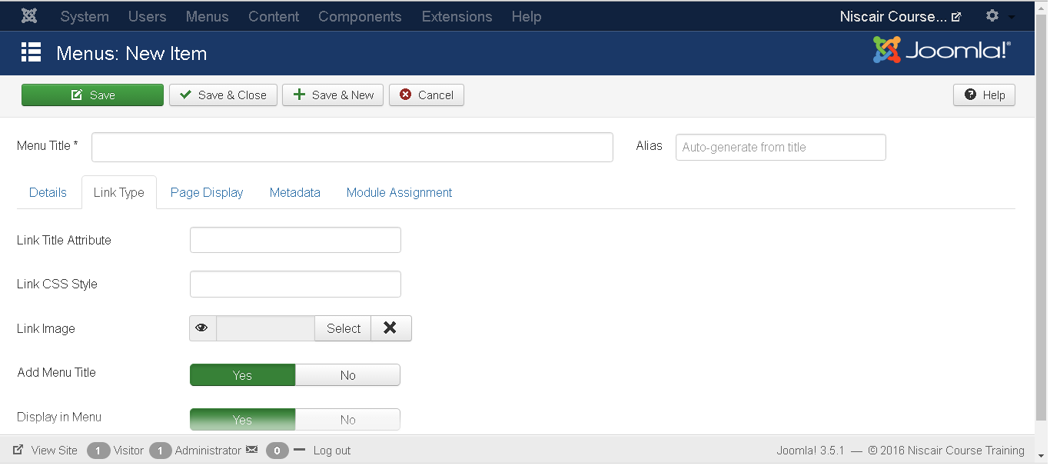
LINK TYPE The next tab is Link Type in Add New Menu Item, as shown below:
Link Title Attribute: It specifies a description for the title attribute of the given hyperlink.
Link CSS Style: It applies a custom CSS style to the hyperlink.
Link Image: It uses an image to be used with hyperlink.
Add Menu Title: It provides Yes or No options and adds the menu title next to the image. The default is Yes.

Slide 26
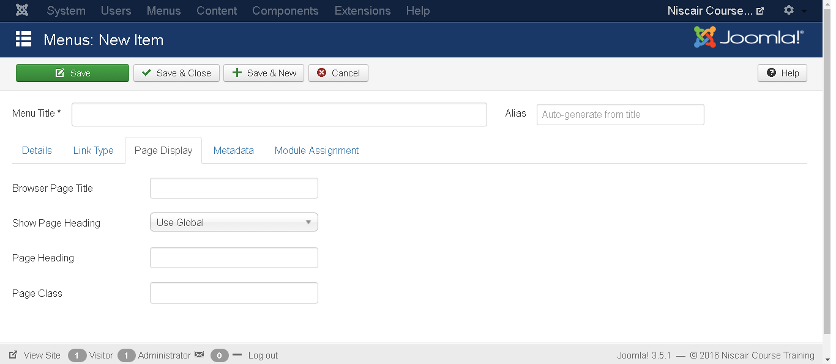
PAGE DISPLAY The next tab Page Display in Add New Menu Item, is as shown below:
Browser Page Title: It specifies the description of the browser page title.
Show Page Heading: It provides Yes or No option which hides or shows the page title in the page heading.
Page Heading: It specifies the text for the page heading.
Page Class: It defines the optional CSS class to styling the elements in the page

Slide 27
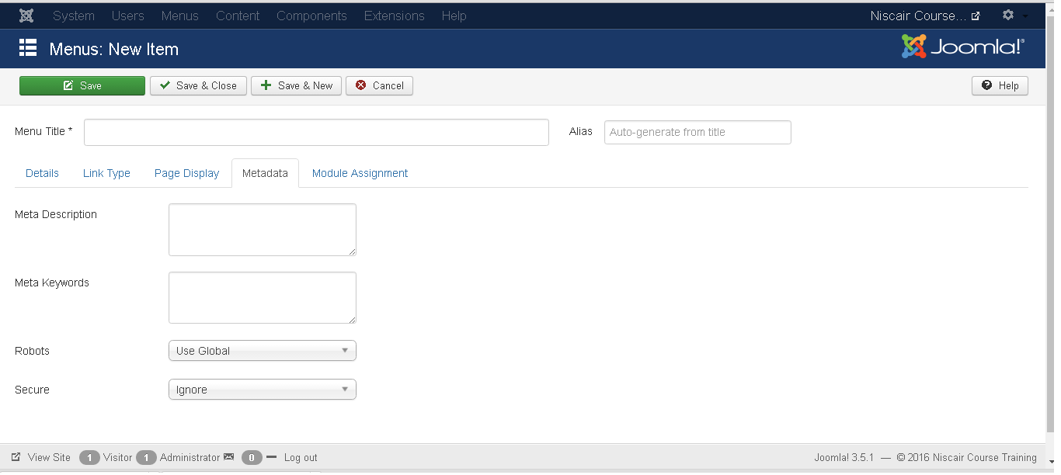
METADATA The next tab Metadata in Add New Menu Item, is as shown below:
It contains following options as described below:
Meta Description: It is used as an optional paragraph which includes a description of the page and is displayed in the results of the search engines.
Meta Keywords: These are the optional keywords to be used in the html page.
Robots: It specifies robot instructions such as use Global, Index, Follow, No Index, No follow.
Secure: It defines whether link must use SSL or Secure Site URL. It provides three options such as Off, On and Ignore.

Slide 28
CONTENT MENU

Slide 29
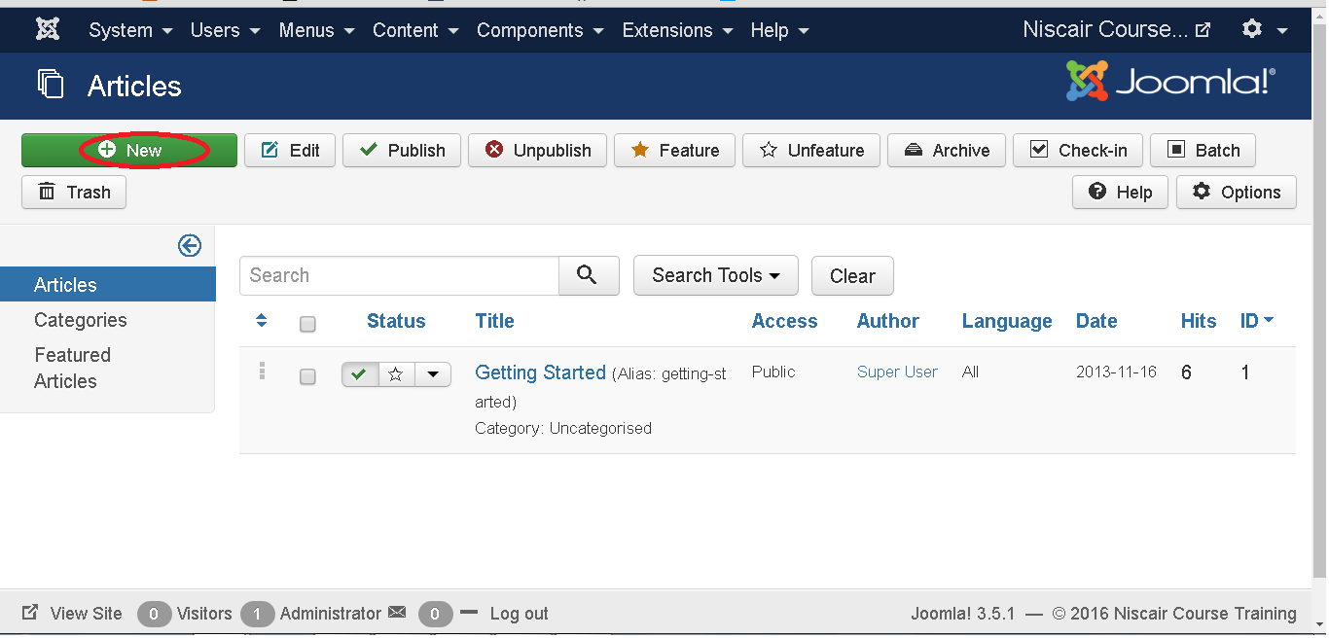
ARTICLE In Article , you can create the standard pages that consist of images, text and hyperlinks. Click on Content->Article menu on Joomla administrative panel, you will get the following screen:
Here, we have mentioned the details about the column header present on the Article page.
Checkbox: It is used to select one or more items.
Status: Specifies the status of the page or article, i.e. Publish/Unpublish/Archive/trashed.
Title: Specifies the name of the title that will be displayed in the menu.

Slide 30
Access: Specifies the access level, i.e. public or private.
Author: This is the author name who has created that particular item.
Language: Specifies the item language used.
Date: Specifies the article creation date.
Hits: Specifies the number of times the item was viewed.
ID: It is the unique identification number assigned to the items automatically.
Let us learn about the Search box in the article page which is used to search the items very easily.
Here you can search the item in the article page by selecting any of these: Select Status, Select category, Select Max Levels, Select Access, Select Author, Select language or Select Tag.

Slide 31
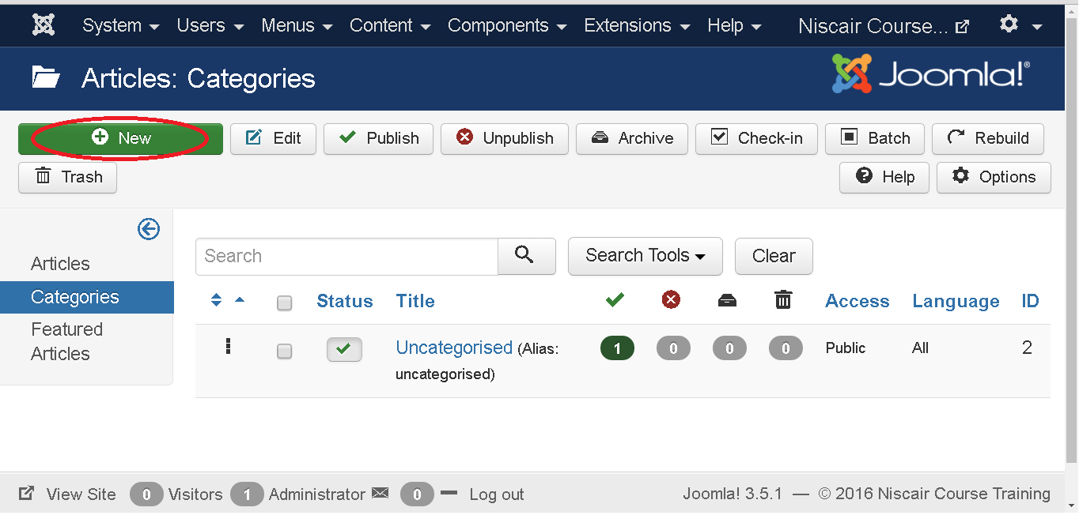
CATEGORY Category is used to create categories for the articles which allows grouping your content better. Click on Content --> Category menu on the Joomla administrative panel, then you will get the following screen image:

Slide 32
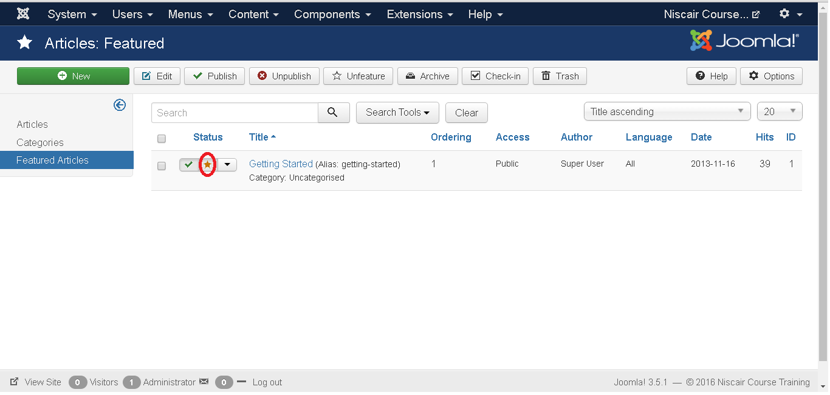
FEATURED ARTICLE
Click on Content --> Featured menu on the Joomla administrative panel, then you will get the following screen:
Here the yellow star mark indicates the article is featured. The star mark is present next to each article for featured articles.

Slide 33
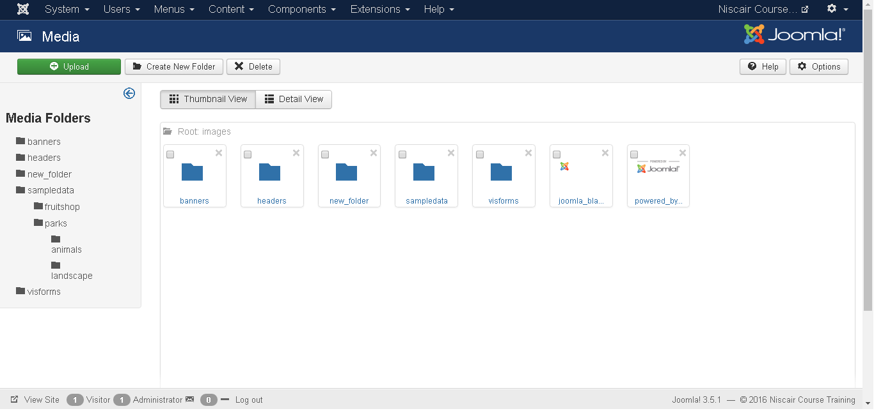
MEDIA
You can manage your media files by uploading a new file or deleting the existing ones using media . Click on Content-->Media menu on the Joomla administrative panel, then you will get the following screen:

Slide 34
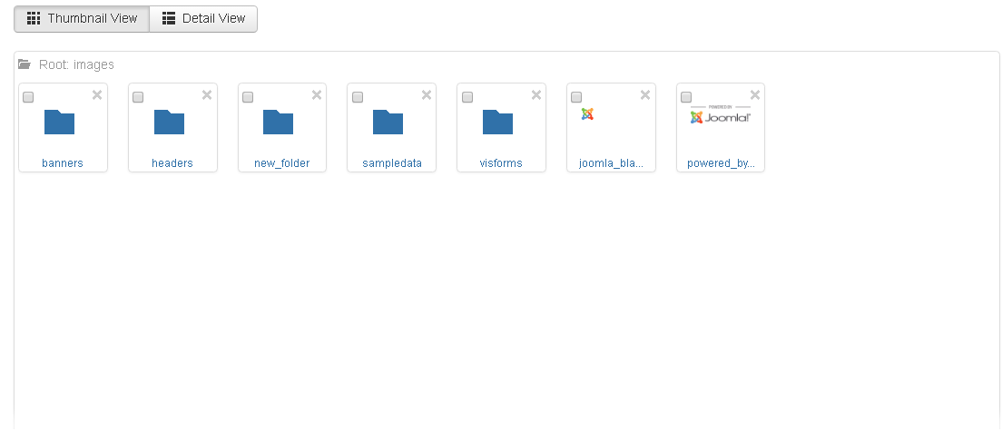
THUMBNAIL VIEW
Thumbnail view contains previews of images and icons of sub-folder. When we click on Thumbnail View then the media will look like as shown below.

Slide 35
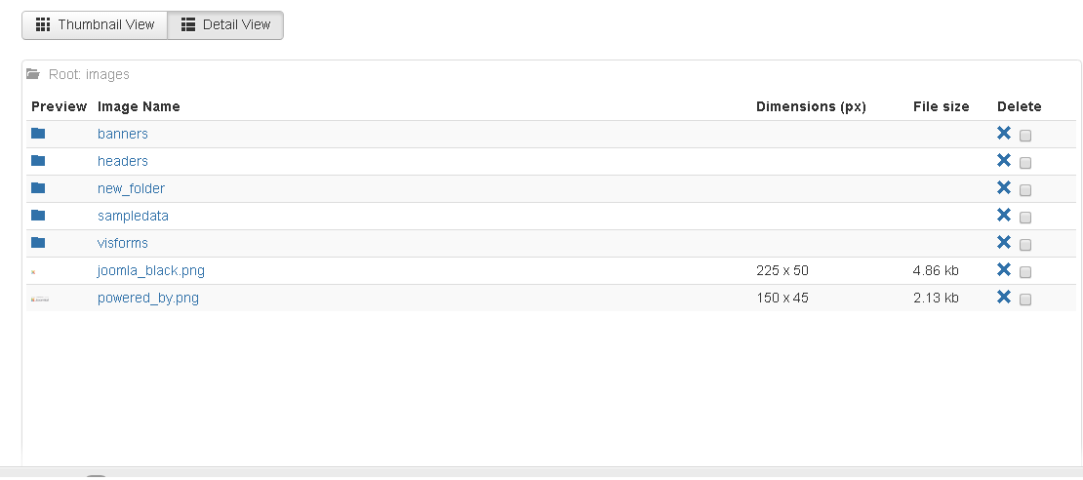
DETAIL VIEW
Detail view contains the file details. In the detail view, the file information such as dimension and file size are displayed. When we click on the Detail View then the media will look like as shown below.

Slide 36
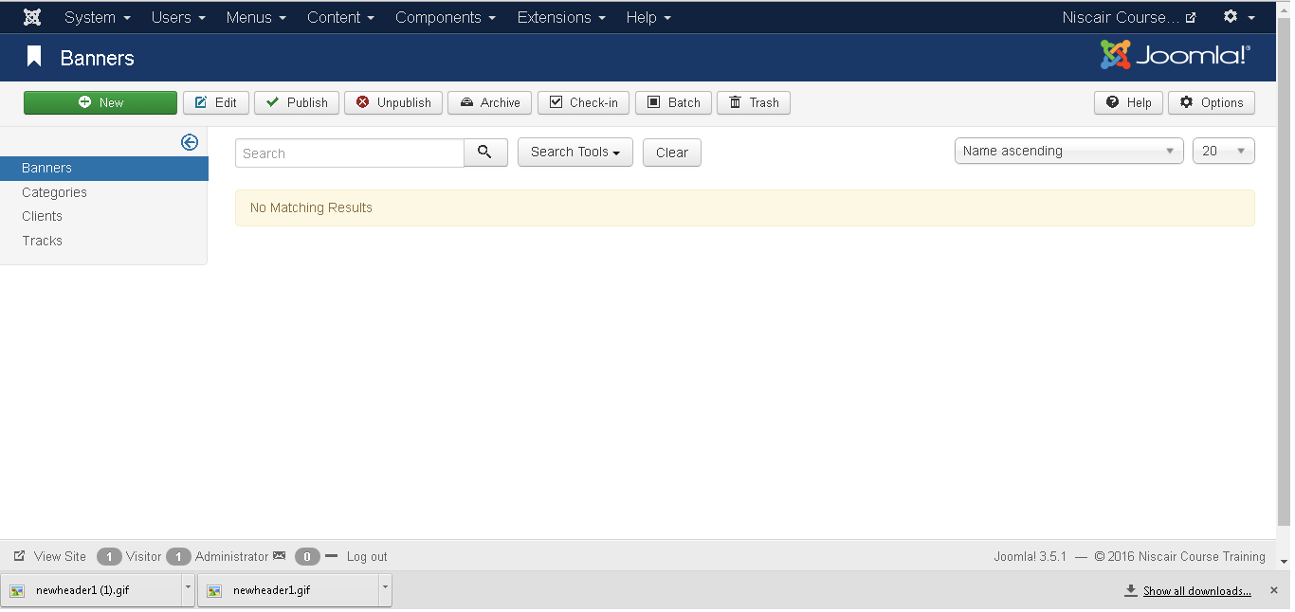
COMPONENTS MENU
BANNERS
It is used to edit or add banners in the Joomla website to display.
Click Components --> Banners --> Banners, a screen as shown below will get displayed.

Slide 37
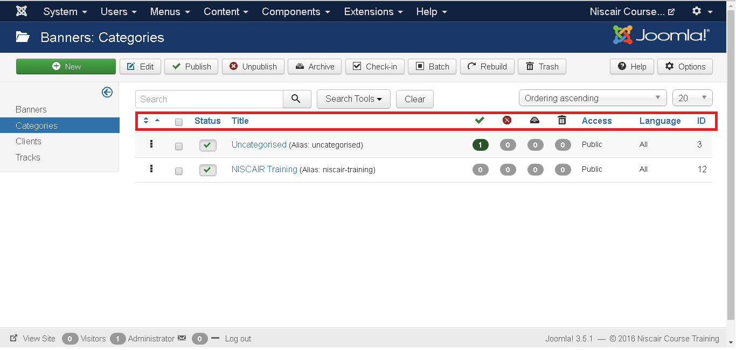
CATEGORIES
With Category you can create new banner categories or edit the existing banner categories.
Click Components --> Banners--> Categories, a screen as shown below will get displayed.

Slide 38
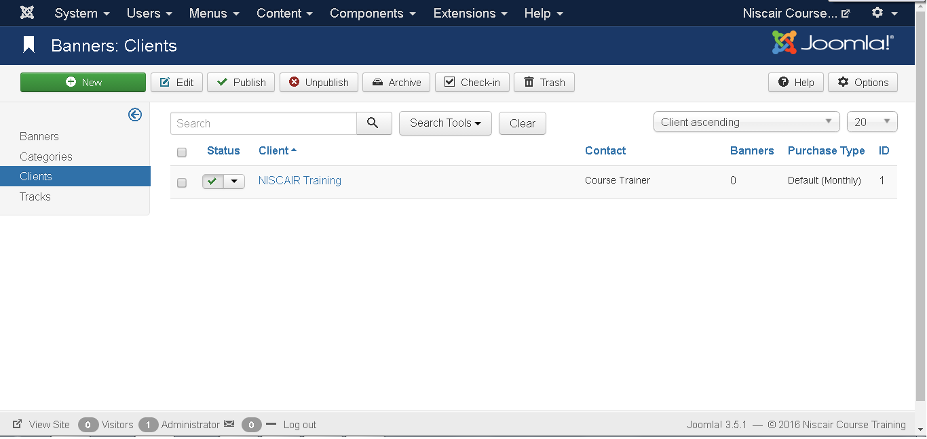
CLIENTS
With Client you can create a new client banner or edit the existing ones.
Click Components --> Banners --> Clients, a screen as shown below will get displayed.
Client: Specifies the name of the Banner clients.
Contact: Specifies Contact information of the client.
Banners: Specifies the number of banners defined for this client.
Purchase Type: It indicates how the clients are purchasing the banners i.e. Yearly or Monthly. By default it is monthly

Slide 39
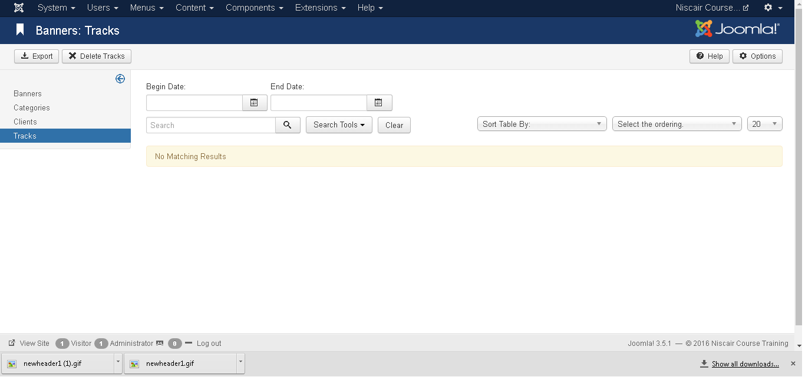
TRACKS In Tracks, you can view the tracking information for a list of existing banners.
Click Components --> Banners--> Tracks, a screen as shown below will get displayed.

Slide 40
The Begin Date and End date, in previous slide is used to track the information of the banner within a particular period (For instance, consider begin date as 2015-07-06 and end date as 2015-07-10, within this period of time the banner information will get tracked).
Export: It exports the banner tracking information in the CSV file.
Delete Tracks: Deletes the information of the selected tracks.

Slide 41
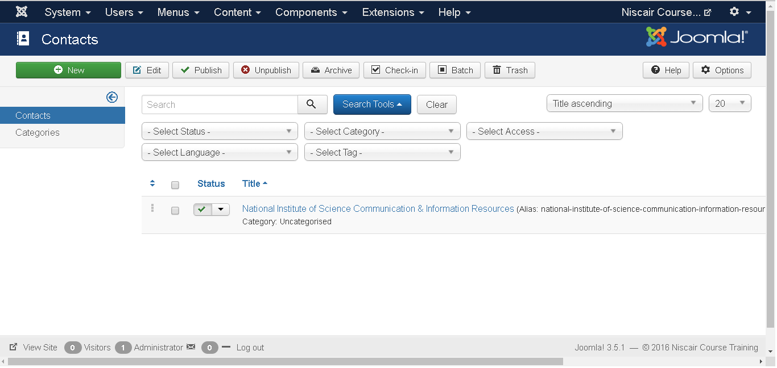
CONTACTS
It adds contact information of client on Joomla site such as name, address, telephone number, email etc.
Click Components --> Contacts --> Contacts, a screen as shown below will get displayed.

Slide 42
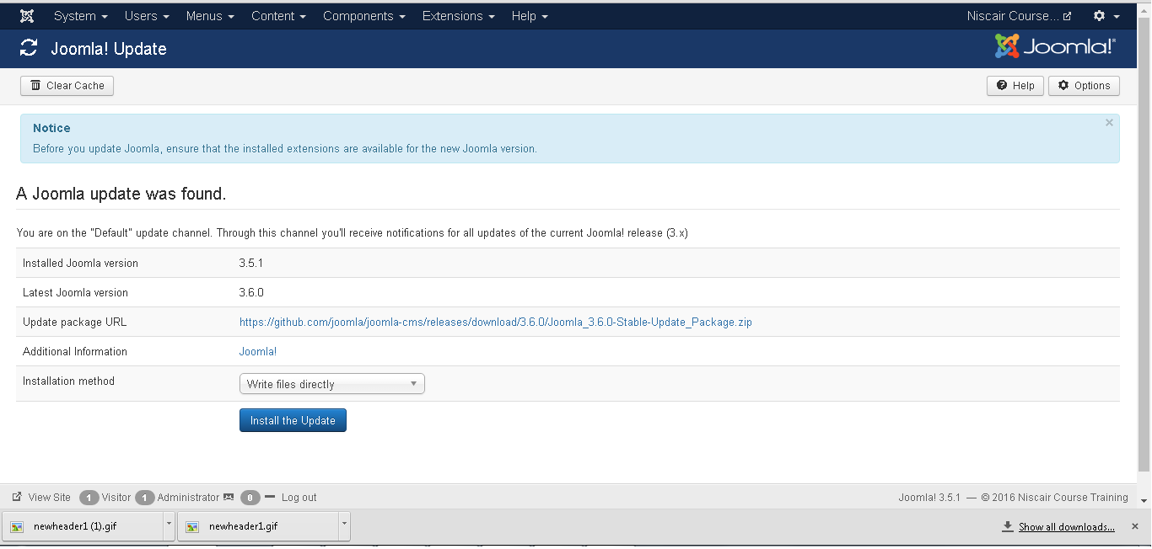
JOOMLA UPDATE
It specifies the Joomla latest version which is being used.
Click Components --> Joomla! Update, a screen as shown below will get displayed.

Slide 43
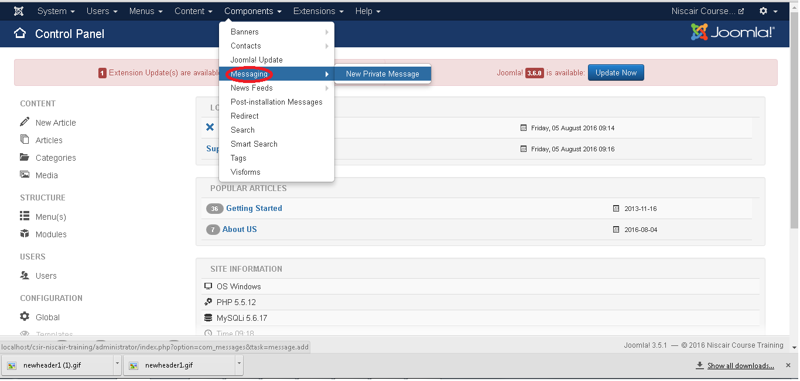
MESSAGING
Components --> Messaging allows sending and reading messages in Joomla. When you click on Messaging, you see a submenu as shown below.

Slide 44
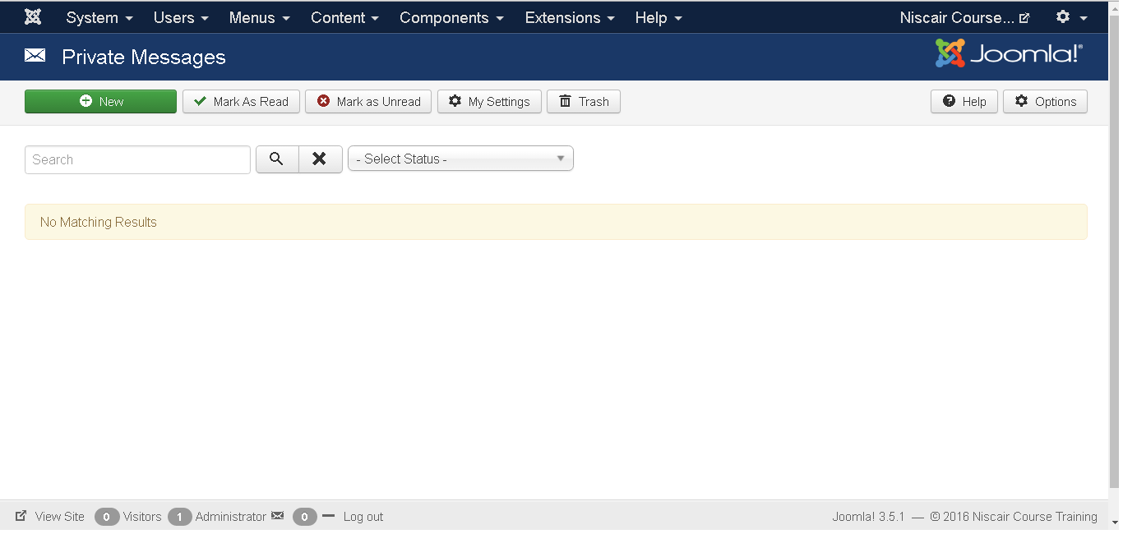
NEW PRIVATE MESSAGE
It is used to send messages to the other backend of Joomla site. You can read, write or delete the messages.
Click Components --> Messaging --> New Private Message.

Slide 45
TOOLBARS Below, we have mentioned details about the toolbars present in Read Private Message.
New: Creates a new message.
Mark as Read: Marks the messages as read from this section.
Mark as Unread: It marks the messages which have not been read yet.
Trash: It deletes the messages permanently.
My Settings: It is used to set the messages i.e. Lock the inbox, email a new message and auto-purge the message.

Slide 46
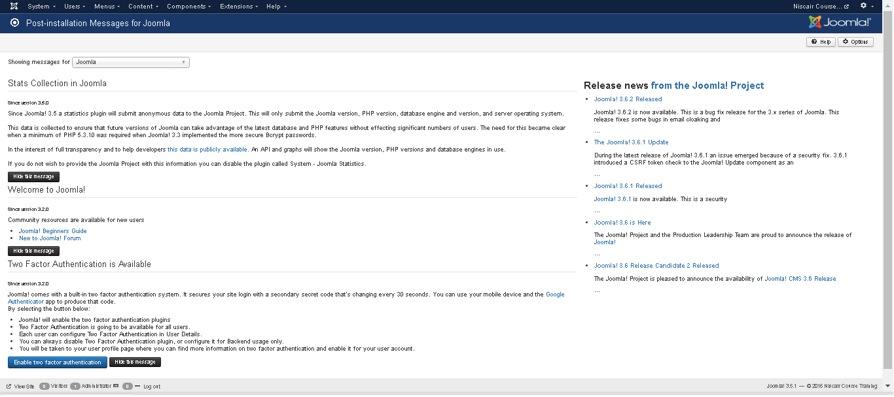
POST-INSTALLATION MESSAGES
It allows reviewing actionable messages after installation.
Click Components --> Post Installation Messages, a screen as shown below will get displayed.
Here it delivers messages after successful installation of Joomla extension or core

Slide 47
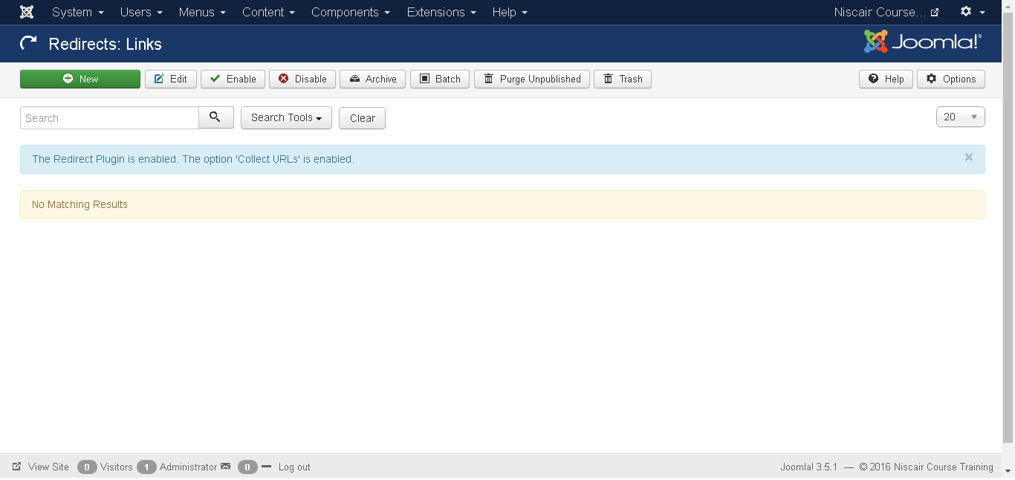
REDIRECT
Redirect is used to redirect the URLs that do not exist on the website with web pages that are working.
Click Components --> Redirect, a screen as shown below will get displayed.

Slide 48
The details about the column header present in the Redirect page are mentioned below.
Checkbox: It is used to select one or more items by clicking on the box.
Expired URL: The URL is redirected towards the website.
New URL: Redirects the designated URL.
Referring Page: Redirects the referring web pages.
Created Date: Specifies the date the URL was created.
404 Hits: The pages were not forwarded after making the number of requests.
ID: It is the unique identification number assigned to the items automatically.
TOOLBARS
Below, we have mentioned details about the toolbars present on Redirect page.
New: Creates a new Redirect URL.
Edit: Edits the selected redirect.
Enable: It makes available the selected redirect to use.
Disable: It makes unavailable the selected redirect to use.
Archive: It can change the status of the selected redirect to published or unpublished by selecting archived in the select status filter.
Trash: It changes the status of the selected redirect to trash.

Slide 49
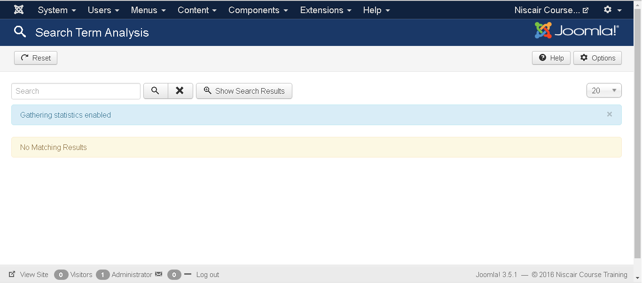
SEARCH
Search allows you to see how many searches were done for each key combination and what was the result for each search.
Click Components --> Search, a screen as shown below will get displayed.

Slide 50
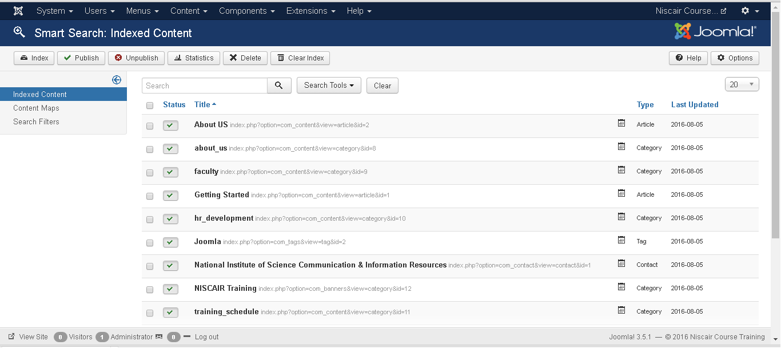
SMART SEARCH
It enhances site search.
Click Components --> Smart Search, a screen as shown below will get displayed.
Checkbox: It is used to select one or more items by clicking on the box.
Status: Specifies the status of the items i.e. Publish/Unpublish.
Title: Specifies the name of the title.
Type: Specifies the type of the page i.e. Article or Tag.
Last Updated: Specifies the date of the last modification.

Slide 51
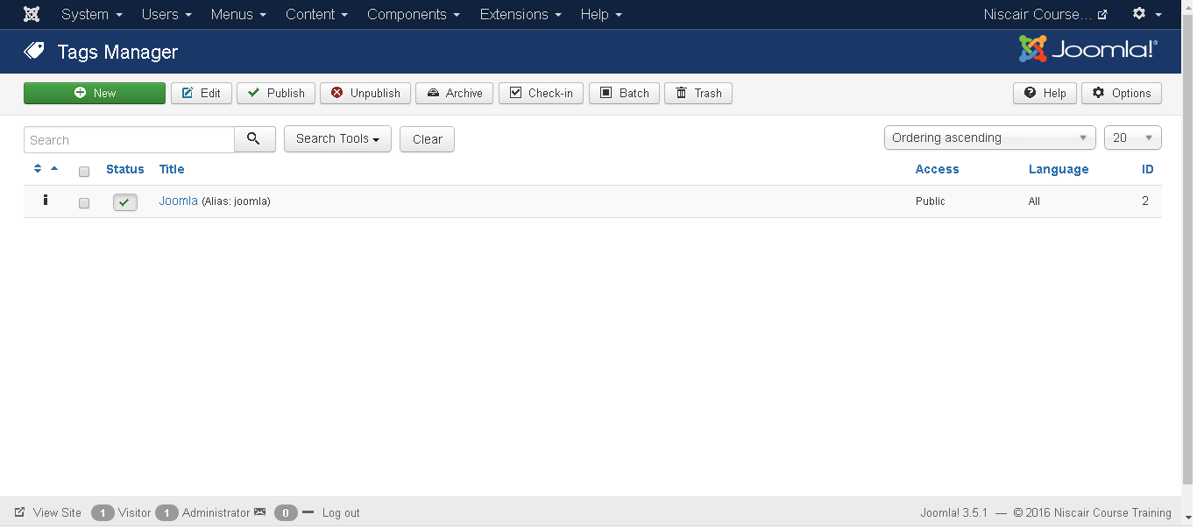
TAGS
It is used to display the list of the tagged pages.
Click Components --> Tags, a screen as shown below will get displayed.

Slide 52
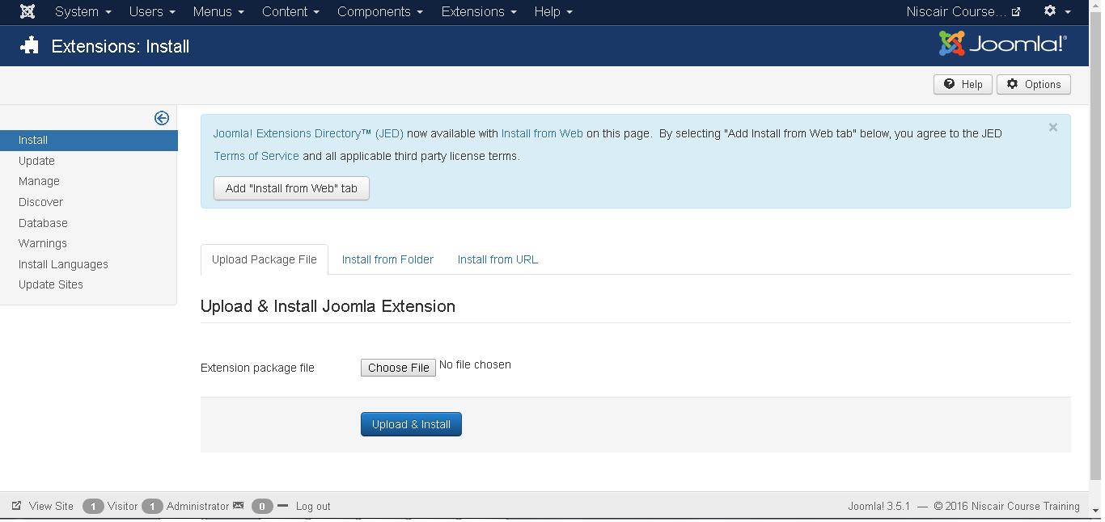
EXTENSIONS MENU
EXTENSIONS
Extension is used to extend the functionality of Joomla website.
Click Extensions --> Extension , a screen as shown below will get displayed.

Slide 53
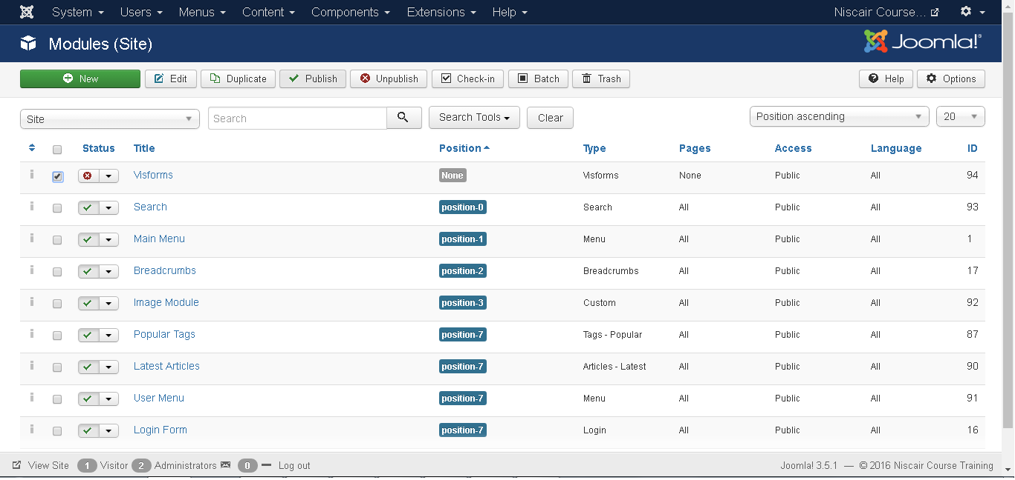
MODULE
It manages the modules that are installed on the site i.e. the location and function of modules.
Click Extensions --> Module , a screen as shown below will get displayed.

Slide 54
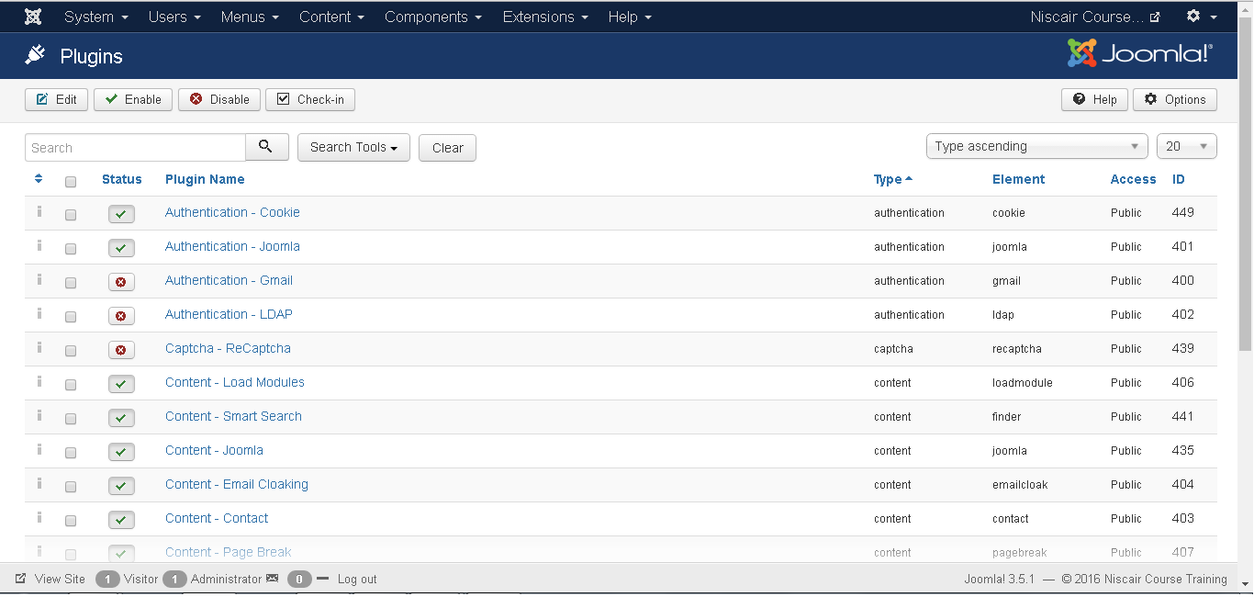
PLUGINS
It manages the Joomla plugins and allows to enable/disable or edit the details of plugins. Click Extensions --> Plugins , a screen as shown below will get displayed.

Slide 55
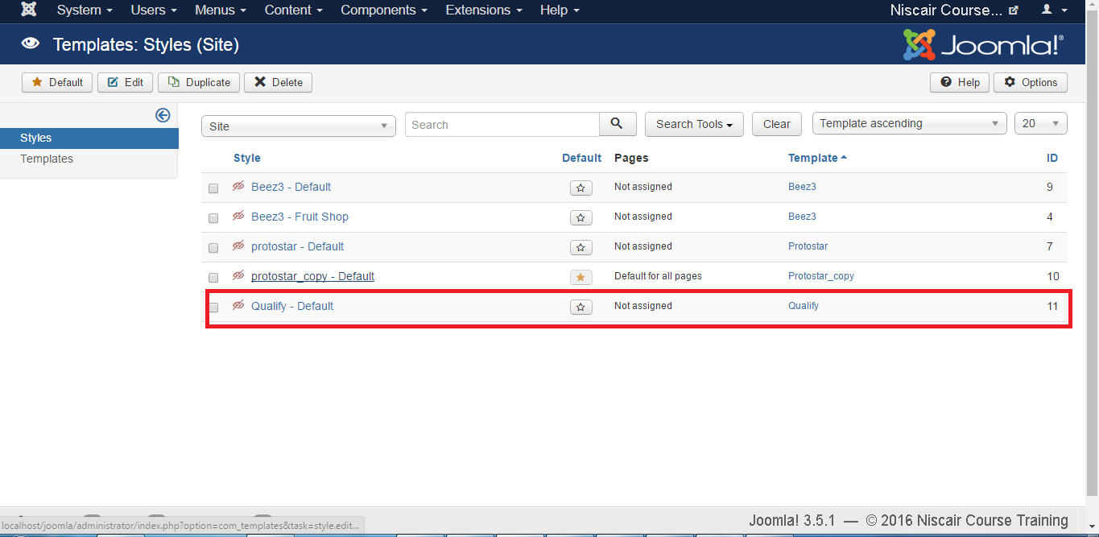
TEMPLATE
It manages the designs that are used in the website. The templates can be implemented without changing the content structure within a few seconds.
Click Extensions --> Template , a screen as shown below will be displayed.

Slide 56
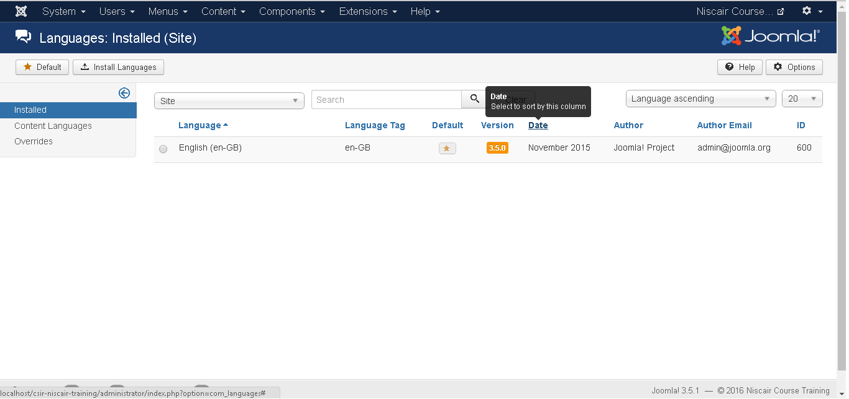
LANGUAGE
This helps you set a default language for your site.
Click Extensions --> Language a screen as shown below will get displayed.

Slide 57
Thank You

