Slide 1
CONTENT MANAGEMENT SYSTEM
Presented by:
Mukesh A. Pund
Principal Scientist
CSIR-NISCAIR, New Delhi

Slide 2
JOOMLA GLOBAL SETTINGS

Slide 3
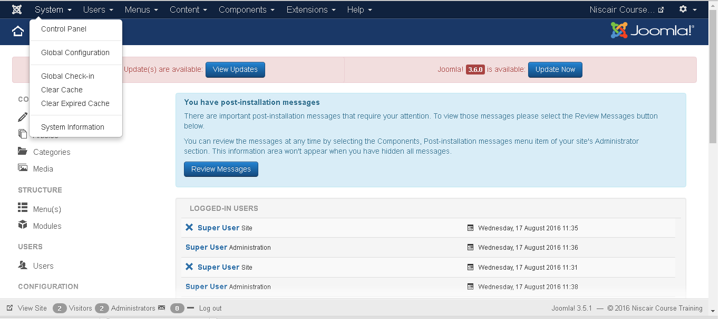
SYSTEM SETTINGS
The Global Configuration is used for configuring Joomla site with your
personal settings. To access the system settings, just follow the following
steps:
Step (1): Go to System --> Global Configuration as shown in the following
screen.

Slide 4
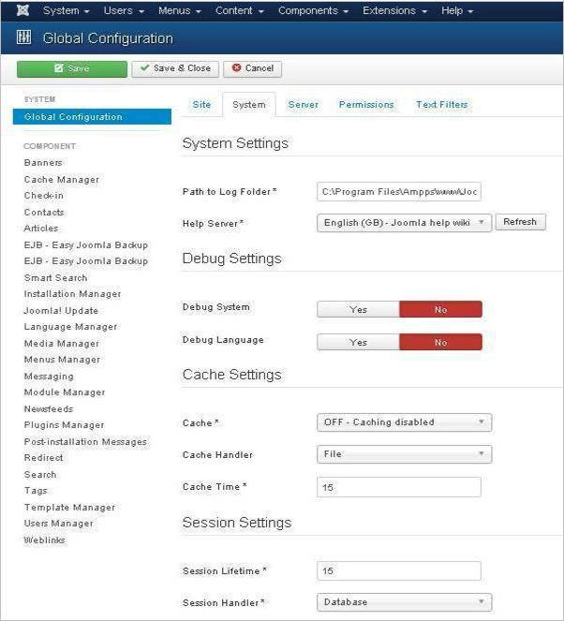
Step (2): Under Global Configuration section, click on the System tab to get
System Settings as shown in the following screen.

Slide 5
Under System Settings, you can see there are two options:
Path to Log Folder: It gives a path to store the logs by Joomla. This path is automatically set up on Joomla installation and should not be changed.
Help Server: It provides help information when the button is clicked. It uses appropriate language for the help service. It uses Joomla main help site by default.
DEBUG SETTINGS
The Debug Settings contain two options:
Debug System: It is a debugging system of Joomla which provides debug information by setting it to "Yes". It provides various forms such as diagnostic information, language translations and SQL errors. The default setting is "No".
Debug Language: It provides debug language translations for Joomla site by setting it to "Yes".

Slide 6
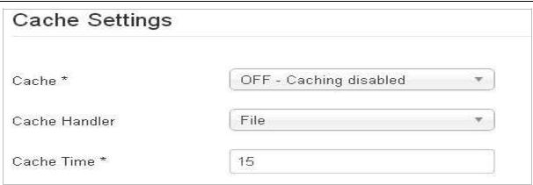
CACHE SETTINGS
The Cache Settings contain three options:
Cache: It specifies whether the cache is enabled or not. It reduces the load used by the websites to a web server. The default is "OFF - Caching disabled".
Cache Handler: It provides file-based caching mechanism for cache handling.
Cache Time: It specifies the maximum time for a cache file before it is refreshed. The default cache time is 15 minutes.

Slide 7
SESSION SETTINGS
The Session Settings contain two options:
Session Lifetime: It defines the session time for users who remain signed in. The default session is 15 minutes.
Session Handler: It provides session handler which informs how the session should be handled after a user logs into the site. The default setting is "Database".
Toolbar
Following are the details about the toolbar function tabs:
Save: Saves your setting.
Save & Close: Saves the settings and closes the current screen.
Cancel: Cancels the setting in Joomla.

Slide 8
SYSTEM SETTINGS
MEDIA SETTINGS
Joomla Media Settings help to configure the global media files options such like file format, MIME Specifications, Upload of files, Size of files, etc.
Step (1): Go to System --> Global Configuration as shown in the following
screen.

Slide 9
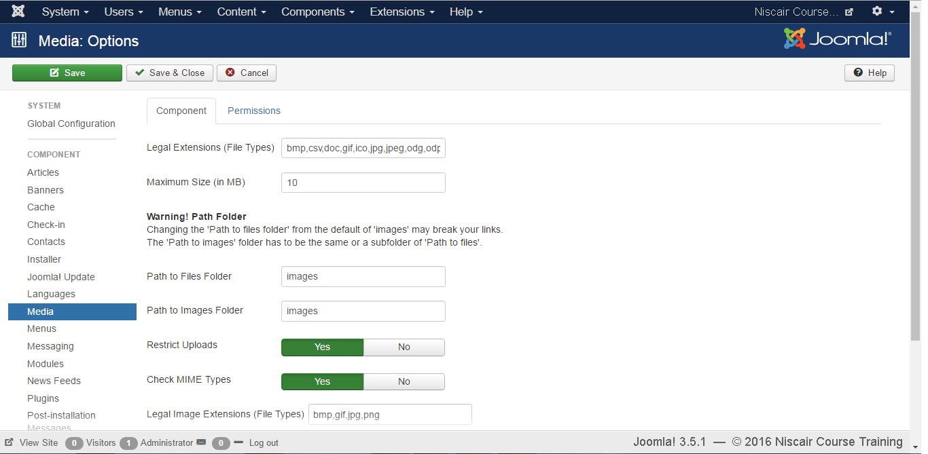
Click on Media in Joomla Global Configuration. You will get to see the
following screen and fill the fields with appropriate values.

Slide 10
Below we have mentioned the details of the fields present in
the Joomla Media Settings page:
Legal Extensions (File Types): Provide an extension for the user file uploads which are separated by the comma (,). For example: jpg, png, json....
Maximum Size (in MB): Maximum size of the file in MB i.e. allowed for an uploading.
Path to files folder: Provide the path for the file folder i.e. related to the root of the Joomla installation directory.
Path to images folder: Provide the Path for the image folder i.e. related to the root of the Joomla installation directory.
Restrict Uploads: It restricts a user to upload the image files, if there is no
Permission if File info or MIME Magic isn't installed on the server.
Check MIME Types: MIME Magic or File info is used to verify the MIME types.
Legal Image Extensions (File Types): Check for valid image headers of image files.
Ignored Extensions (File types): Ignores the file types which are specified in this field with comma separated.
Legal MIME Types: Specifies the legal MIME types separated by comma.
Illegal MIME Types: Specifies the illegal MIME types separated by comma.

Slide 11
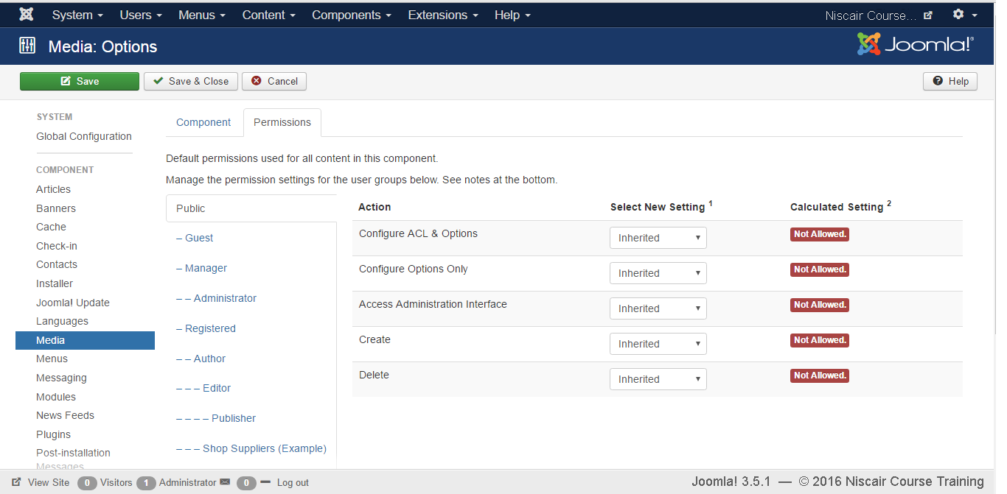
Step (2): Click on Permission and select the required options from the
dropdown menu.

Slide 12
The following steps describe how to change the permissions for the Media
component:
Step (2.1): You can select the Title that is listed in the Group, located on the right.
Step (2.2): The possible desired Actions are:
Configure: Users can configure this component.
Access Administration Interface: Users are able to access the administration interface.
Create: Users can create the content in this component.
Delete: Users can delete any content that is defined in this component.
Step (2.3): Select the Permission for an Action that you want to change:
Inherited: The Global Configuration, Component Configuration, Article Options, or Category permissions are used to inherit for users in this Group.
Allowed: This shows the allowed Users for this Group.
Denied: This shows the denied Users for this Group.

Slide 13
SYSTEM SETTINGS
LANGUAGE SETTINGS
Joomla Language option is used to set native title, language code, SEF Prefix, and Image Prefixes of the installed or to be installed languages.
Step (1): Go to System --> Global Configuration as shown in the following
screen.

Slide 14
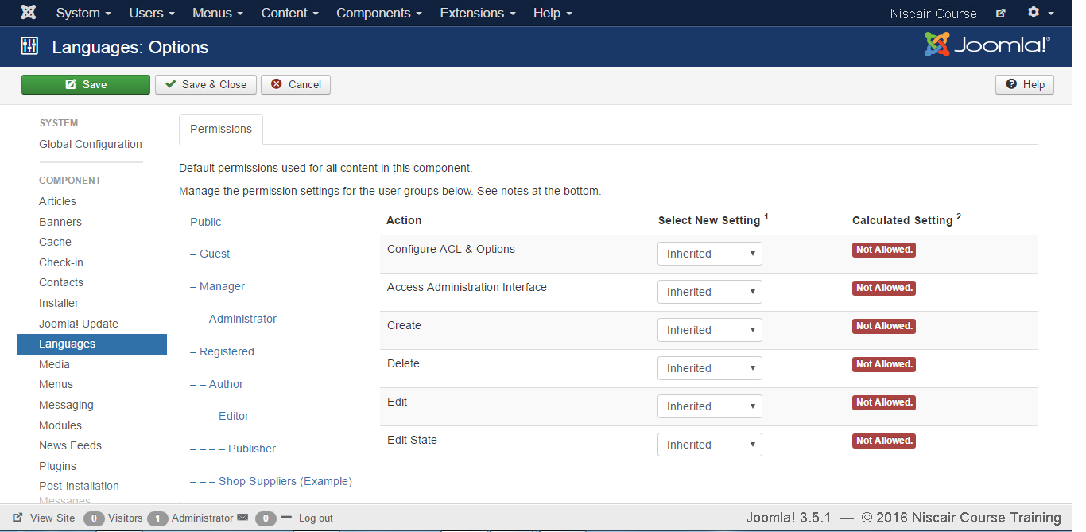
Next, click on the Language in Joomla Global Configuration and you will get
the screen as shown below.

Slide 15
Below we have mentioned the details of the fields present in the Joomla Language page.
Configure: Configure the installed language.
Access Administration Interface: Users are able to access the administration interface.
Create: It creates new languages in the component.
Delete: It deletes the created new languages in the component.
Edit: It edits an existing language.
Edit State: Changes the language state such as Publish, Unpublished, Archive and Trash in the component.
Toolbar
Following are the toolbar options in the Language .
Save: Saves your language setting.
Save & Close: Saves the language setting and closes the current screen.
Cancel: Cancels the language setting in Joomla.

Slide 16
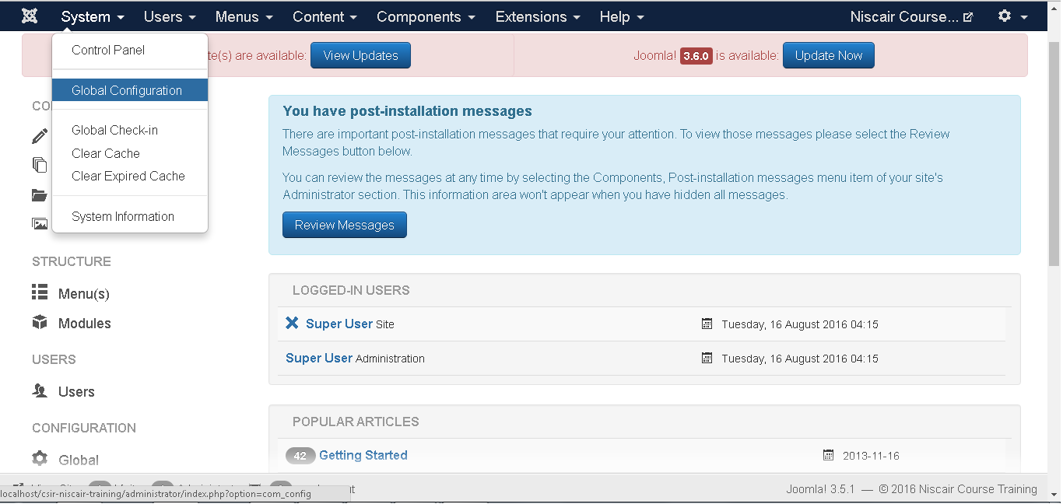
USERS SETTING
Step (1): Go to System --> Global Configuration as shown in the following
screen.

Slide 17
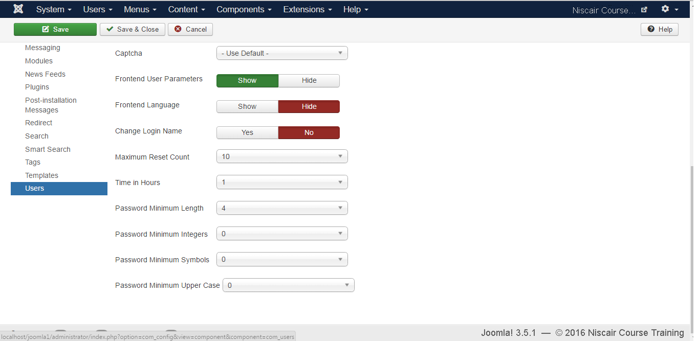
Next, click on Users in Joomla Global Configuration. You will get the screen
as shown below and select the fields with appropriate values.
We can view the different tabs present in the screen shown above. By default, the Component tab is displayed.

Slide 18
Below we have mentioned the details of the fields present in the Component
tab.
Allow User Registration: It allows the new user registration and set it to Yes.
New User Registration Group: The default group which allows the user to register via front-end.
Guest User Group: Setting up the Guest user.
Send Password: If it is set to Yes, password will be mailed to the registered user as a part of registration mail.
New User Account Activation: If it is set to None the new user will be registered immediately. If it set to Self, the new user gets the activation mail which helps to activate the account themselves.
Notification Mail to Administrators: If it is set No, It sends the new user activation mail to the admin.
Captcha: Provides the captcha options to activate the new user.
Front-end User Parameters: It is set to Show, the user will be able to modify their language, editor and help websites.
Front-end Language: It is set to Show, the language option will appear during the new user registration.
Change Login Name: If it is set to Yes, it allows the new user to edit the login name.
Maximum Reset Count: It defines the maximum reset of password for the user and 0 indicates no limits.

Slide 19
Time in Hours: Time for the reset counter in hour.
Minimum Password Length: Specifies the length of the password.
Password Minimum Integers: It specifies the minimum number of integers that must be included in the password entry.
Password Minimum Symbols: It specifies the minimum number of symbols that must be included in the password entry.
Password Upper Case Minimum: It specifies the minimum number of upper case characters that must be included in the password entry.

Slide 20
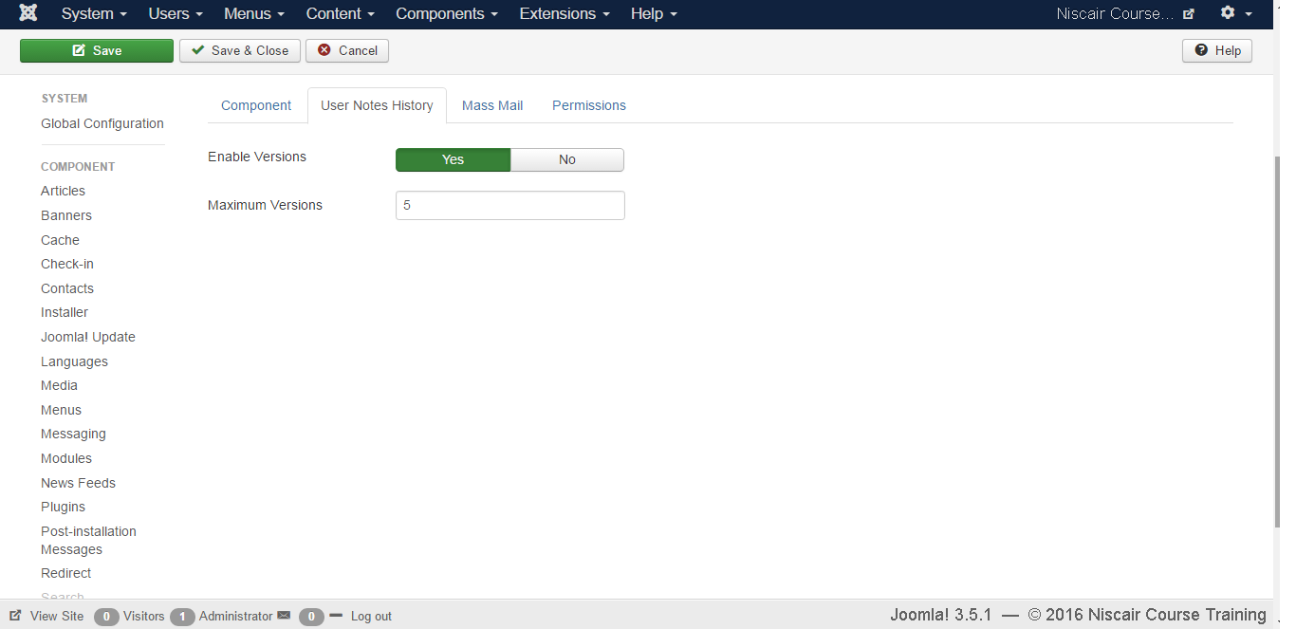
Step (2): The User Notes History tab is used to save history of the user notes.
Save History: It saves the version history of the component when selected as Yes. Otherwise no version history is saved.
Maximum Versions: It always saves the maximum number of versions for an item.

Slide 21
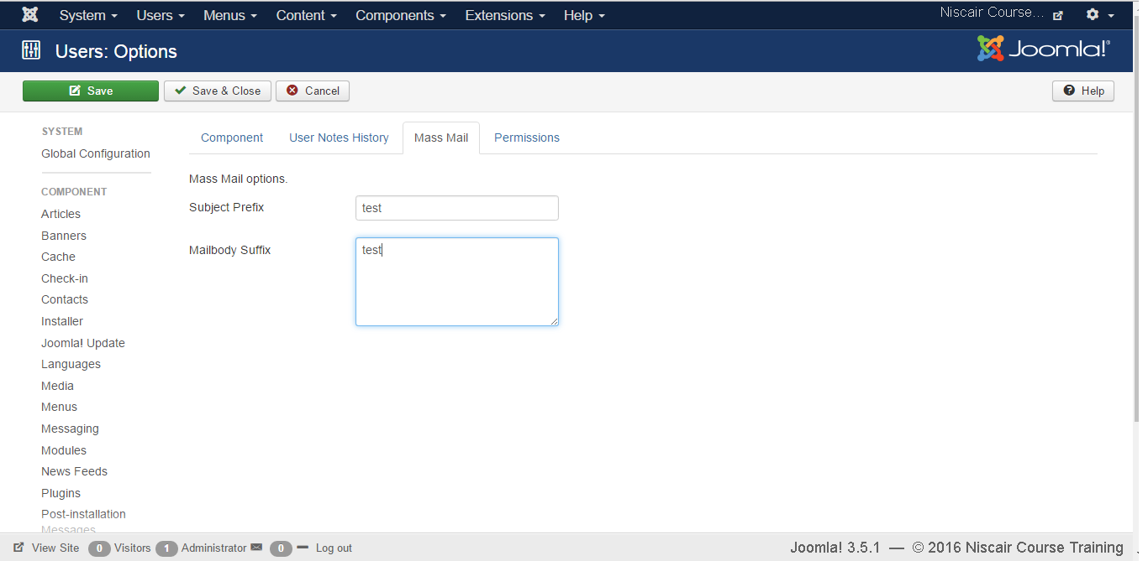
Step (3): The Mass Mail tab is used to save setting for the mass mail.
Subject Prefix: Automatically text is inserted before the subject of mass mail
Mailbody Suffix: Automatically text is inserted after the body of the email.

Slide 22
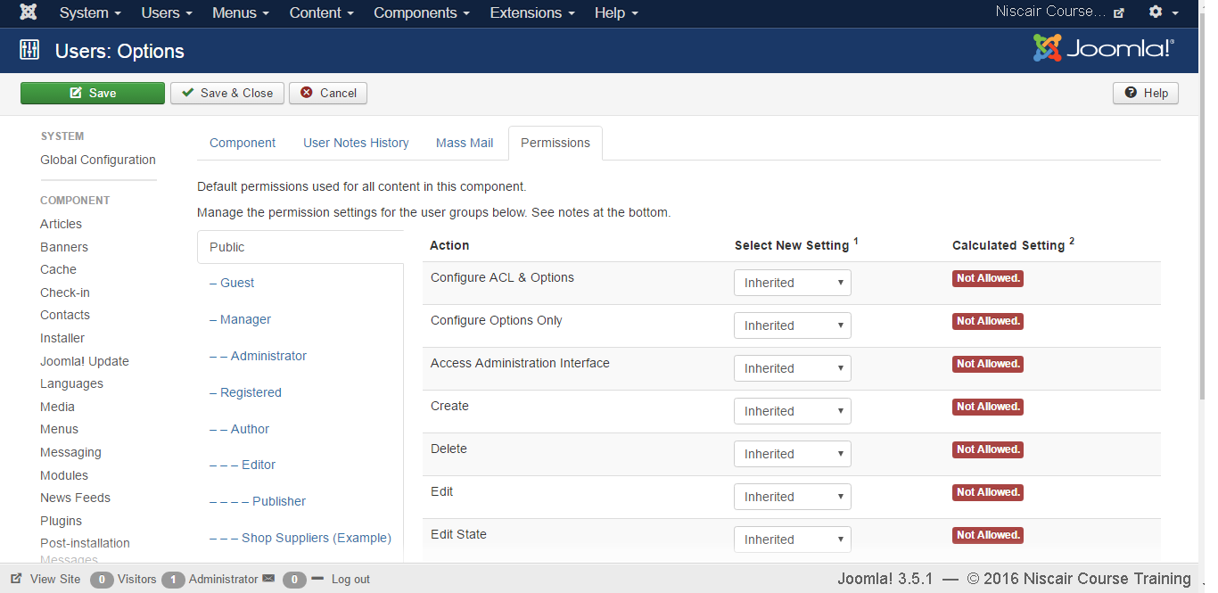
Step (4): In Permissions tab, we can view the six actions as can be seen in the
screen below. This tab is used to manage the permission settings for the user groups.
Configure: It allows users to edit the user option.
Access Administration Interface: It allows users to access the administration interface.
Create: It allows users in group to create the content present in the extension.
Delete: It allows users in group to delete the content present in the extension.

Slide 23
Edit: It allows users in group to edit the content present in the extension.
Edit State: It allows users in group to change the state of content present in the extension.
Toolbar
Following are the toolbar options in the Users Setting.
Save: Saves your user settings.
Save & Close: Saves the user settings and closes the current screen.
Cancel: Cancels the user settings in Joomla.

Slide 24
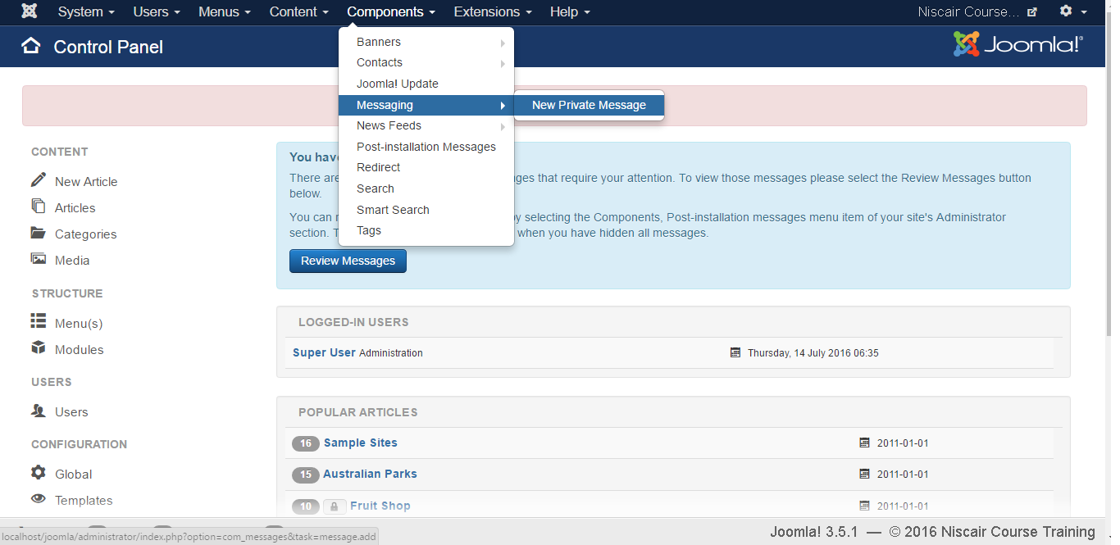
PRIVATE MESSAGES
The messaging system allows to send messages to the back-end users of Joomla. You can send, read, write and delete messages.
Step (1): You can create a new private message as shown in the screen below.
Go to Components --> Messaging --> New Private Message to write a new private message.

Slide 25
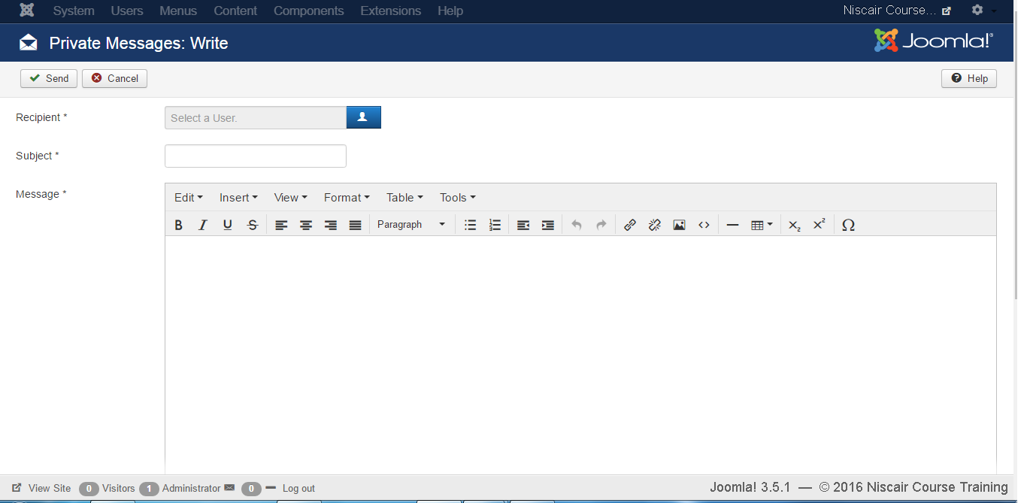
Step (2): When you open the New Private Message, you will get the following
screen.
You can select a "Recipient" by clicking on the select user button.
Note :Please note that private messages can only be sent to Administrators and Super Users!
Enter a subject in the "Subject" field. Enter your message in the "Message“area.
Message area provides an editor kind of interface with options such as
bold, italic, heading format, insertion of image, link, table, indentation of
text, text alignment, special characters etc.

Slide 26
Step (3): At the top left, you will see a toolbar that provides following functions:
New: It is used to create a new message.
Mark as Read: It selects the status of message as Read.
Mark as Unread: It selects the status of the message as Unread.
Trash: It is used to delete the message.
My Settings: It provides the pop-up window to change message settings.

Slide 27
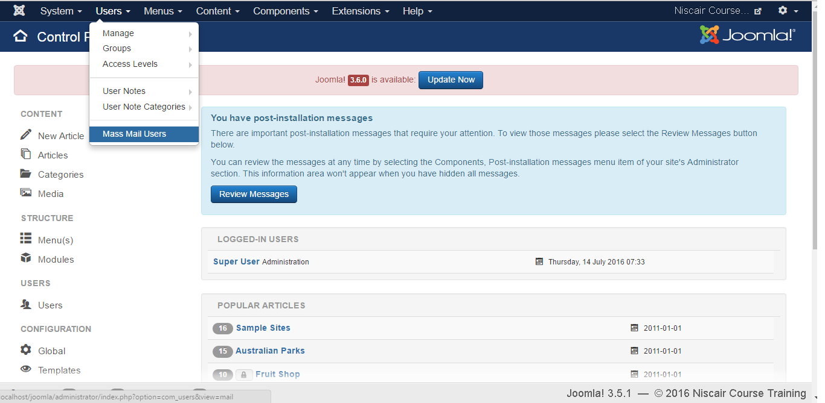
MASS EMAILING
Mass Mail is used for sending emails to the group of registered users. Users
can be selected based on groups.
Step (1): To use this feature, go to Users --> Mass Mail Users as shown in the
screen below.

Slide 28
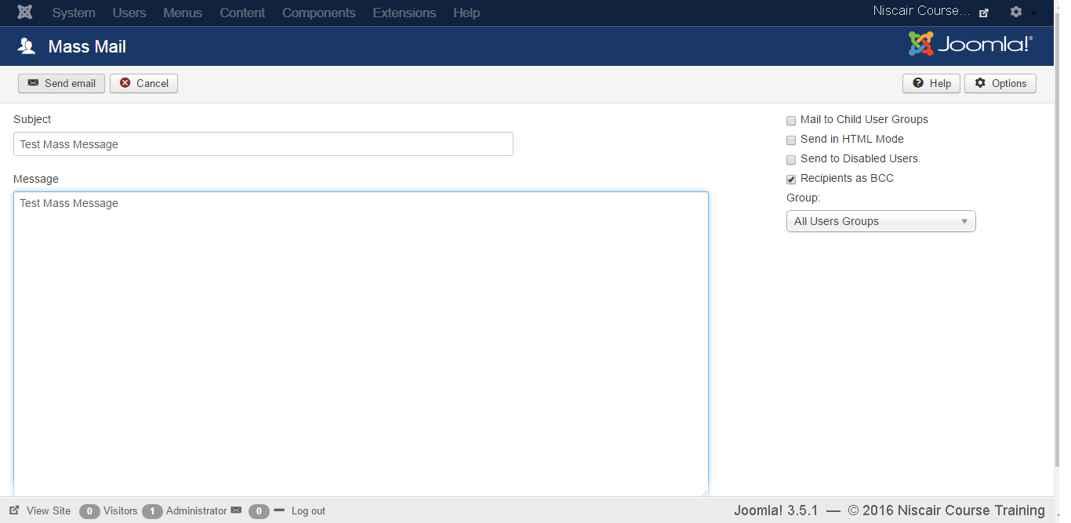
Step (2): The following screen shows Mass Mail window.

Slide 29
The Mass Mail window provides following options:
Subject: It is used for the email subject.
Message: It adds the content of the email.
Mail to Child User Groups: It is used to send email to all child groups of the parent group.
Send in HTML Mode: It uses HTML code in the mail.
Send to disable users: Disable users will be included when sending mail, if it is checked.
Recipients as Bcc: It hides the recipient list and adds copy to site mail.
Group: It chooses a group to send the mail to.
At the top left, there's a toolbar with following options:
Send Mail: It is used to send an email once finished editing.
Cancel: It cancels the unsaved edits.

Slide 30
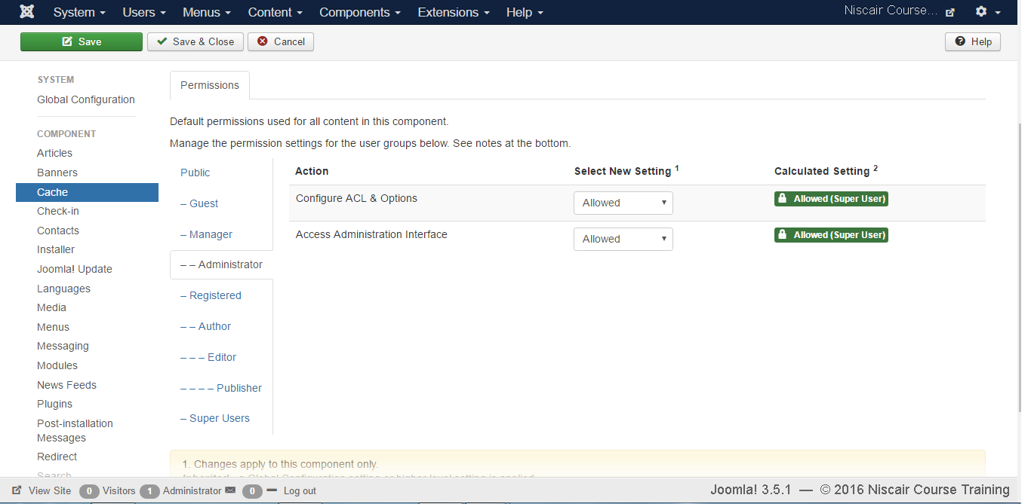
CACHE MANAGEMENT
Step (1): Click on Cache Management in Joomla Global Configuration. You
will get the screen as shown below.

Slide 31
Following are the details of the fields present in the Joomla Cache
Management page:
Configure: It is used to select the system for which your site should be used for caching. It also caches your PHP opcode.
Access Administration Interface: It allows users to access the administration interface.
Toolbar
Following are the toolbar options in Cache Management.
Save: Saves your Cache Setting.
Save & Close: Saves the Cache Setting and closes the current screen.
Cancel: Cancels the Cache Setting in Joomla.

Slide 32
DEBUG
Step (1): Go to System --> Global Configuration as shown in the following
screen.

Slide 33
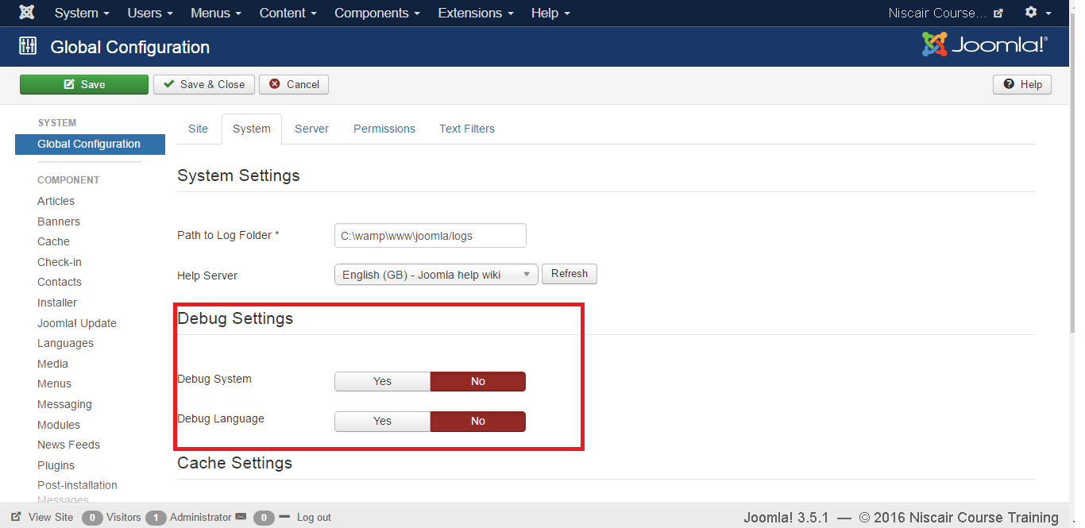
Next, click on the System tab in Joomla Global Configuration as shown below.

Slide 34
Below we have mentioned the details of the fields present in the Joomla Debug Setting section.
Debug System: It is a debugging system of Joomla which provides debug information by setting it to "Yes". It provides various forms such as diagnostic information, language translations and SQL errors. The default setting is "No".
Debug Language: It provides debug language translations for Joomla site by setting it to "Yes".
Toolbar
Following are the toolbar options in the debug.
Save: Saves your configuration setting.
Save & Close: Saves the configuration setting and closes the current screen.
Cancel: Cancels the configuration setting in Joomla.

Slide 35
Thank You

