Slide 1
CONTENT MANAGEMENT SYSTEM
Presented by:
Mukesh A. Pund
Principal Scientist
CSIR-NISCAIR, New Delhi

Slide 2
JOOMLA EXTENSIONS & CREATING FORMS USING EXTENSIONS

Slide 3
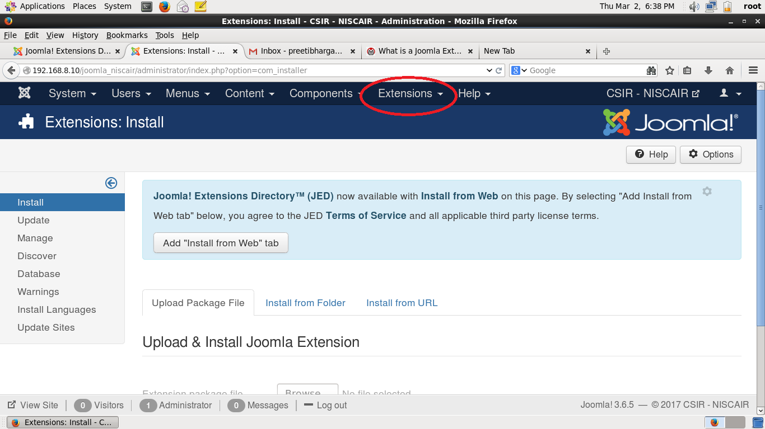
EXTENSIONS
Joomla! already is a rich featured content management system, but if you're building a website with Joomla! and you need extra features which aren't available in Joomla! by default, you can easily extend it with extensions.
A Joomla extension extends the functionality of your Joomla-powered website. Extensions can include templates, modules, components or plugins. Each of these extensions handles a specific functionality.

Slide 4
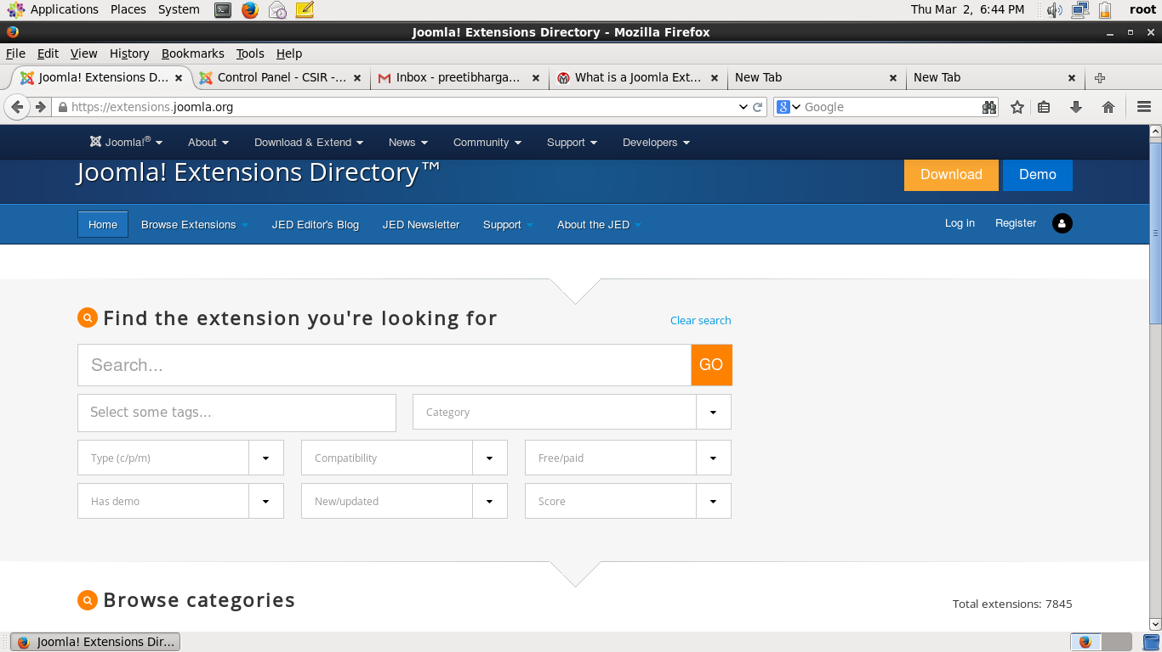
INSTALLING EXTENSION
Step (1): Download required extensions from https://extensions.joomla.org

Slide 5
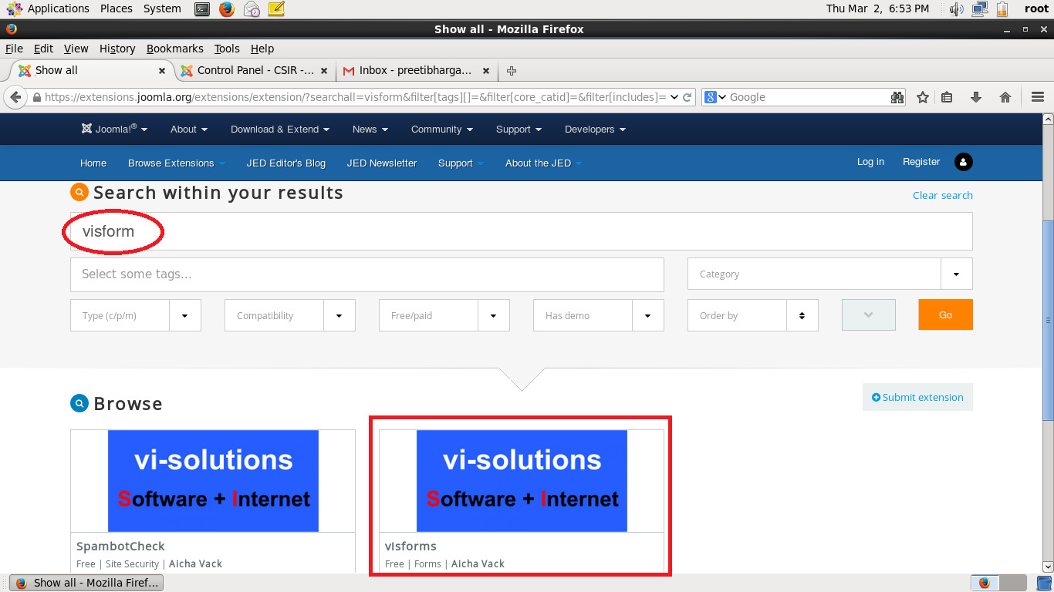
Step (2): Search for the required extension . It will show you the results. Hovering over them can show you the brief description about that extension. (Eg. Visforms) for creating forms.

Slide 6
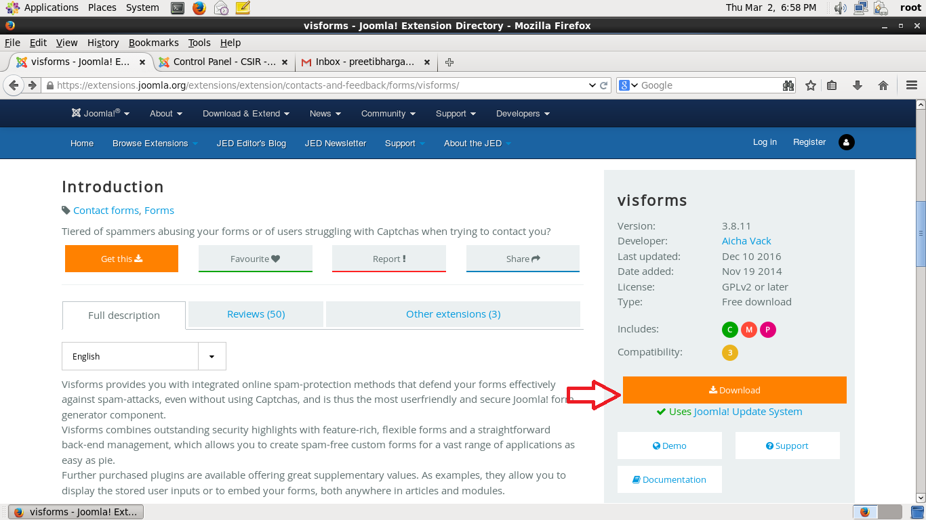
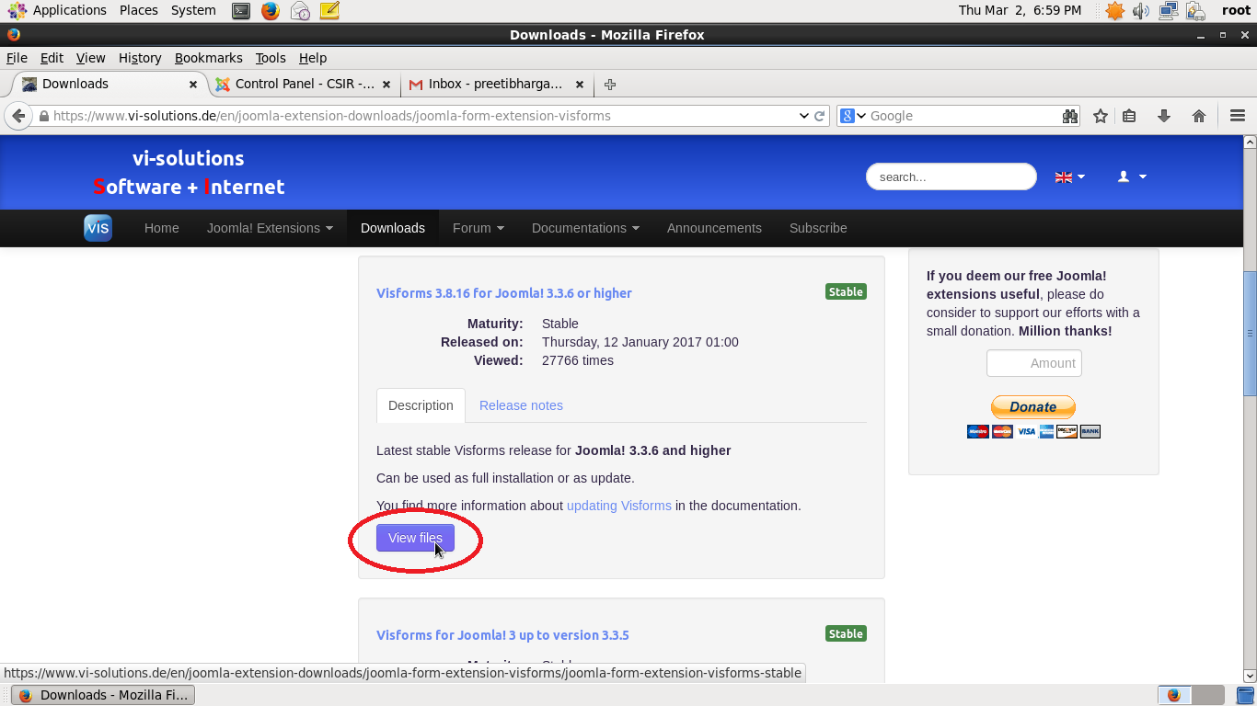
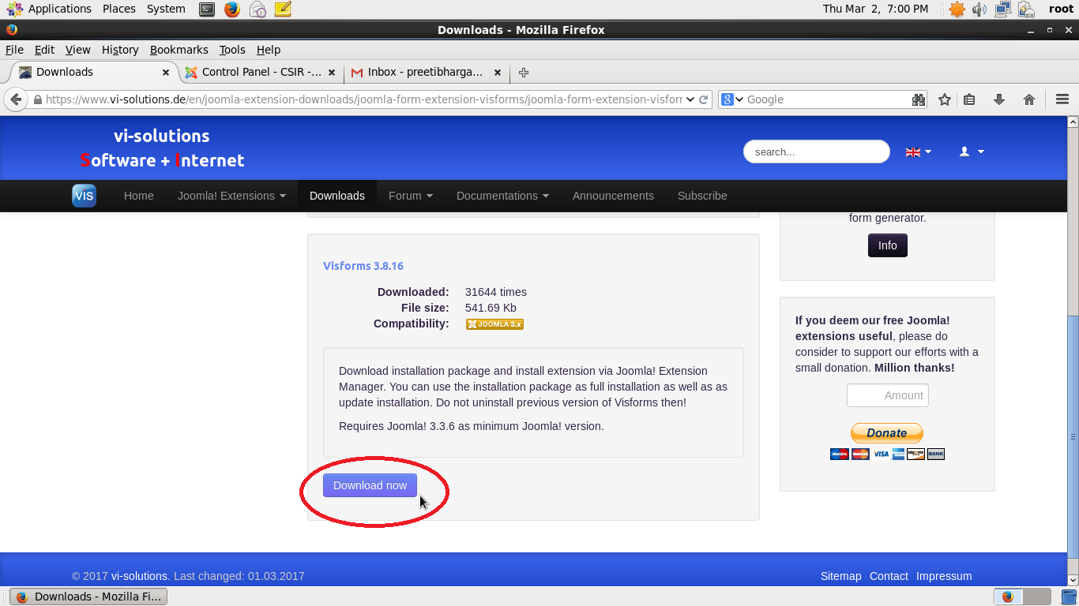
Step (3): Select the extension → Click on Download → Click on “View Files” as per your Joomla Version → Click on “Download Now”

Slide 7
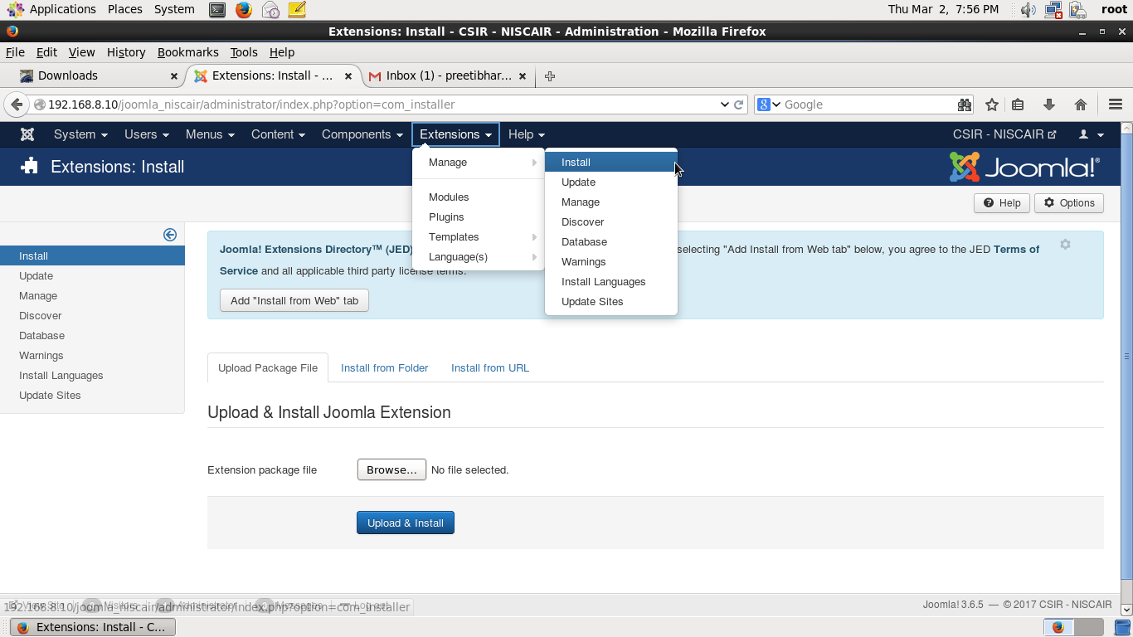
Step (4): After download, zip file will be created. Extract the file and copy the extracted folder in C:\wamp\www\joomla\tmp
Step (5): Login as Administrator
Step (6) : Go to Extensions → Manage → Install

Slide 8
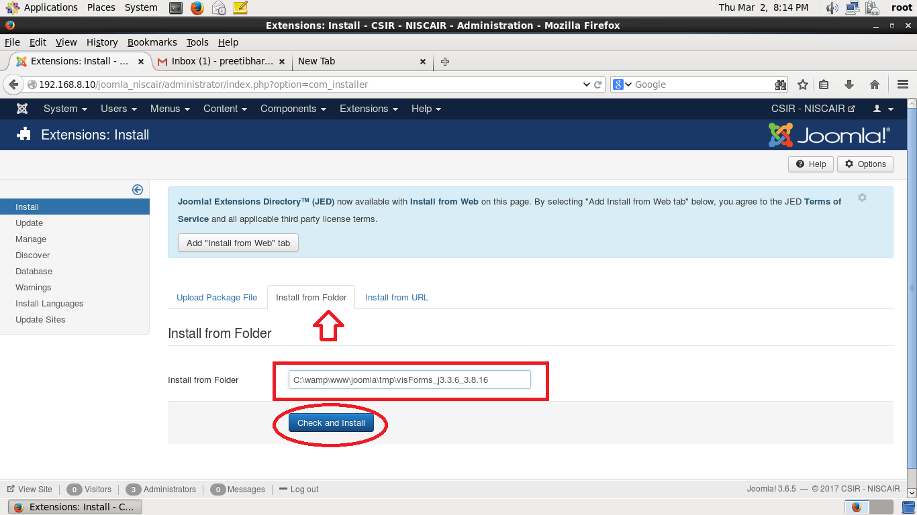
Step (7): Click on Tab “Install from folder” and Give path of the directory where extracted folder is copied (C:\wamp\www\joomla\tmp\Name of extracted folder) and Click on “Check and Install”

Slide 9
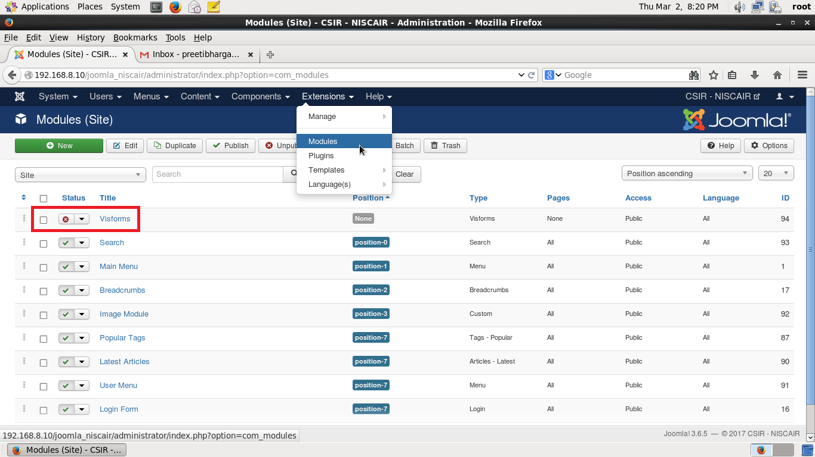
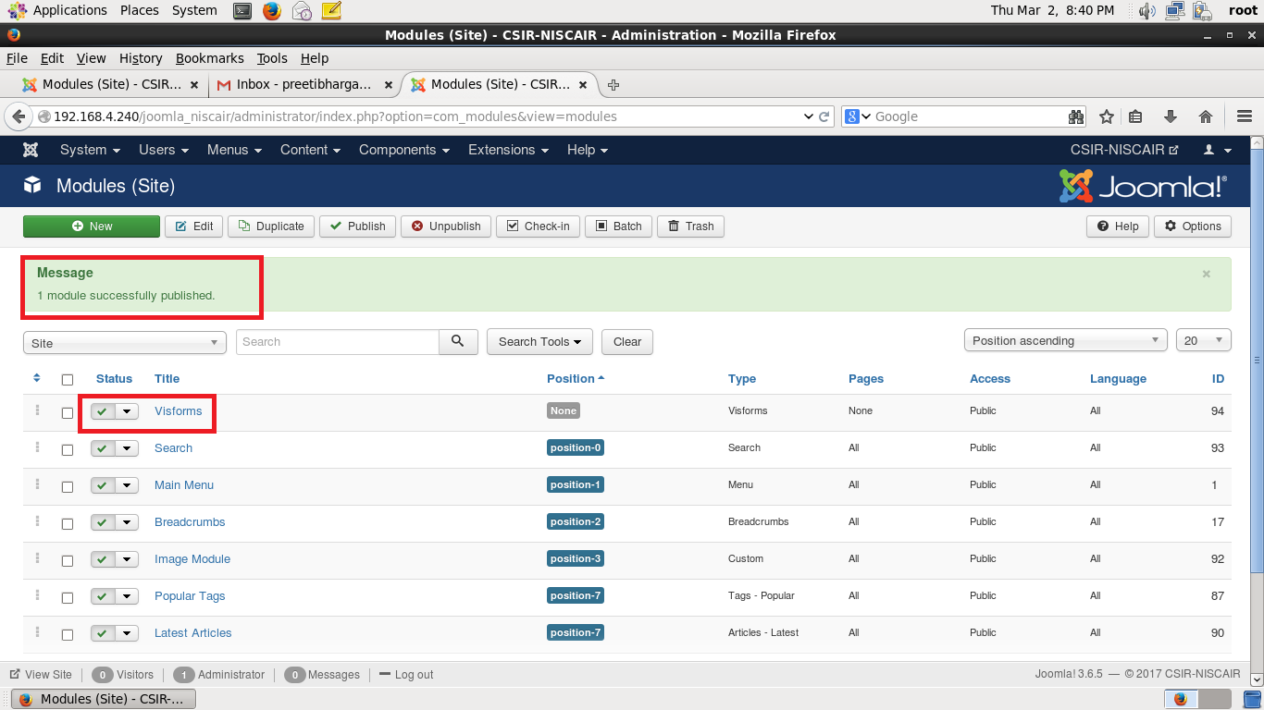
Step (8): Go to Extensions → Modules and Publish Visforms by Clicking on red “x” symbol.

Slide 10
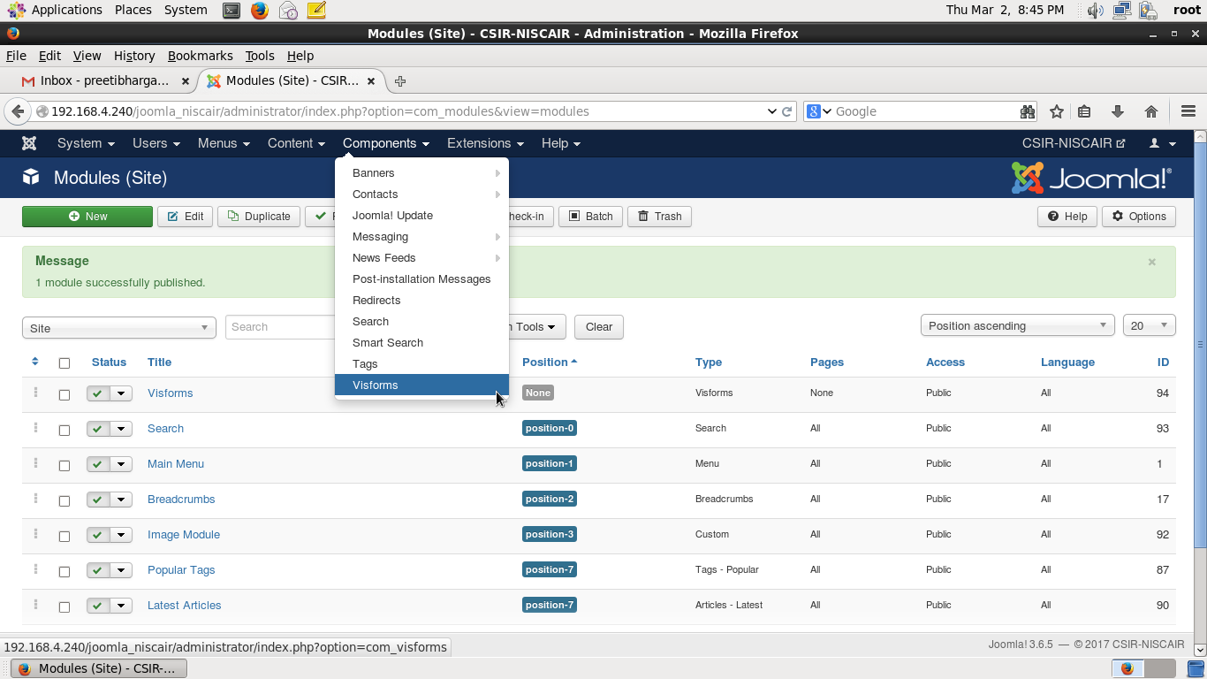
CREATING FORMS USING VISFORMS EXTENSION
Step (1): Go to Components → Visforms

Slide 11
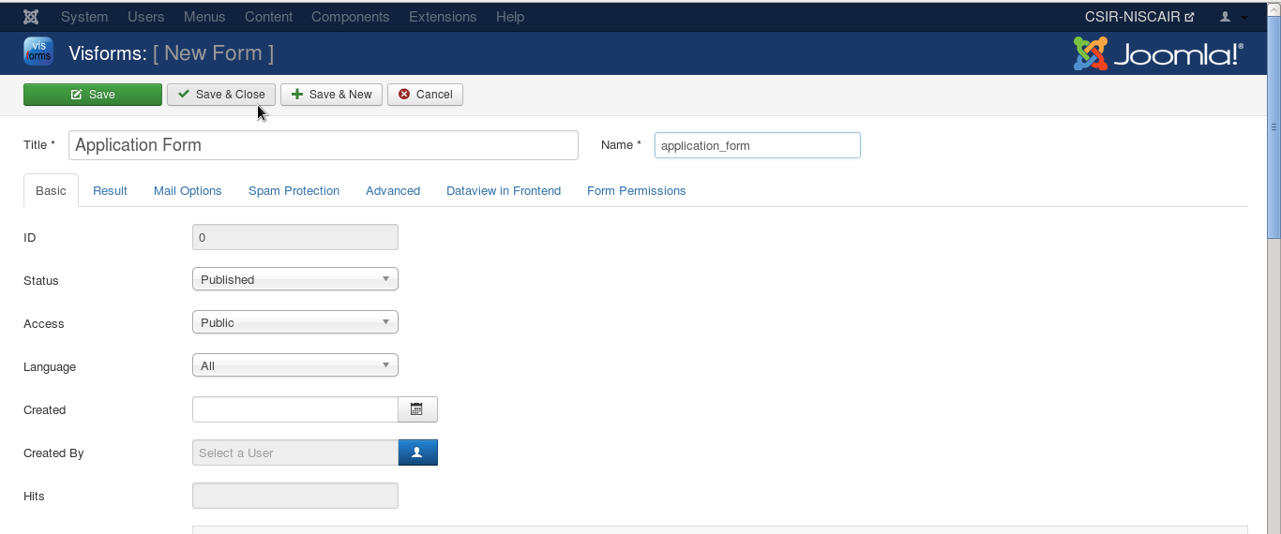
Step (2): Click on Forms Tab on Left Pane and then Click “New” .
Step (3): Give Title and Name (Mandatory Fields)
( Eg. Title: Application Form and Name : application_form )
Step (4): Now Click “Save & Close”

Slide 12
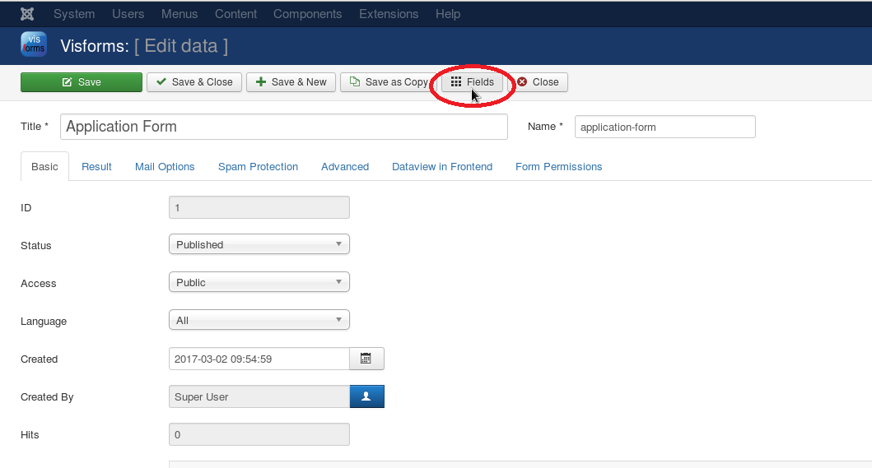
Step (5): Click on Form just created (Here Application Form) → Click on Fields → Click on “New” to create fields in this form

Slide 13
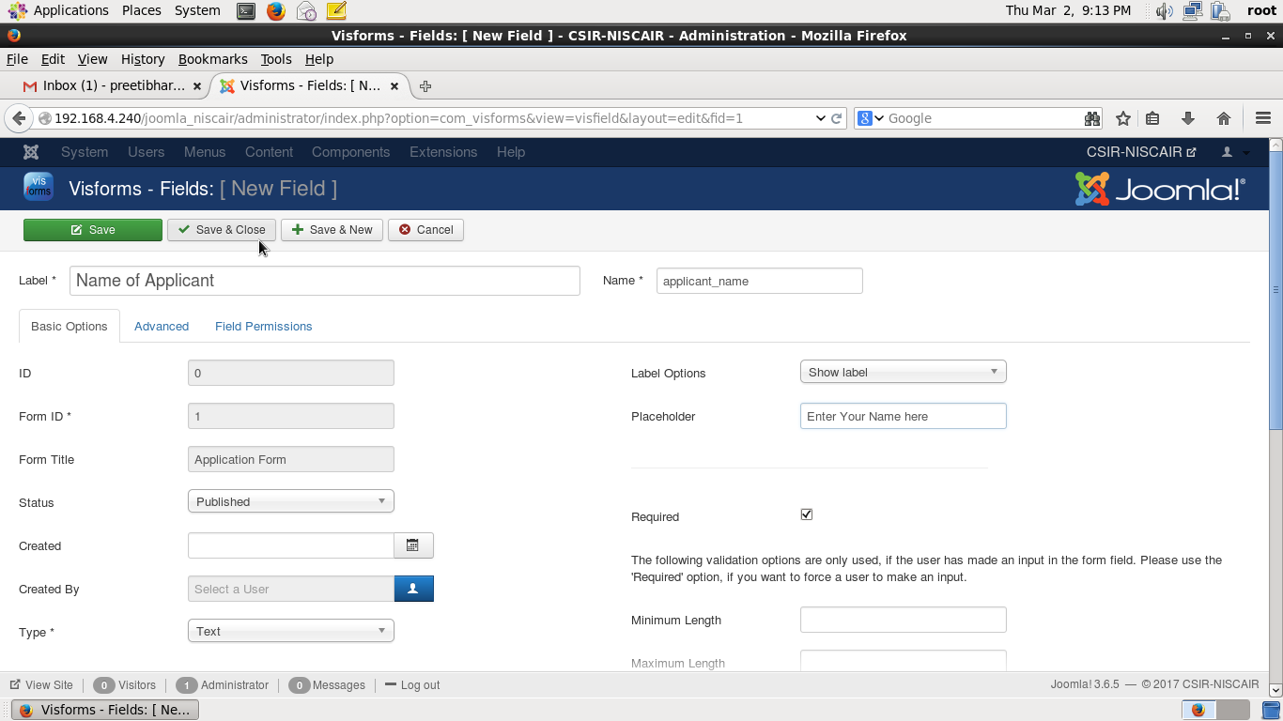
Step (6): Give Label, Name and Text (Mandatory Fields)
( Eg. Label: Name of Applicant , Name : applicant_name, Type: Text)
Step (7): Give other information as per requirement
( Eg. Placeholder: Enter your name here )

Slide 14
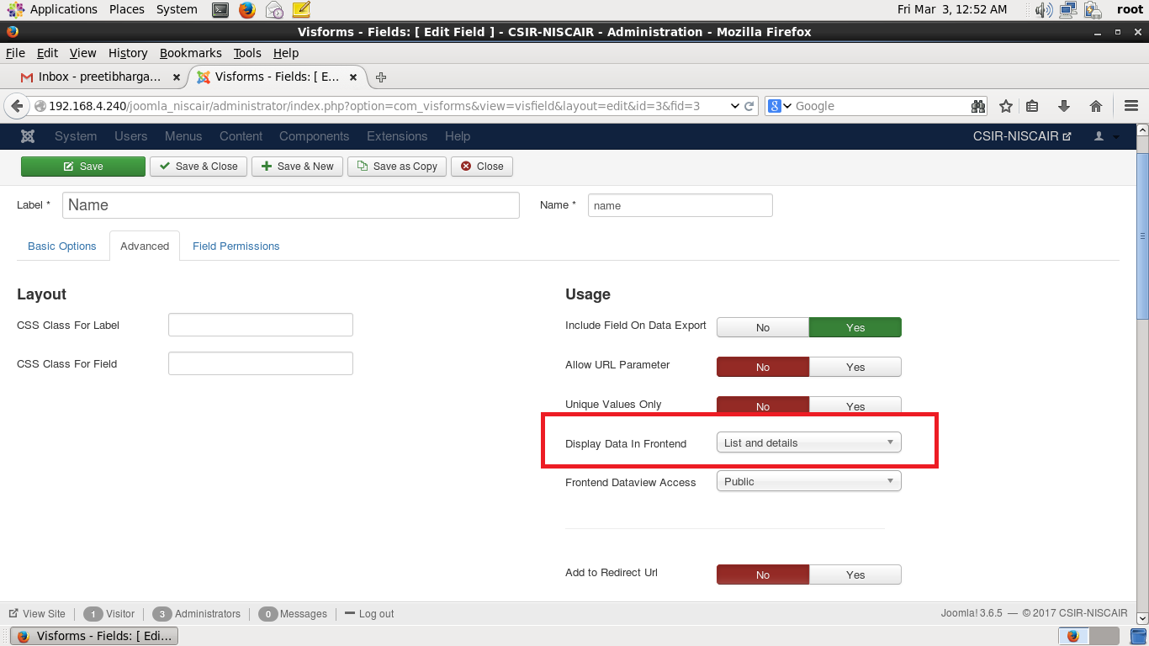
Step (8): Click on “Advanced” Tab
Select List and Details in “Display Data in Frontend ” drop down
Step (9): Now Click “Save & Close”
Note : Data will not be displayed if this parameter is not set

Slide 15
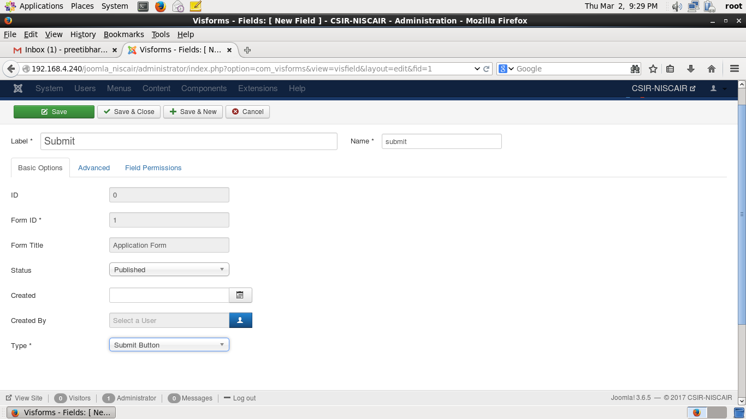
Step (9): Similarly create a Submit Button as you have created field.
(Give Label, Name and Text (Mandatory Fields)
( Eg. Label: Submit, Name : submit, Type: Submit Button )
Step (10): Now Click “Save & Close” EXERCISE

Slide 16
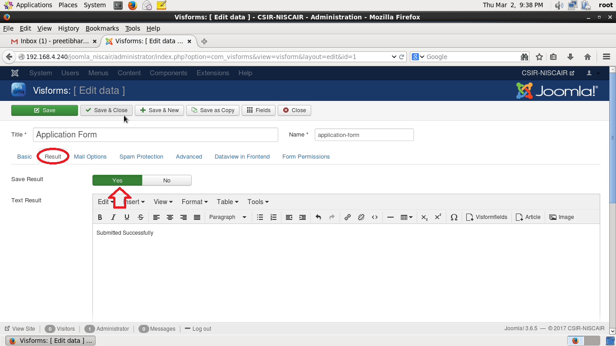
Step (11): Storing Form Data into Database :
Go to Components → Visforms → Click on “Forms” Tab on Left Pane → Click on Application Form created → Click on “Result” Tab → Select “Yes” on Save Result and write any text (Eg. Submitted Successfully) in Text Result

Slide 17
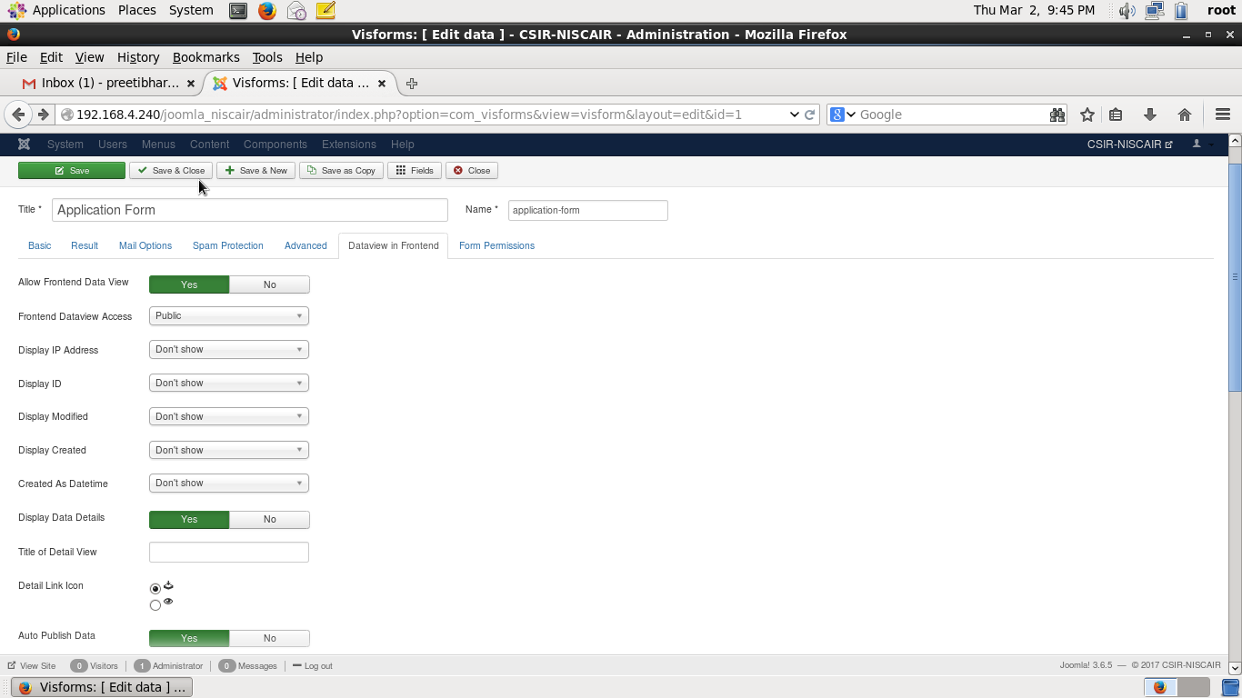
Step (12): Click on “Dataview in Frontend ” Tab → Select “Yes” on Allow Frontend Data View , Display Data Details and Auto Publish Data.
Click on Save & Close

Slide 18
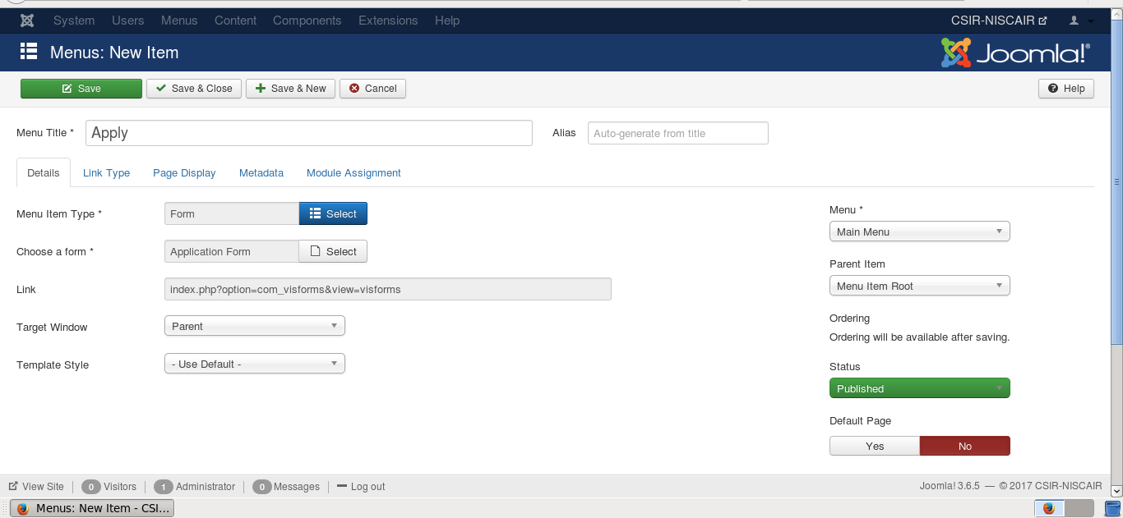
Step (13): Create a Menu Item to Link newly created Data Entry Form
Create a Main Menu Item (Menus → Main Menu → Create New Menu)
Give Menu Title (Eg. “Apply”)
Select “Menu Item Type” as Visforms → Form
Select “Choose a Form “as Application Form you have created.
Save & Close

Slide 19
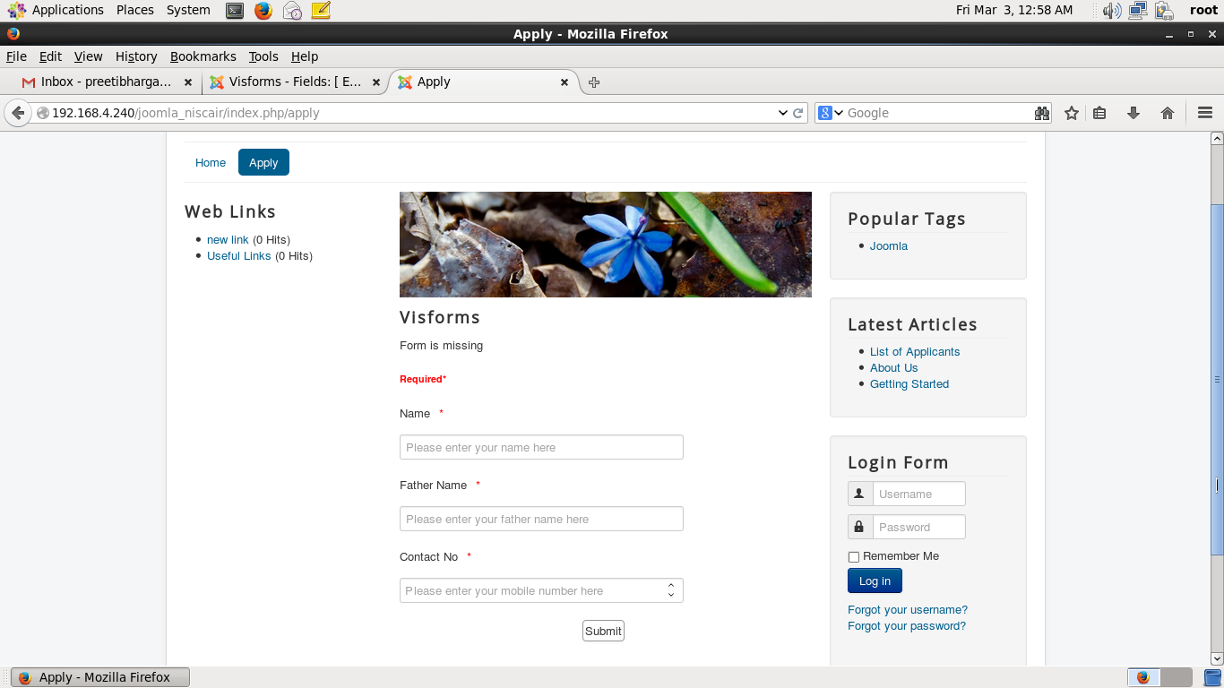
The form and Menu Item you have created is displayed by accessing site view (http://192.168.4.54/joomla)

Slide 20
JOOMLA DISPLAY FORM RESULTS

Slide 21
DISPLAY FORM RESULTS
It is required by Administrator to view the form results that have been submitted successfully by applicants . For that, we need to create another Menu Item which will only be visible and accessible to Super User/ Administrator.
You can display data to any users depending upon the permissions/settings.

Slide 22
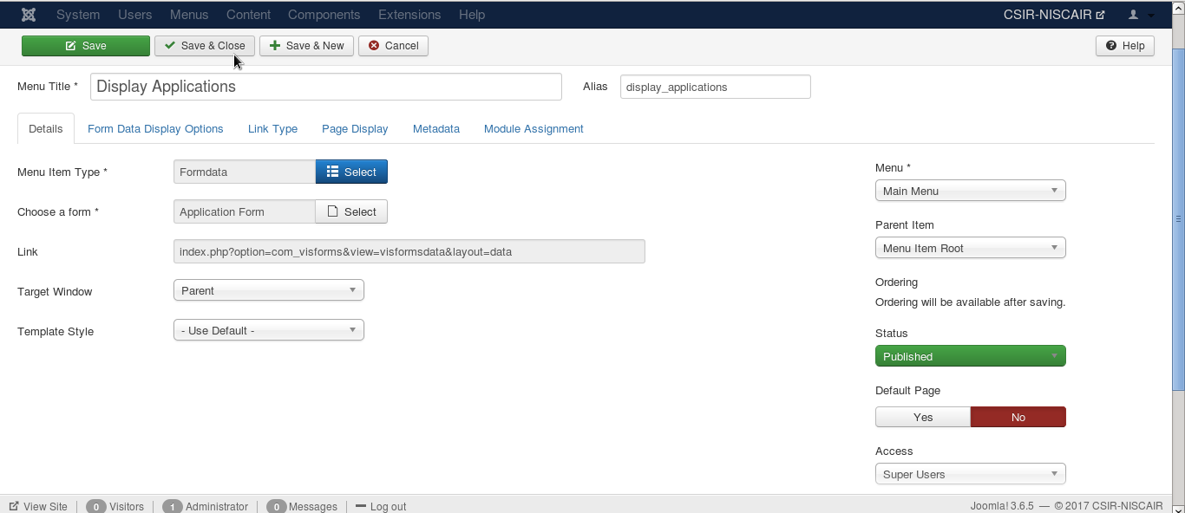
Step (1): Create a Main Menu Item (Menus → Main Menu → Create New Menu)
Give Menu Title (Eg. “Display Applications”)
Select “Menu Item Type” as Visforms → Formdata
Select “Choose a Form “as Application Form you have created.
Select “Access” as Super Users
Save & Close

Slide 23
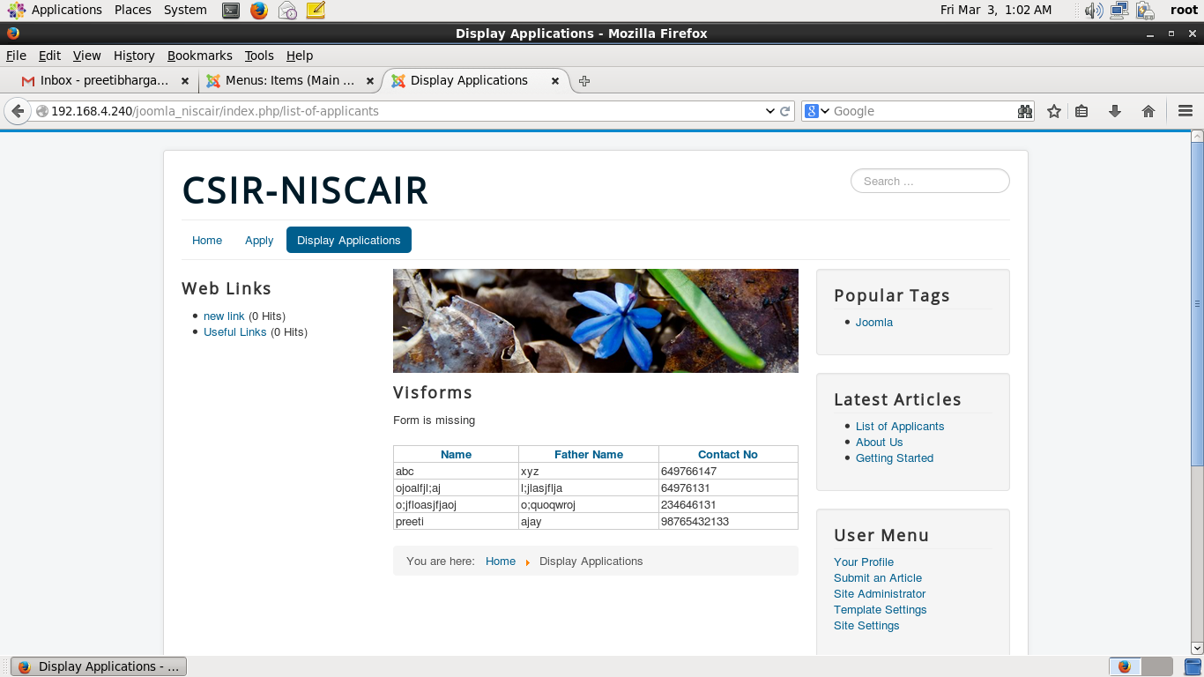
Display Applications will be accessible only to Administrator as below:
Login as Administrator and then you can view the link “Display Applications” to view results

Slide 24
Thank You

