Slide 1
CONTENT MANAGEMENT SYSTEM
Presented by:
Mukesh A. Pund
Sr. Principal Scientist
CSIR-NISCAIR, New Delhi

Slide 2
JOOMLA ACCESSING DATABASE USING JDATABASE

Slide 3
Accessing Database using JDatabase
Joomla provides a sophisticated database abstraction layer to simplify the usage for third party developers.
Joomla Platform API provide additional functionality which extends the database layer further, and includes features such as connectors to a greater variety of database servers and the query chaining to improve readability of connection code and simplify SQL coding.
Joomla can use different kinds of SQL database systems and run in a variety of environments with different table-prefixes.

Slide 4
In addition to these functions, the class automatically creates the database connection. Besides instantiating the object you need just two lines of code to get a result from the database in a variety of formats. Using the Joomla database layer ensures a maximum of compatibility and flexibility for your extension.
Joomla's database querying has changed since the new Joomla Framework was introduced "query chaining" is now the recommended method for building database queries (string queries are still supported).
Query chaining refers to a method of connecting a number of methods, one after the other, with each method returning an object that can support the next method, improving readability and simplifying code.
To obtain a new instance of the JDatabaseQuery class we use the JDatabaseDriver getQuery method:
$db = JFactory::getDbo();
$query = $db->getQuery(true);

Slide 5
The JDatabaseDriver::getQuery takes an optional argument, $new, which can be true or false (the default being false).
Some of the more frequently used methods include; select, from, join, where and order. There are also methods such as insert, update and delete for modifying records in the data store. By chaining these and other method calls, you can create almost any query against your data store without compromising portability of your code.

Slide 6
Writing PHP code for Database Connectivity
Step(1): Install Plugin for writing php/Javascript etc. (E.g. Sourcerer plugin ) (Download from https://www.regularlabs.com/extensions/sourcerer#download)
Sourcerer enables you to place PHP and any kind of HTML style code (including CSS and JavaScript) right into your content! Not only in your articles, but also in sections, categories, modules, components, META tags, etc.
You can now just place your original codes right into your WYSIWYG editor. The only thing you have to do is surround the code with the Sourcerer tags. Easy peasy!
So now you can also use PHP scripts in your content. That opens up a great deal of possibilities.
Most Joomla! Text Editors will strip parts of your HTML code, like JavaScripts (think of statistics scripts) and movie embed tags. With Sourcerer you won't have these limitations.

Slide 7
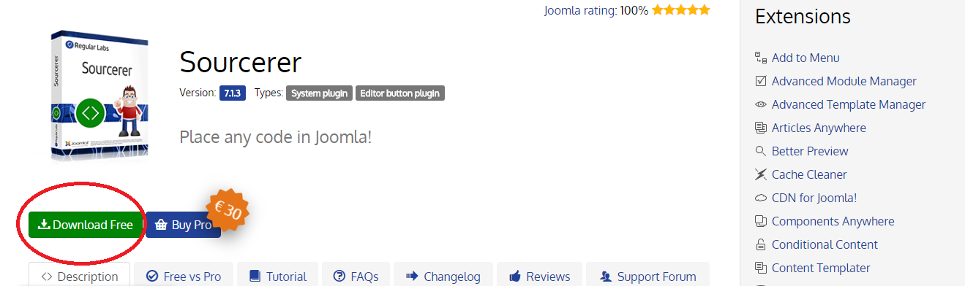
Step(2): Click on Extension→ Manage→ Install → Upload Package File as shown below

Slide 8
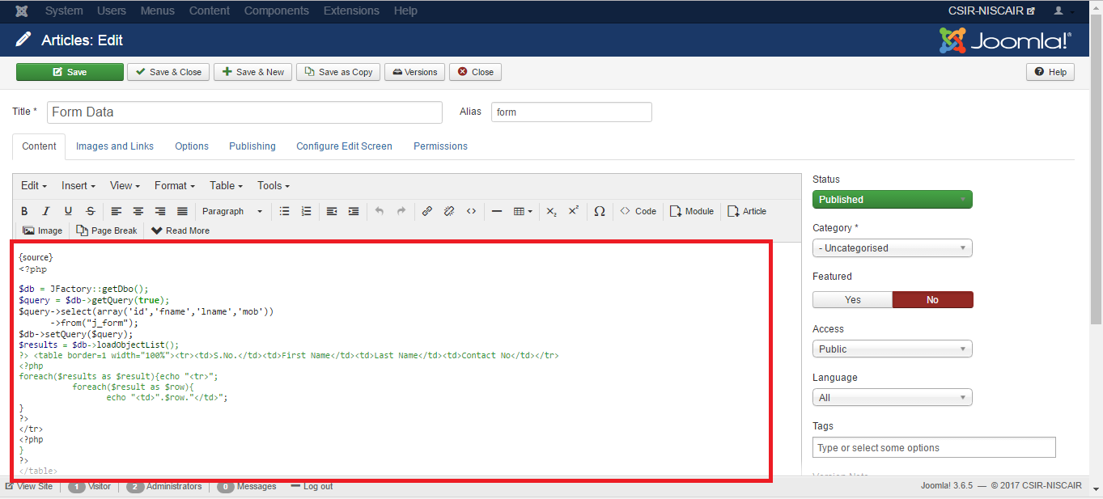
Step(3): Write the code in an article as shown below.

Slide 9
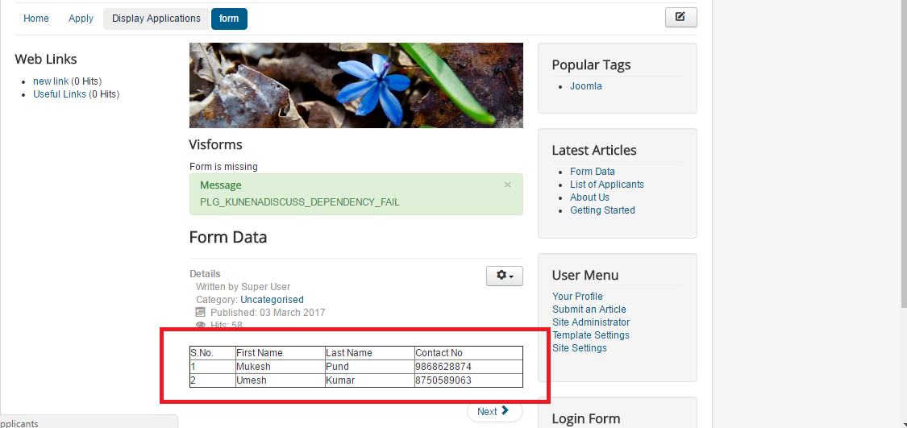
Output of code written above

Slide 10
Inserting a Record
The JDatabaseQuery class provides a number of methods for building insert queries, the most common being insert, columns and values.
// Get a db connection.
$db = JFactory::getDbo();
// Create a new query object.
$query = $db->getQuery(true);
// Insert columns.
$columns = array('user_id', 'profile_key', 'profile_value','ordering');
// Insert values.
$values = array(1001, $db->quote('custom.message'),
$db->quote('Inserting a record using insert()'), 1);
// Prepare the insert query. $query ->insert($db>quoteName('#__user_profiles')) ->columns($db->quoteName($columns)) ->values(implode(',', $values));
// Set the query using our newly populated query object and execute it. $db->setQuery($query);
$db->execute();

Slide 11
Updating a Record
The JDatabaseQuery class also provides methods for building update queries, in particular update and set.
$db = JFactory::getDbo();
$query = $db->getQuery(true);
// Fields to update.
$fields = array(
$db->quoteName('profile_value') . ' = ' . $db->quote('Updating custom message for user 1001.'),
$db->quoteName('ordering') . ' = 2' );
// Conditions for which records should be updated.
$conditions = array(
$db->quoteName('user_id') . ' = 42',
$db>quoteName('profile_key') . ' = ' . $db->quote('custom.message') );
$query>update($db>quoteName('#__user_profiles'))>set($fields)>where($conditions);
$db->setQuery($query);
$result = $db->execute();

Slide 12
Deleting a Record
$db = JFactory::getDbo();
$query = $db->getQuery(true);
// delete all custom keys for user 1001.
$conditions = array( $db->quoteName('user_id') . ' = 1001',
$db->quoteName('profile_key') . ' = ' . $db->quote('custom.%') );
$query->delete($db->quoteName('#__user_profiles'));
$query->where($conditions);
$db->setQuery($query);
$result = $db->execute();

Slide 13
Thank You

